Slide 1



Skuller: A volumetric shape registration algorithm for modeling skull deformities
Yusuf Sahillioğlu¹ and Ladislav Kavan²
Medical Image Analysis 2015
Computer Eng. Depts, ¹, Turkey
², USA.
Notes:
Follow in slide show (F5) mode for the explanatory animations.

Slide 2
Problem Statement
Medical objective
  Quantify the deviation of given skull from a healthy one.
Geometric objective:
  Develop an algorithm for volumetric registration of 3D
  shapes.

Slide 3


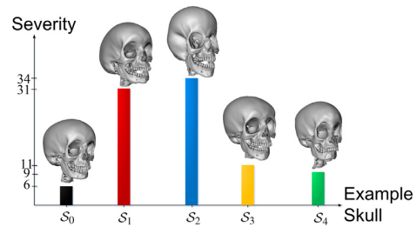
Applications
Shape registration:
Statistical shape analysis:
Objective quantification
of medical condition(s):

Slide 4
Contributions
A fast and robust solution to a new version of the well-
known shape registration problem, namely the registration
of two volumetric shapes.
  Source: volumetric tetrahedral mesh.
  Target: volumetric shape defined by voxels.
In contrast to point- and surface-based registration
techniques, our method better captures volumetric nature
of the data, such as bone thickness.
ICP with adaptive scaling.
Multi-initialization ICP.

Slide 5
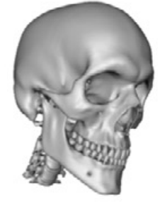
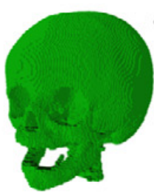
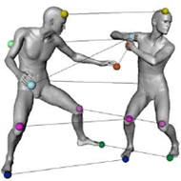
Scope
Input: A tetrahedral mesh & A voxelized object (CT scan).
Input pair differs by non-isometric/non-rigid transformation.
//an isometric pair

Slide 6
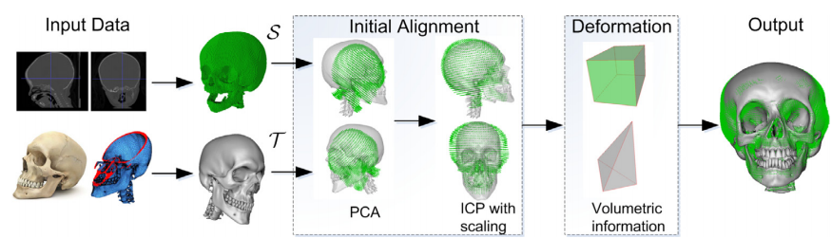
Algorithm
Overview.

Slide 7
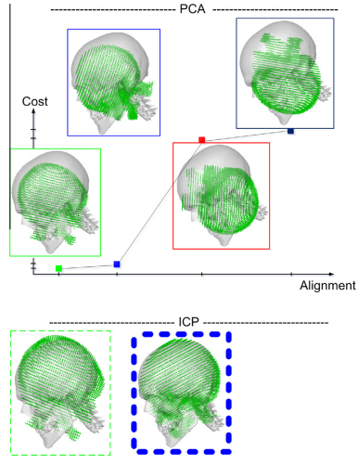
Algorithm
Initial alignment.
A global rigid alignment.
  Rotation, translation, uniform scale.
Treat input pair as 3D point clouds.
PCA-based alignment for
multiple ICP initialization.

Slide 8
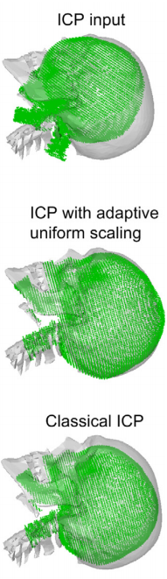
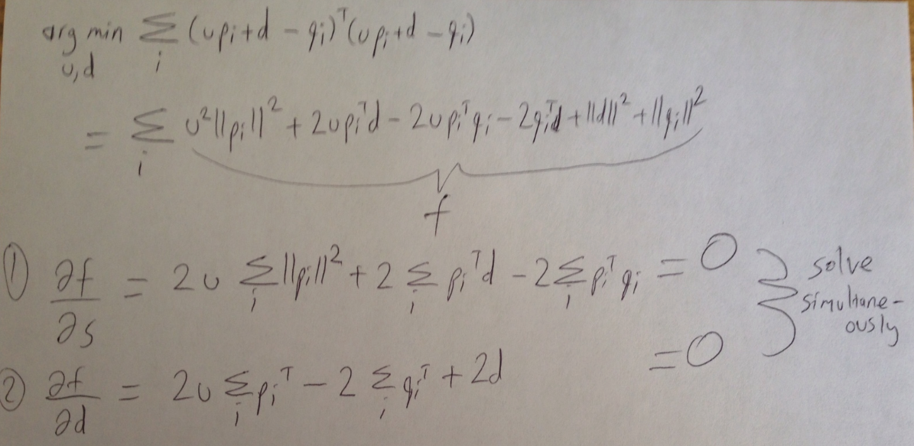

Algorithm
Initial alignment.
A global rigid alignment.
  Rotation, translation, uniform scale.
Treat input pair as 3D point clouds.
Solve for uniform scale u in addition
to the translation d once you have the
ICP-rotated points p.

Slide 9
Algorithm
Volumetric registration.
A non-rigid alignment.
  Bending/warping allowed.
Seek t that minimizes the following energy:

Slide 10

Algorithm
Volumetric registration.
A non-rigid alignment.
  Bending/warping allowed.
Correspondence/matching term.
  Brings transformed vertices t to the scan voxels s as close as
  possible.
  Permutation matrix P defines closest-point correspondences.

Slide 11

Algorithm
Volumetric registration.
A non-rigid alignment.
  Bending/warping allowed.
Regularization term: Volumetric Dirichlet energy.
  Preserves rest-pose coordinates t₀, hence the good shape, as much
  as possible.

Slide 12

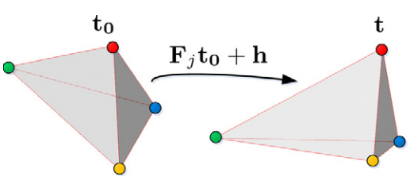
Algorithm
Volumetric registration.
A non-rigid alignment.
  Bending/warping allowed.
Regularization term: Volumetric Dirichlet energy.
  Measures deviation of tetrahedra’s deformation gradients F from I using the mesh Laplacian L.

Slide 13


Algorithm
Volumetric registration.
A non-rigid alignment.
  Bending/warping allowed.
Regularization term: Volumetric Dirichlet energy.
  Measures deviation of tetrahedra’s deformation gradients F from I using the mesh Laplacian L.
    , where G_{j} extracts vectorized gradient F_{j}
    when multiplied with all vertices, i.e.,

Slide 14

Algorithm
Volumetric registration.
A non-rigid alignment.
  Bending/warping allowed.
Regularization term: Tiknohonov energy.
  Keeps the amount of displacement from the previous step’s coordinates t_{prev} as small as possible, i.e., no jumps.

Slide 15
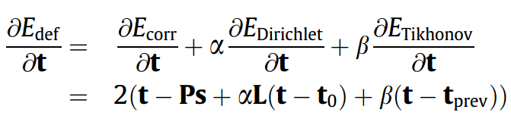
Algorithm
Volumetric registration.
A non-rigid alignment.
  Bending/warping allowed.
Differentiating overall energy w.r.t. t gives:
Setting this derivative to 0 gives a sparse linear sys to solve:

Slide 16
Algorithm
Volumetric registration.
A non-rigid alignment.
  Bending/warping allowed.
Tricks to make this process work well.
  Adaptive weighting.
  Initially high \alpha \beta as the closest-point correspondences in P
  are not so reliable.
    Regularization (\alpha \beta) prevents a potential damage from E_{corr}.
  Reduce regularization strength when t is very close to t_{prev}, i.e., little/no progress.
    E_{corr} becomes more reliable thanks to better correspondences.

Slide 17
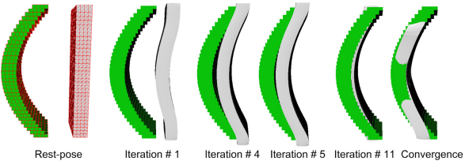
Algorithm
Volumetric registration.
A non-rigid alignment.
  Bending/warping allowed.
Tricks to make this process work well.
  Adaptive weighting.
  Little displacement b/w iter 4 & 5 triggers adaptive weighting.

Slide 18
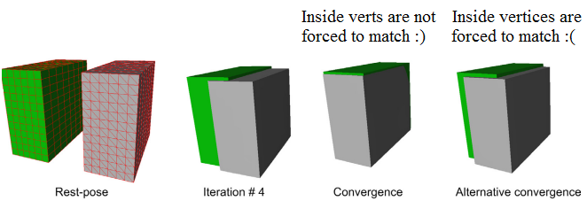
Algorithm
Volumetric registration.
A non-rigid alignment.
  Bending/warping allowed.
Tricks to make this process work well.
  E_{corr} disabling.
  A vertex that is already inside the volume should not be affected
  by E_{corr} as it is not possible to establish meaningful matches now.
  Instead it should be free to move as dictated by regularization.

Slide 19
Algorithm
Computational complexity.
n tetrahedral mesh vertices, m scan voxels.
Initial global alignment.
  O(nlogm) due to closest-point search.
Volumetric registrations.
    O(nlogm) due to closest-point search.
    O(n + w) Cholesky factorization performed i times, where i = #
    deformation iterations is about 20 in our runs. w high constant.

Slide 20
Algorithm
Computational complexity.
n tetrahedral mesh vertices, m scan voxels.
Initial global alignment.
  O(nlogm) due to closest-point search.
Volumetric registrations.
    O(nlogm) due to closest-point search.
    O(n + w) Cholesky factorization performed i times, where i = #
    deformation iterations is about 20 in our runs. w high constant.
Execution time on a 2.2 GHz PC.
  Input tetrahedral mesh: 160K vertices, 560K tetrahedra.
  Input CT scan: 190K voxels.
  20 minutes.
    133 secs initial alignment, 1 sec (closest-point) + 49 sec (Cholesky) per
    deformation iteration.

Slide 21
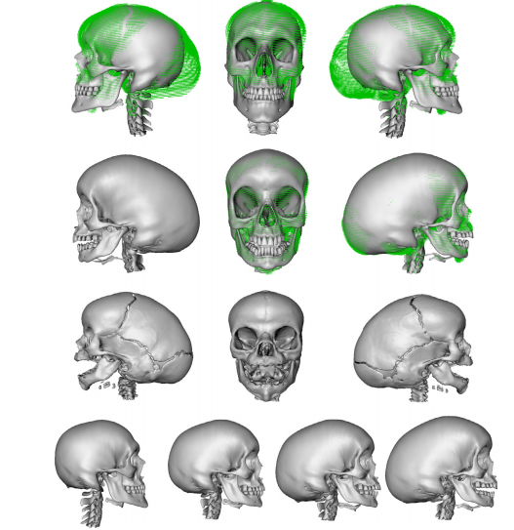
Results
//Initial global alignment.
//Resulting registered model.
//Underlying ground-truth surf.
//(extracted by Marching Cubes)
//Deformation process.

Slide 22
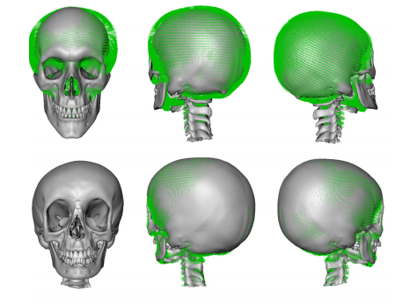
Results
//Initial global alignment.
//Resulting registered model.

Slide 23
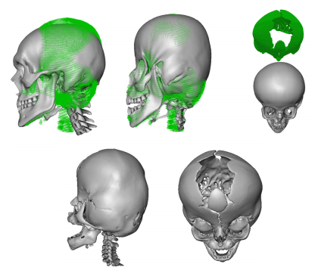
Results
//Initial global alignment and //resulting registered model.
//Underlying ground-truth surf.

Slide 24
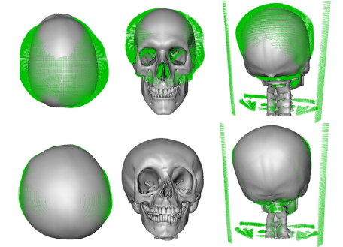
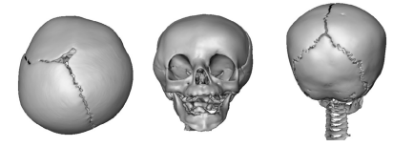
Results
//Initial global alignment.
//Resulting registered model.
//Underlying ground-truth surf.

Slide 25
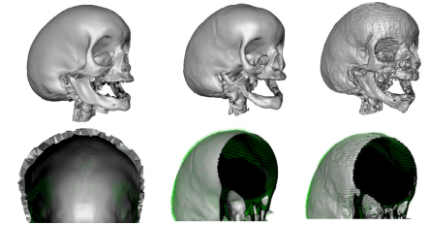
Results
//Our volumetric registration //that respects bone thickness //(left column) is favorable over //unscreened and screened //Poisson surface registrations.

Slide 26
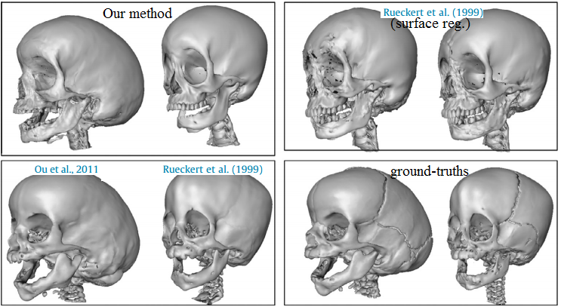
Results
//Our volumetric registration //in comparison with volumetric //image registration techniques.

Slide 27
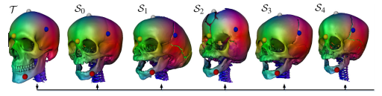
Applications
//Transfer of colors (or any //other attributes) through the
//dense correspondence //achieved b/w the template and
//deformed/registered pose, and //effectively between ground- //truth geometries of all the //example skulls

Slide 28
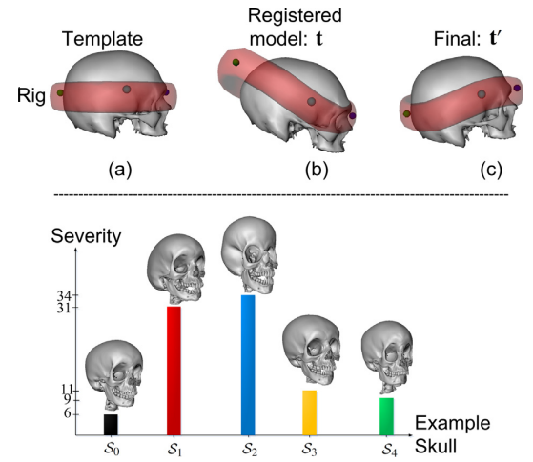
Applications
//Objective quantification of //severity of skull deformities. //Rig designed specifically for //the template mesh (top) //enables interactive //deformation of the registered //model using ARAP energy. //The effort of the doctor during //this session, i.e., the //deformation energy, is used as //the objective quantification //(bottom).

Slide 29
Future Work
Identify most efficient user interfaces for quantification.
Data-driven statistical models for quantification.
Remeshing algorithms to handle the missing data (teeth) or
the finest details (cracks) in the CT scans.

Slide 30
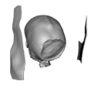
Conclusion
Fast and robust solution to volumetric registration of 3D
solid shapes.
Volumetric deformation energy plus additional tricks such as disabling of correspondence term and adaptive weighting.
Faster than registering volume images as mostly done in the medical imaging community.
  Also using a template mesh makes it robust to outliers.
More accurate than surface registration as mostly done in computer graphics community.
Side contributions for ICP (uniform scale, multi-init).
Cool apps.
  Dense correspondence and objective quantification.

Slide 31
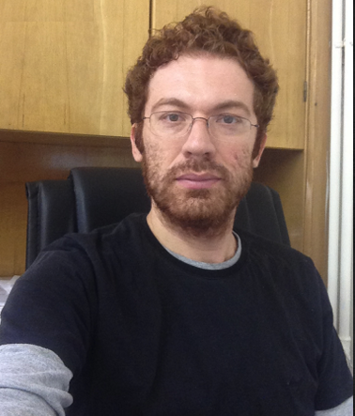

People
Asst. Prof. Yusuf Sahillioğlu, METU, Turkey.
Asst. Prof. Ladislav Kavan, UPenn, USA.

