Slide 1
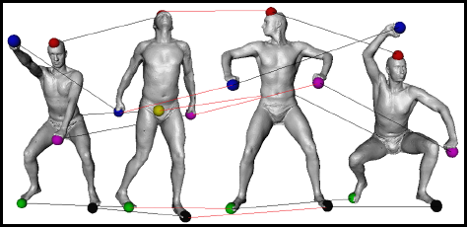


Multiple Shape Correspondence by Dynamic Programming
Yusuf Sahillioğlu¹ and Yücel Yemez²
Pacific Graphics 2014
Computer Eng. Depts, ¹,
², Turkey.
Notes:
Follow in slide show (F5) mode for the explanatory animations.

Slide 2




Problem Statement
Goal: Find correspondences between all shapes in the collection: ..
Key: Minimize the overall distortion.
Naïve algorithm: Pick the min-distortion map between each consecutive pair . .
Problem: No guarantee on the overall distortion, i.e., distortions of the maps between non-consecutive pairs, e.g.,
and , may be very high.
Our dynamic programming algorithm addresses this
multiple shape correspondence problem.

Slide 3

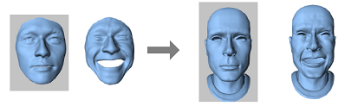

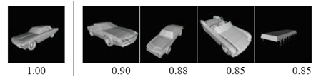

Applications
Improved pairwise correspondences to better perform
  Shape interpolation:
  Attribute transfer:
  Shape registration:
  Shape matching:
Statistical shape analysis:

Slide 4
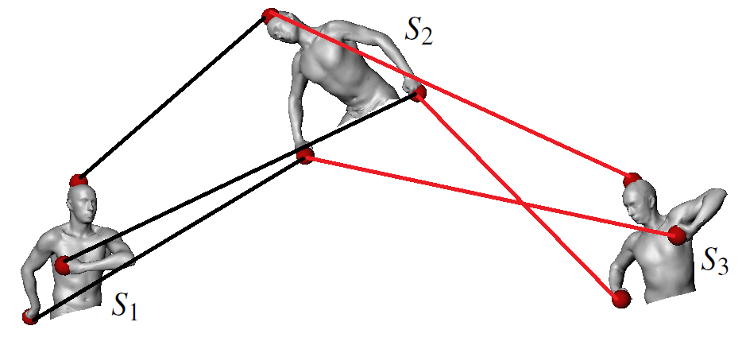
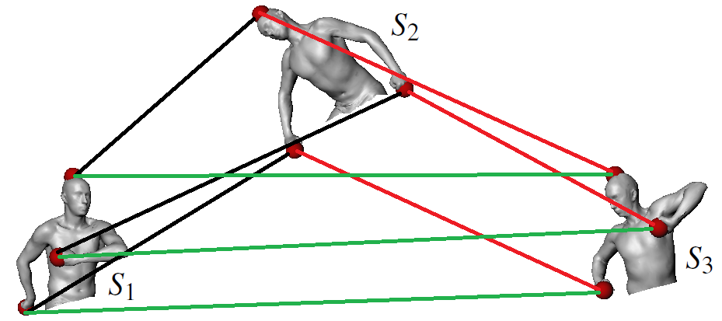
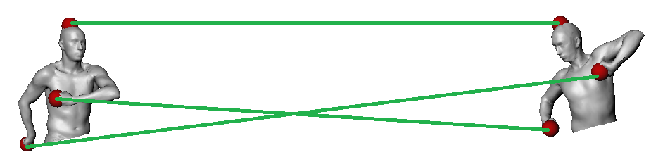
Contributions
Improved pairwise correspondences
suggests
with a total distortion sum of with a total distortion sum of
.061 + .063 + .069 = .193 .061 + .065 + .060 = .186
.186 < .196 ☺
VS.

Slide 5
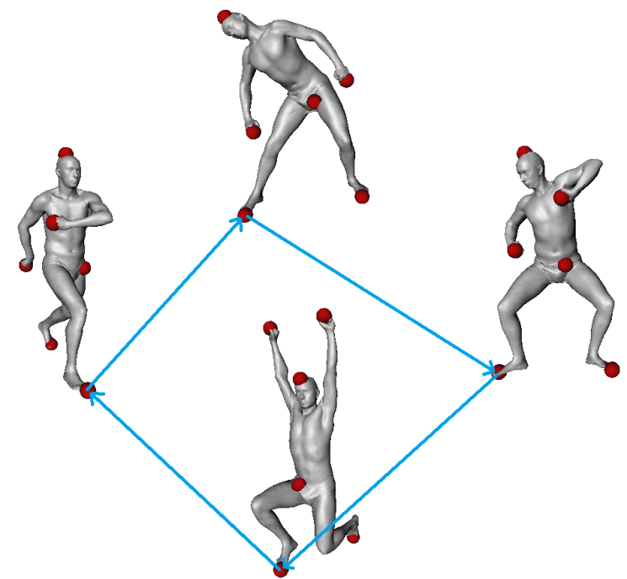
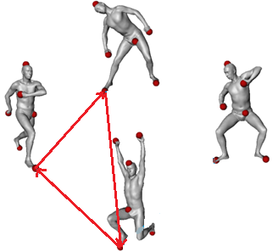
Contributions
An algorithm which explicitly minimizes the overall
distortion while enforcing consistency*.
  Dynamic programming.
    Novel graph structure.
    No initial set of maps required.
    No embedding ambiguities and errors.
    Close approximation to the optimal solution.
    Much faster than the alternatives.
* A set of maps is consistent iff all cycles
of maps yield the identity map.

Slide 6
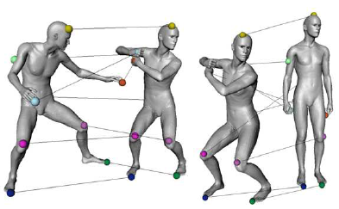
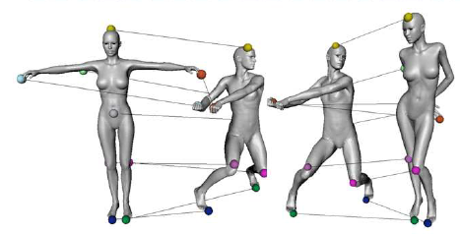
Scope
A collection of initially unmatched
  isometric:
  or nearly isometric shapes:
with arbitrary topology and scaling, as well as
potential noise and non-uniform triangulation.

Slide 7
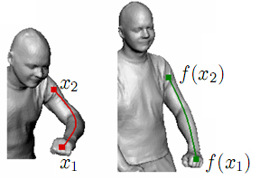



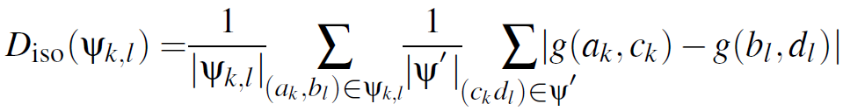



Isometry
Our method is purely isometric.
Intrinsic global property.
  Similar shapes have similar metric structures.
  Metric: Geodesic distance g.
Isometric distortion of a map between shapes and
A variant of the isometric distortion measures used in
Bronstein et al., SISC, 2006.
Huang et al., SGP, 2008.
Sahillioğlu and Yemez, {PAMI, 2012}, {CGF, 2013}.
g
g
g
g
g
g
g
g
average for

Slide 8
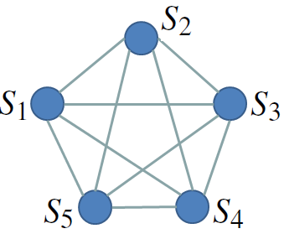
Graph Representation
Same graph used in all multiple shape corresponders so far.
  Vertices: all shapes.
  Edges: weighted by the matching cost of the initially
  assumed pairwise maps.
General theme: Replace potentially “bad” maps with compositions of “better” maps.
Charpiat, NORDIA’09: Replaces a pairwise map b/w each shape pair by the
composition of maps on the shortest path between the two shapes.
Nguyen et al., SGP’11: Force all 3-cycles of maps return to identity.
Huang et al., SIGGRAPH Asia’12: Cycle consistency plus neighbor-preservation.
Huang and Guibas, SGP’13: Cycle consistency as the solution to a semidef. program.

Slide 9
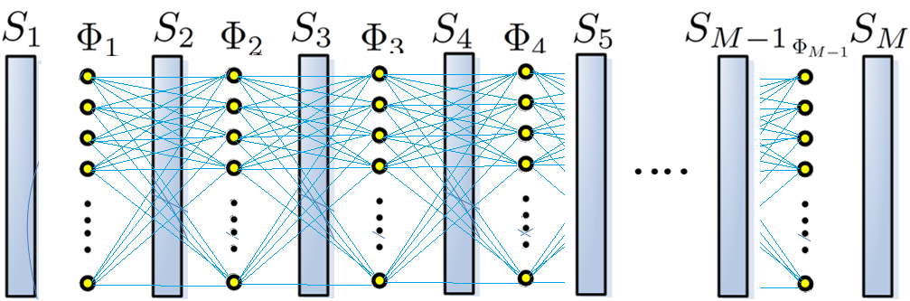
Graph Representation
We introduce a novel graph.
  Vertices: maps between shape extremities.
  Edges: no weighting (no initial maps required).
Optimal path finding on this graph to solve our problem.
Accumulate & Use distortion info on growing paths via DP.

Slide 10
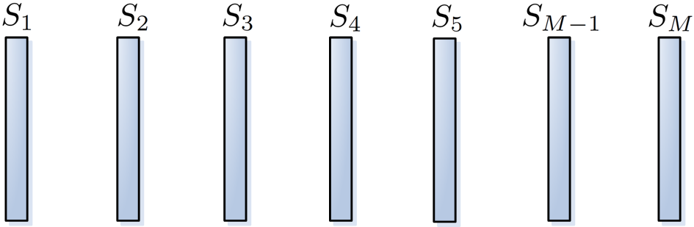
Algorithm
All shapes in the collection:

Slide 11








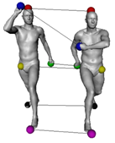
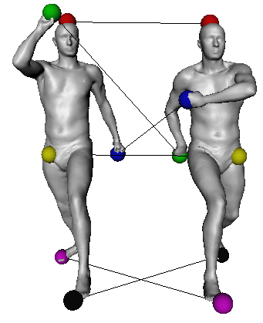
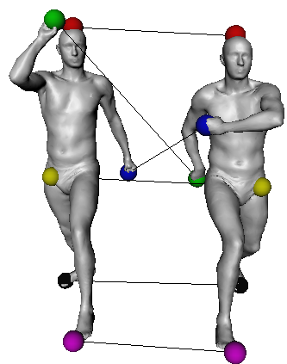
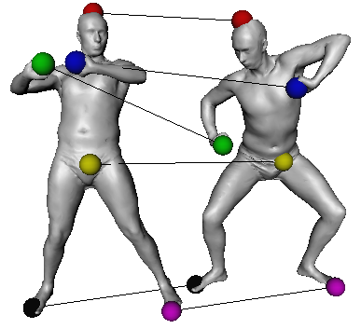
Enumerate maps between consecutive shapes
as graph vertices: for

Slide 12
















Create paths from to and store their
overall isometric distortions
.
m=1
m=2
m=3
m=4
m=M-1
Initially (m=1) a path is just a vertex and its distortion is easy to compute: .
3rd shape in process.
Create paths ending at x-marked vertex. Compute each path distortion via dynamic programming: Eq. 6
4th shape in process. Note that existing paths may change, e.g., subpath to top node in is updated.
Last shape in process.
Do the same for the next x-marked graph vertex.
And the same for another x-marked vertex.
5th shape in process.
Save only the highlighted path with min-distortion.
Output the path with min-distortion:
That is, the vertices/maps on this red path.

Slide 13
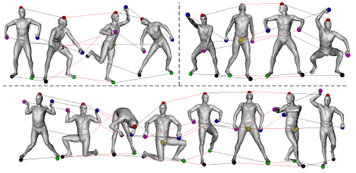
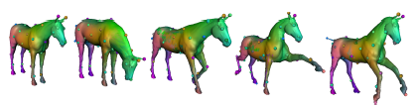
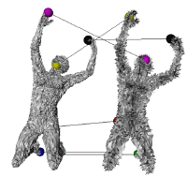
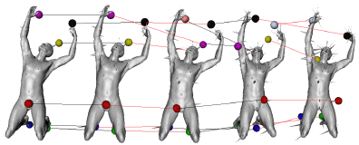
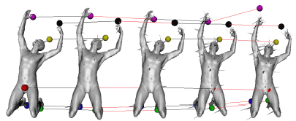
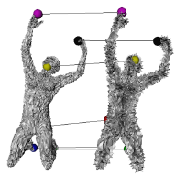
Results
Huang et al., SIGGRAPH Asia, 2012.
Our method.

Slide 14
Future Work
Different map enumarations, e.g., to produce different types
of correspondences.
  Partially isometric.
  Non-isometric.
  Dense (currently we match 300- samples on a high-reso
  and interpolate to full dense map).
New ways of combining maps other than composition.

Slide 15
Conclusion
Rather than improving a given set of initial pairwise maps,
explicitly minimize the overall isometric distortion function
Isometric distortion minimized in the original 3D Euclidean
space wherein isometry is defined, i.e., no embedding.
Output: consistent bijections over all pairs of isometric sets.
Closely approximates the optimal solution in a fast way.
Robust to non-uniform triangulation and noise.
No restriction on topology.

Slide 16
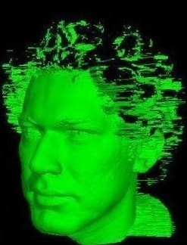
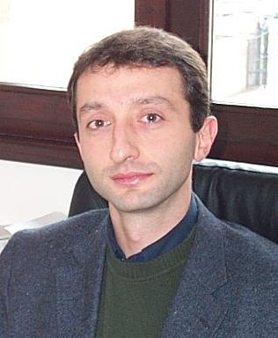


People
Yusuf,
Asst. Prof.
Assoc. Prof. Yücel Yemez,
PhD supervisor

