Slide 1
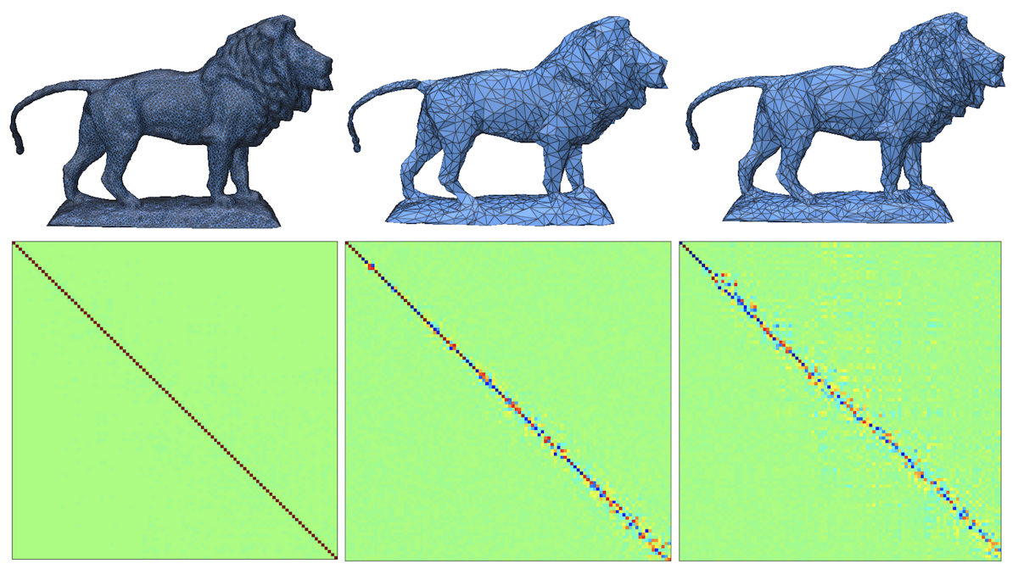
A Partition Based Method for
Spectrum-Preserving Mesh Simplification
Misranur Yazgan and Yusuf Sahillioğlu
Computer Engineering Dept., METU, Turkey
Notes:
Hi, I’m Yusuf Sahillioglu and this work with my MS student Misranur Yazgan is titled .. and I’ll now present it.

Slide 2
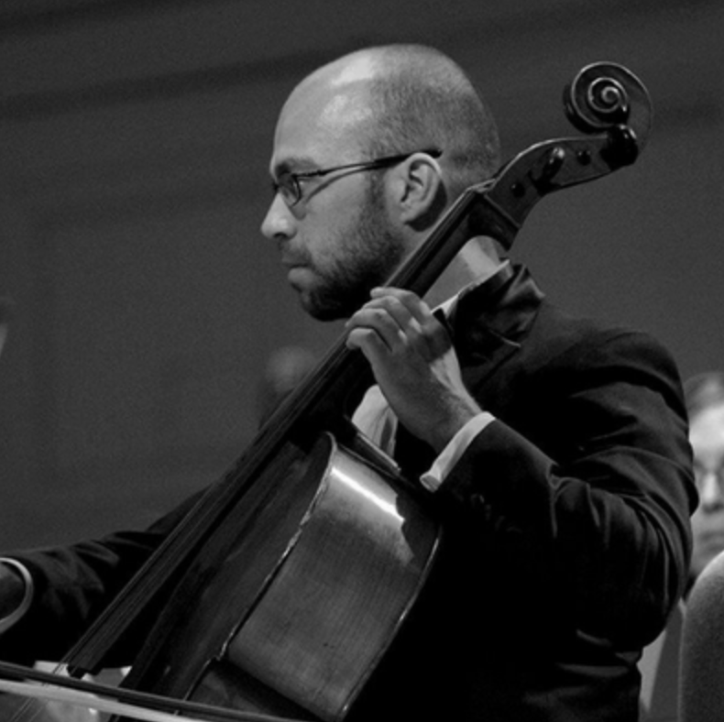
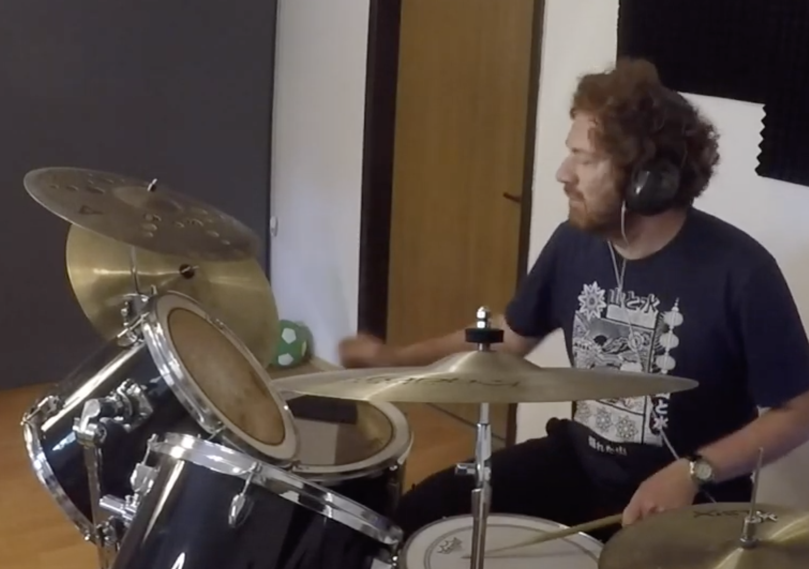
Introduction
1D: We can hear the length of a string ☺
  Justin’s Laplacian lecture in Shape Analysis
nD: We cannot hear the shape of a drum ☹
  Can One Hear the Shape of a Drum? [Kac 1966]
2/46
Notes:
We can reconstruct the length of a string from its sound as hinted by Justin Solomon’s Laplacian lecture. We cannot, however, reconstruct a higher dimensional entity such as the shape of a drum from its sound. //I use this opportunity to advertise the musical sides of both academicians, the latter being me ☺

Slide 3
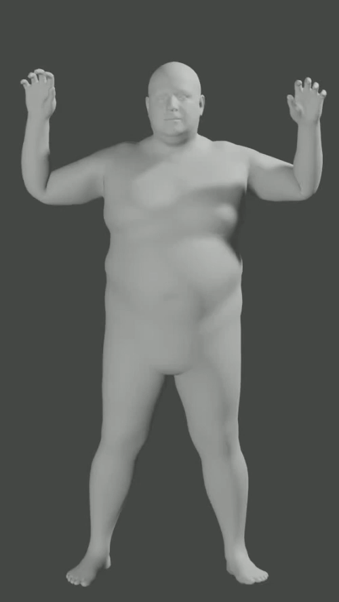
Introduction
We can still learn a lot about the shape of an object from its vibration modes and frequencies
  Laplacian eigenfunctions and eigenvalues
3/46
Notes:
Although a perfect reconstruction is not possible, we can still learn quite a bit about the shape of an object from its vibration modes and vibration frequencies. This is where the mighty Laplacian comes in as its eigenfunctions and eigenvalues enable us to look at the vibration modes and frequencies of our 3D model when it is tapped with a hammer. Being that much informative, Laplacian appears ubiquitously in Geometry Processing tasks and therefore it makes sense to work on a project that protects this operator. //This video is by the way about a related vibration visualization work I’m currently carrying out with another MS student.

Slide 4
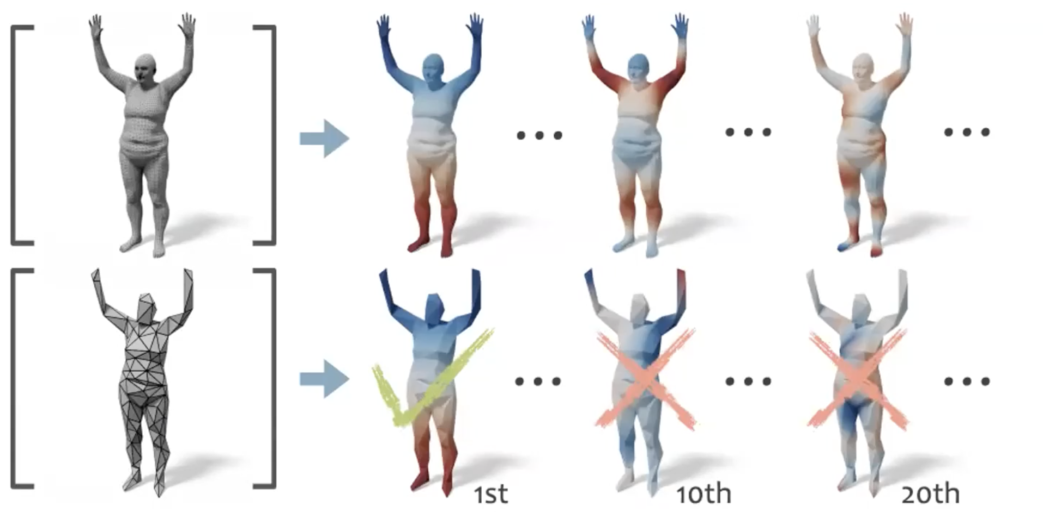
Motivation
Valuable to preserve Laplacian spectrum in low-reso as it is used in many geometry processing tasks
from [Liu et al. 2019]
4/46
Notes:
Let me give our motivation more properly. Since the eigenfunctions of the original model and the low-reso simplified model are not consistent especially for high frequencies (marked with Xs), the related computations that are carried out on these low-reso meshes could be misleading.

Slide 5
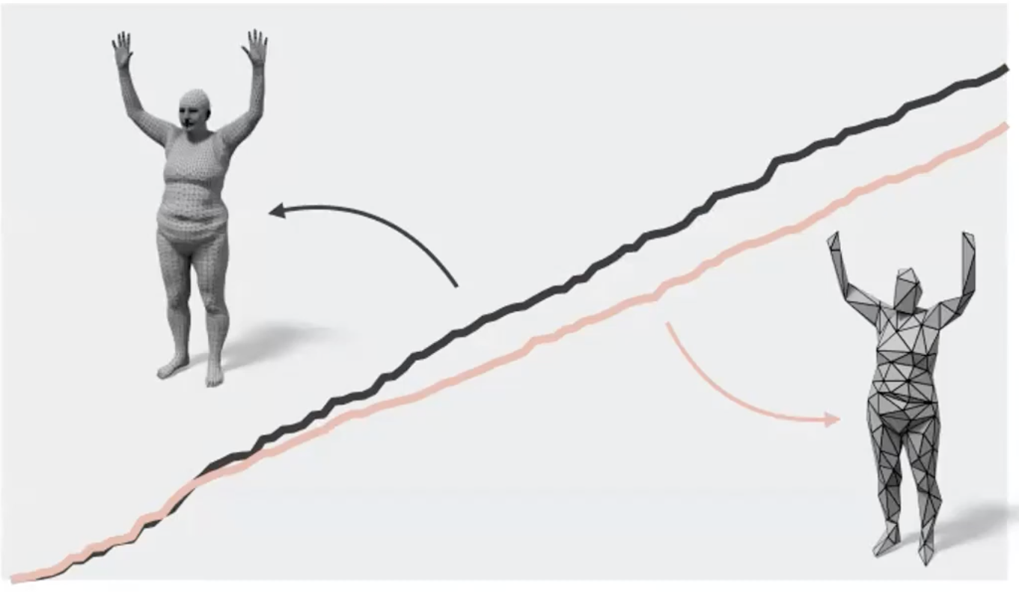
Motivation
Valuable to preserve Laplacian spectrum in low-reso as it is used in many geometry processing tasks
from [Liu et al. 2019]
5/46
Notes:
Same goes for the eigenvalues as they are also mostly inconsistent.

Slide 6
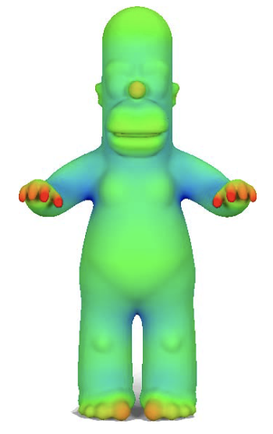
Motivation
Valuable to preserve Laplacian spectrum in low-reso as it is used in many geometry processing tasks
Feature extraction (harmonic isocurves, GPS, HKS)
Segmentation (dot scissor, spectral clustering)
Deformation (differential coordinates)
Compression (least-squares meshes)
Parameterization (Tutte embedding)
Remeshing (spectral simplification)
Correspondence (functional maps)
Smoothing (surface fairing)
Sampling (local maxima)
Distance (biharmonic)
6/46
Notes:
So if we can somehow achieve consistency then all these important geometry processing applications and more will be happy, or more formally will be accelerated by enabling consistent computations on low-resolution. They range from feature extraction to distance computation and satisfy my staircase layout ☺

Slide 7
Motivation
Valuable to preserve Laplacian spectrum in low-reso as it is used in many geometry processing tasks
Feature extraction (harmonic isocurves, GPS, HKS)
Segmentation (dot scissor, spectral clustering)
Deformation (differential coordinates)
Compression (least-squares meshes)
Parameterization (Tutte embedding)
Remeshing (spectral simplification)
Correspondence (functional maps)
Smoothing (surface fairing)
Sampling (local maxima)
Distance (biharmonic)
7/46
Notes:
Take the shape correspondence task, for instance, ..

Slide 8
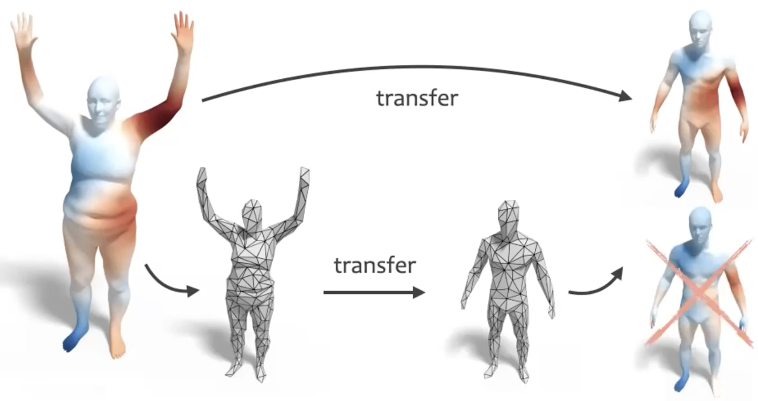
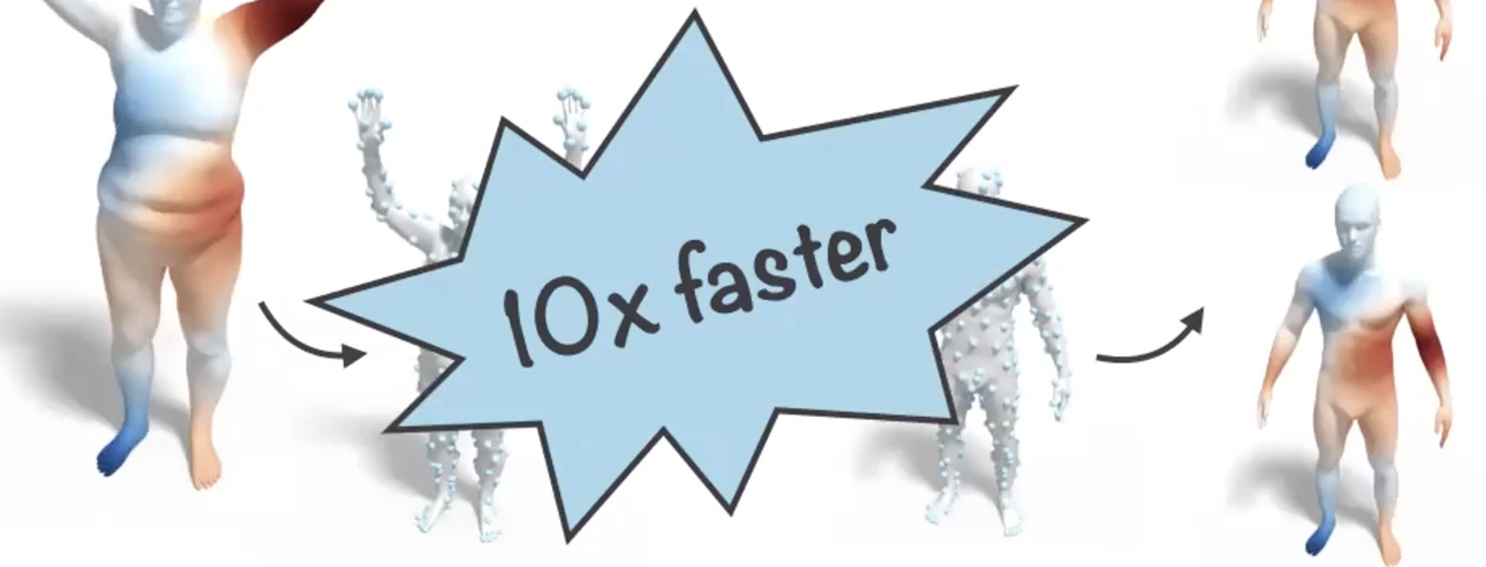
Motivation
Functional Maps [Ovsjanikov et al. 2012] represented using Laplacian eigenbases can be accelerated at low resolution
from [Liu et al. 2019]
8/46
Notes:
.. revolutionary functional maps are efficiently represented by the orthonormal eigen bases extracted from the Laplacian. Working on simplified models is faster but only makes sense if the simplified models’ Laplacians hold the spectral properties of the originals. There are many more similar motivational examples and I’ll present ours in the Results section later.

Slide 9
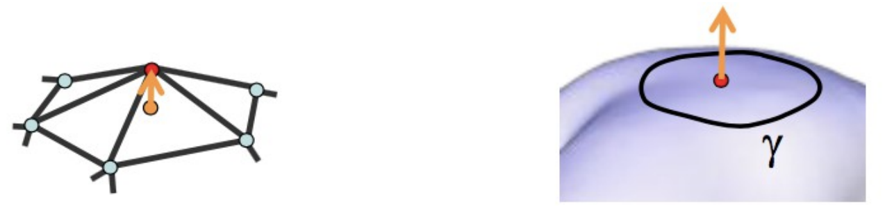
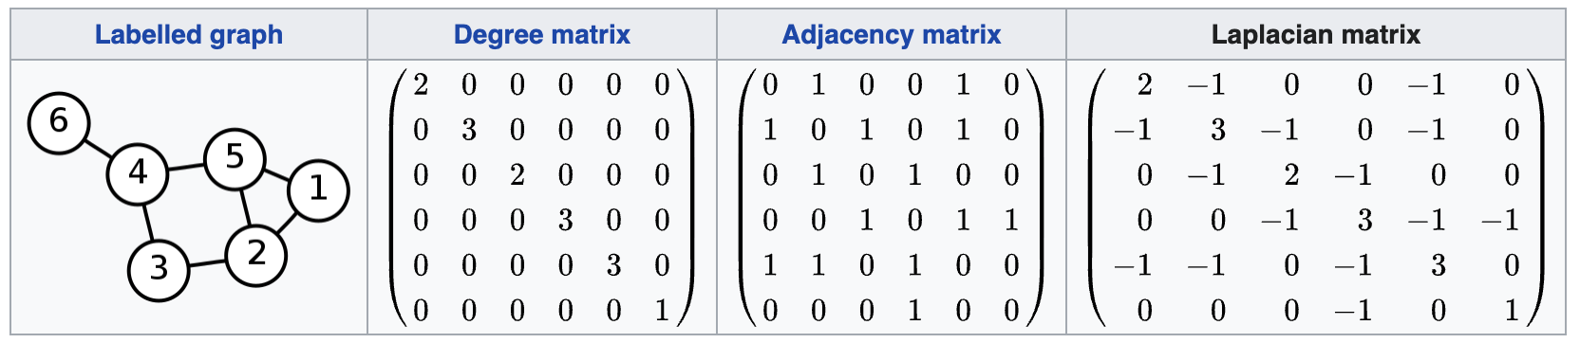
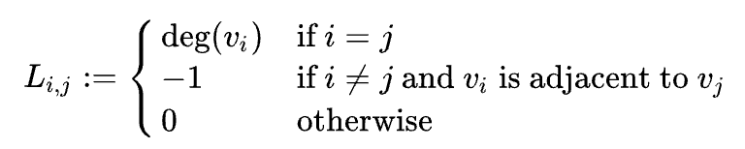
Laplacian
Encodes deviation of a point from its neighbors
Uniform Laplacian
L = D - A
9/46
Notes:
It is customary to call the Laplace-Beltrami operator as a Laplacian, which basically encodes deviation of a point from its 1-ring neighbors. By doing so, it links geometry of manifold to the heat flow.
We have symmetric uniform Laplacian, ..

Slide 10
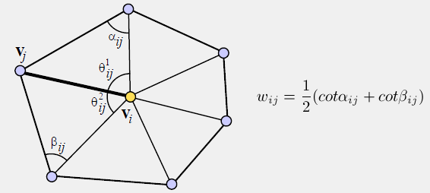
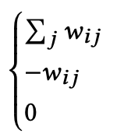
Laplacian
Encodes deviation of a point from its neighbors
Cotangent Laplacian
from [Sorkine et al. 2005]
10/46
Notes:
.. as well as its geometry-aware cotangent version. //Here, if the edge is a boundary edge, we only consider one angle alpha, and assume beta is zero.

Slide 11
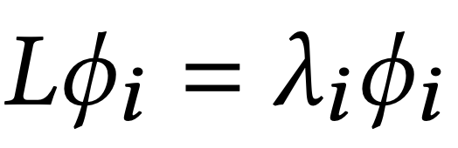
Laplacian Spectrum
11/46
Notes:
Laplacian spectrum, on the other hand, is defined by its eigenvalues lambda and the corresponding eigenvectors or eigenfunctions phi.

Slide 12
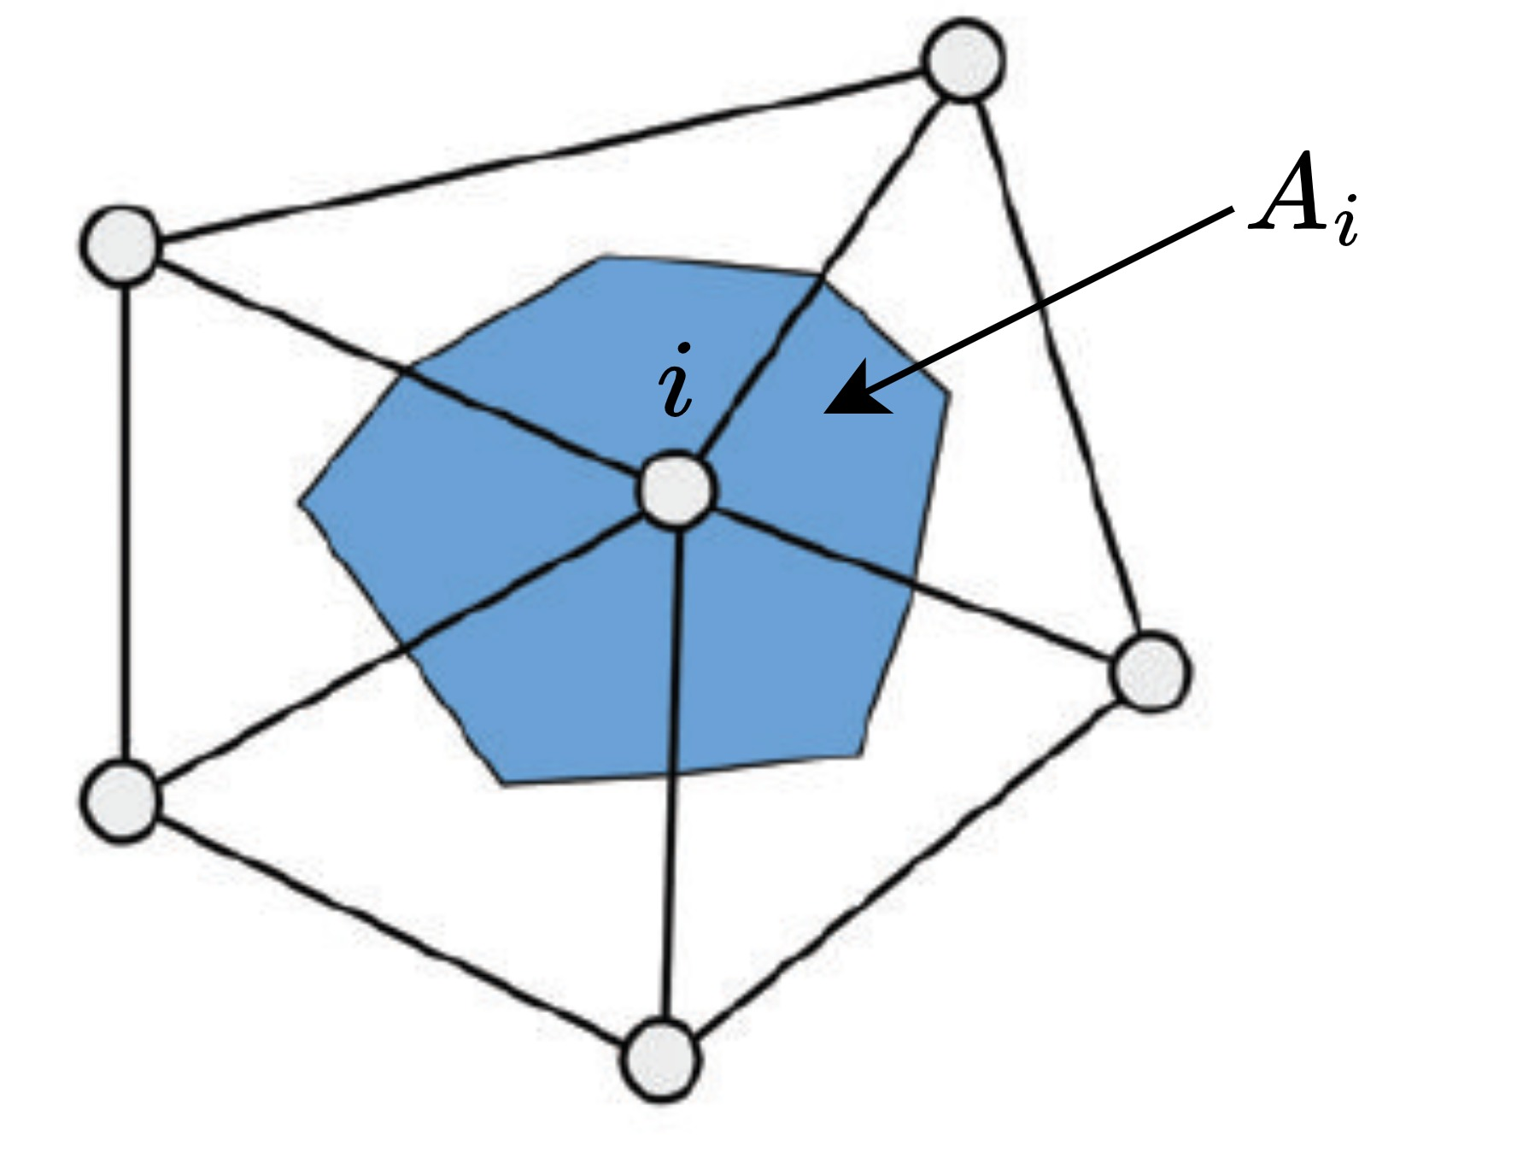
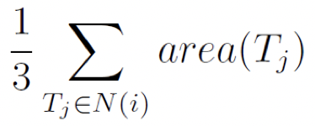
Laplacian Spectrum
L is sym & positive-definite → has orthonormal eigenbasis
Make it more geometry-aware by setting eigenvectors orthonormal w.r.t. mass/area matrix A:
Generalized Eigenvalue Problem
(sparse eigdecomp .1secs V=12K)
12/46
Notes:
L is symmetric positive-definite so its eigenfunctions form a set of good orthonormal bases.
We make it more geometry-aware especially for non-uniform triangulations by injecting the mass matrix A to the mix. When both sides are multiplied by A, we end up with the so-called Generalized Eigenvalue Problem that takes two matrices L and A, not one. Our C++ implementation with Spectra library solves sparse eigendecomposition for 15 eigenvalues in 0.1secs on a 12K-vertex mesh but this time grows almost cubically with vertex size.
//A_ii here stores the Voronoi area of the i^{th} vertex, which is approximated via 1/3 of the total surrounding area. //Sparse eigendecomposition time complexity is O(n^2.376), grows almost cubicly (= complexity of matrix multiplication).

Slide 13
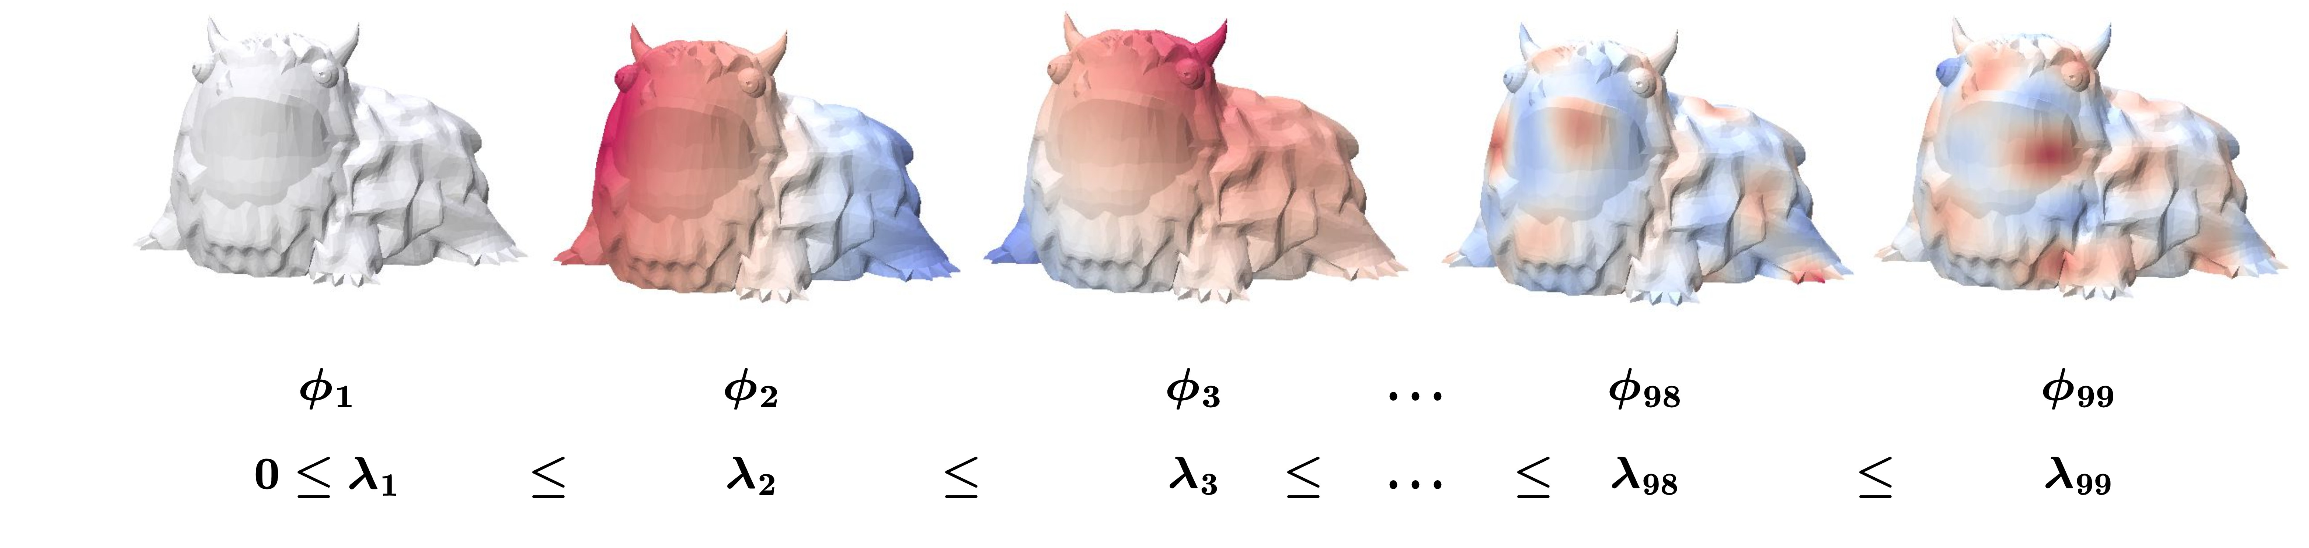
Laplacian Spectrum
First eigvecs are smooth slowly varying functions on mesh
Last eigenvectors have high frequency (rapid oscillations)
First eigvec (leftmost) is the constant smoothest function that does not vary at all → not informative at all/discard
13/46
Notes:
Here are the behaviours of the eigenfunctions corresponding to different eigenvalues or frequencies. While first eigenfunctions are slowly changing, last ones have rapid oscillations. The very first one, on the other hand, is constant and does not vary at all.

Slide 14
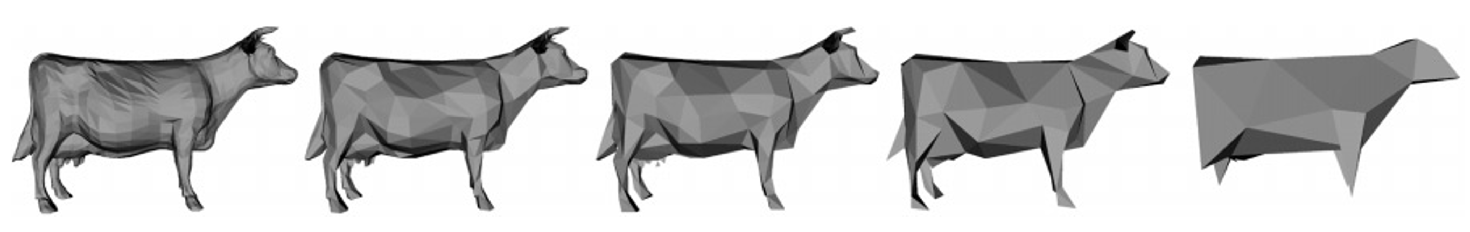
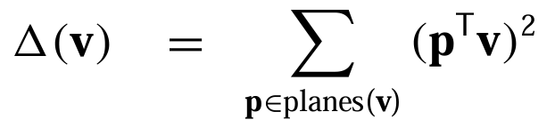
Mesh Simplification Literature
Trimming while preserving original properties
  Appearance, spectrum
[Garland & Heckbert 1997]
[Liu et al. 2023] appearance → equation solving
14/46
Notes:
Let’s see the related work on mesh simplification under appearance- and spectrum-preserving categories. The prominent example of the former assigns each edge a cost, namely sum of squared distances to the supporting planes, and collapses them based on a priority queue keyed on this cost. Its intrinsic version by Liu et al. aims to solve equations on surface meshes, rather than display them on screen.

Slide 15
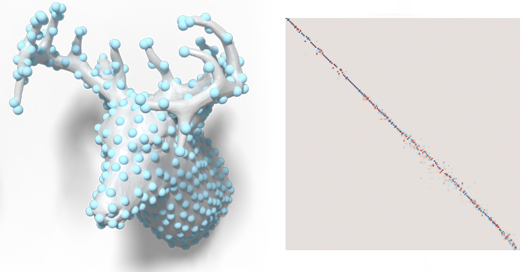
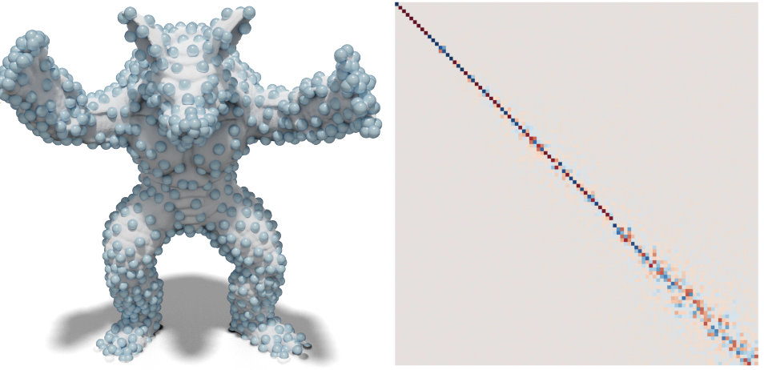
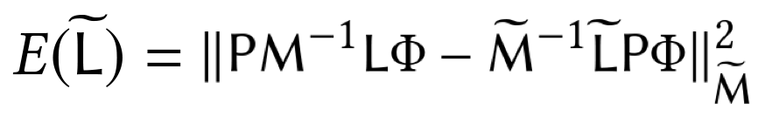
Mesh Simplification Literature
Trimming while preserving original properties
  Appearance, spectrum
[Liu et al. 2019, Chen et al. 2020]
15/46
Notes:
Spectrum-preserving simplification is a relatively new emerging field. Liu et al. and Chen et al. find coarsened operators Ltilde, not coarsened meshes, that minimize the energy here via Galerkin formulation and chordal solver, respectively. Post-processing existing results, Chen performs better.
The commutative energy here first applies the operator to some function phi on mesh and projects the result to the coarsened domain via P. It then projects phi to the coarsened domain via P and applies the coarsened operator. To deal with nonuniform triangulations, mass matrices are also included. If these two paths give the same result then L and Ltilde operators share the same similar spectral properties so Ltilde is the desired solution.
//Since these methods don’t produce a mesh, vertices that are sampled to exist on the coarsened domain are visualized by marking them on the original mesh via spheres.

Slide 16
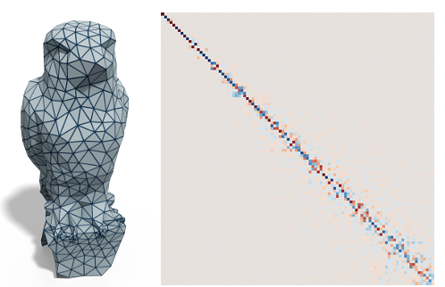
Mesh Simplification Literature
Trimming while preserving original properties
  Appearance, spectrum
[Liu et al. 2019, Chen et al. 2020]
[Lescoat et al. 2020] same energy for each edge
16/46
Notes:
Lescoat et al. define the same energy locally for each edge, instead of globally for the entire operator, which produces a coarsened mesh as they can now queue up the edges for mesh simplification.

Slide 17
Mesh Simplification Literature
Trimming while preserving original properties
  Appearance, spectrum
[Liu et al. 2019, Chen et al. 2020]
[Lescoat et al. 2020] same energy for each edge
[Keros & Subr 2023] generalized spectral coarsening
17/46
Notes:
Recently a generalized spectral coarsening method is presented and it can simplify triangle and tetrahedral meshes by considering multiple Laplacian operators defined in different dimensionalities.

Slide 18
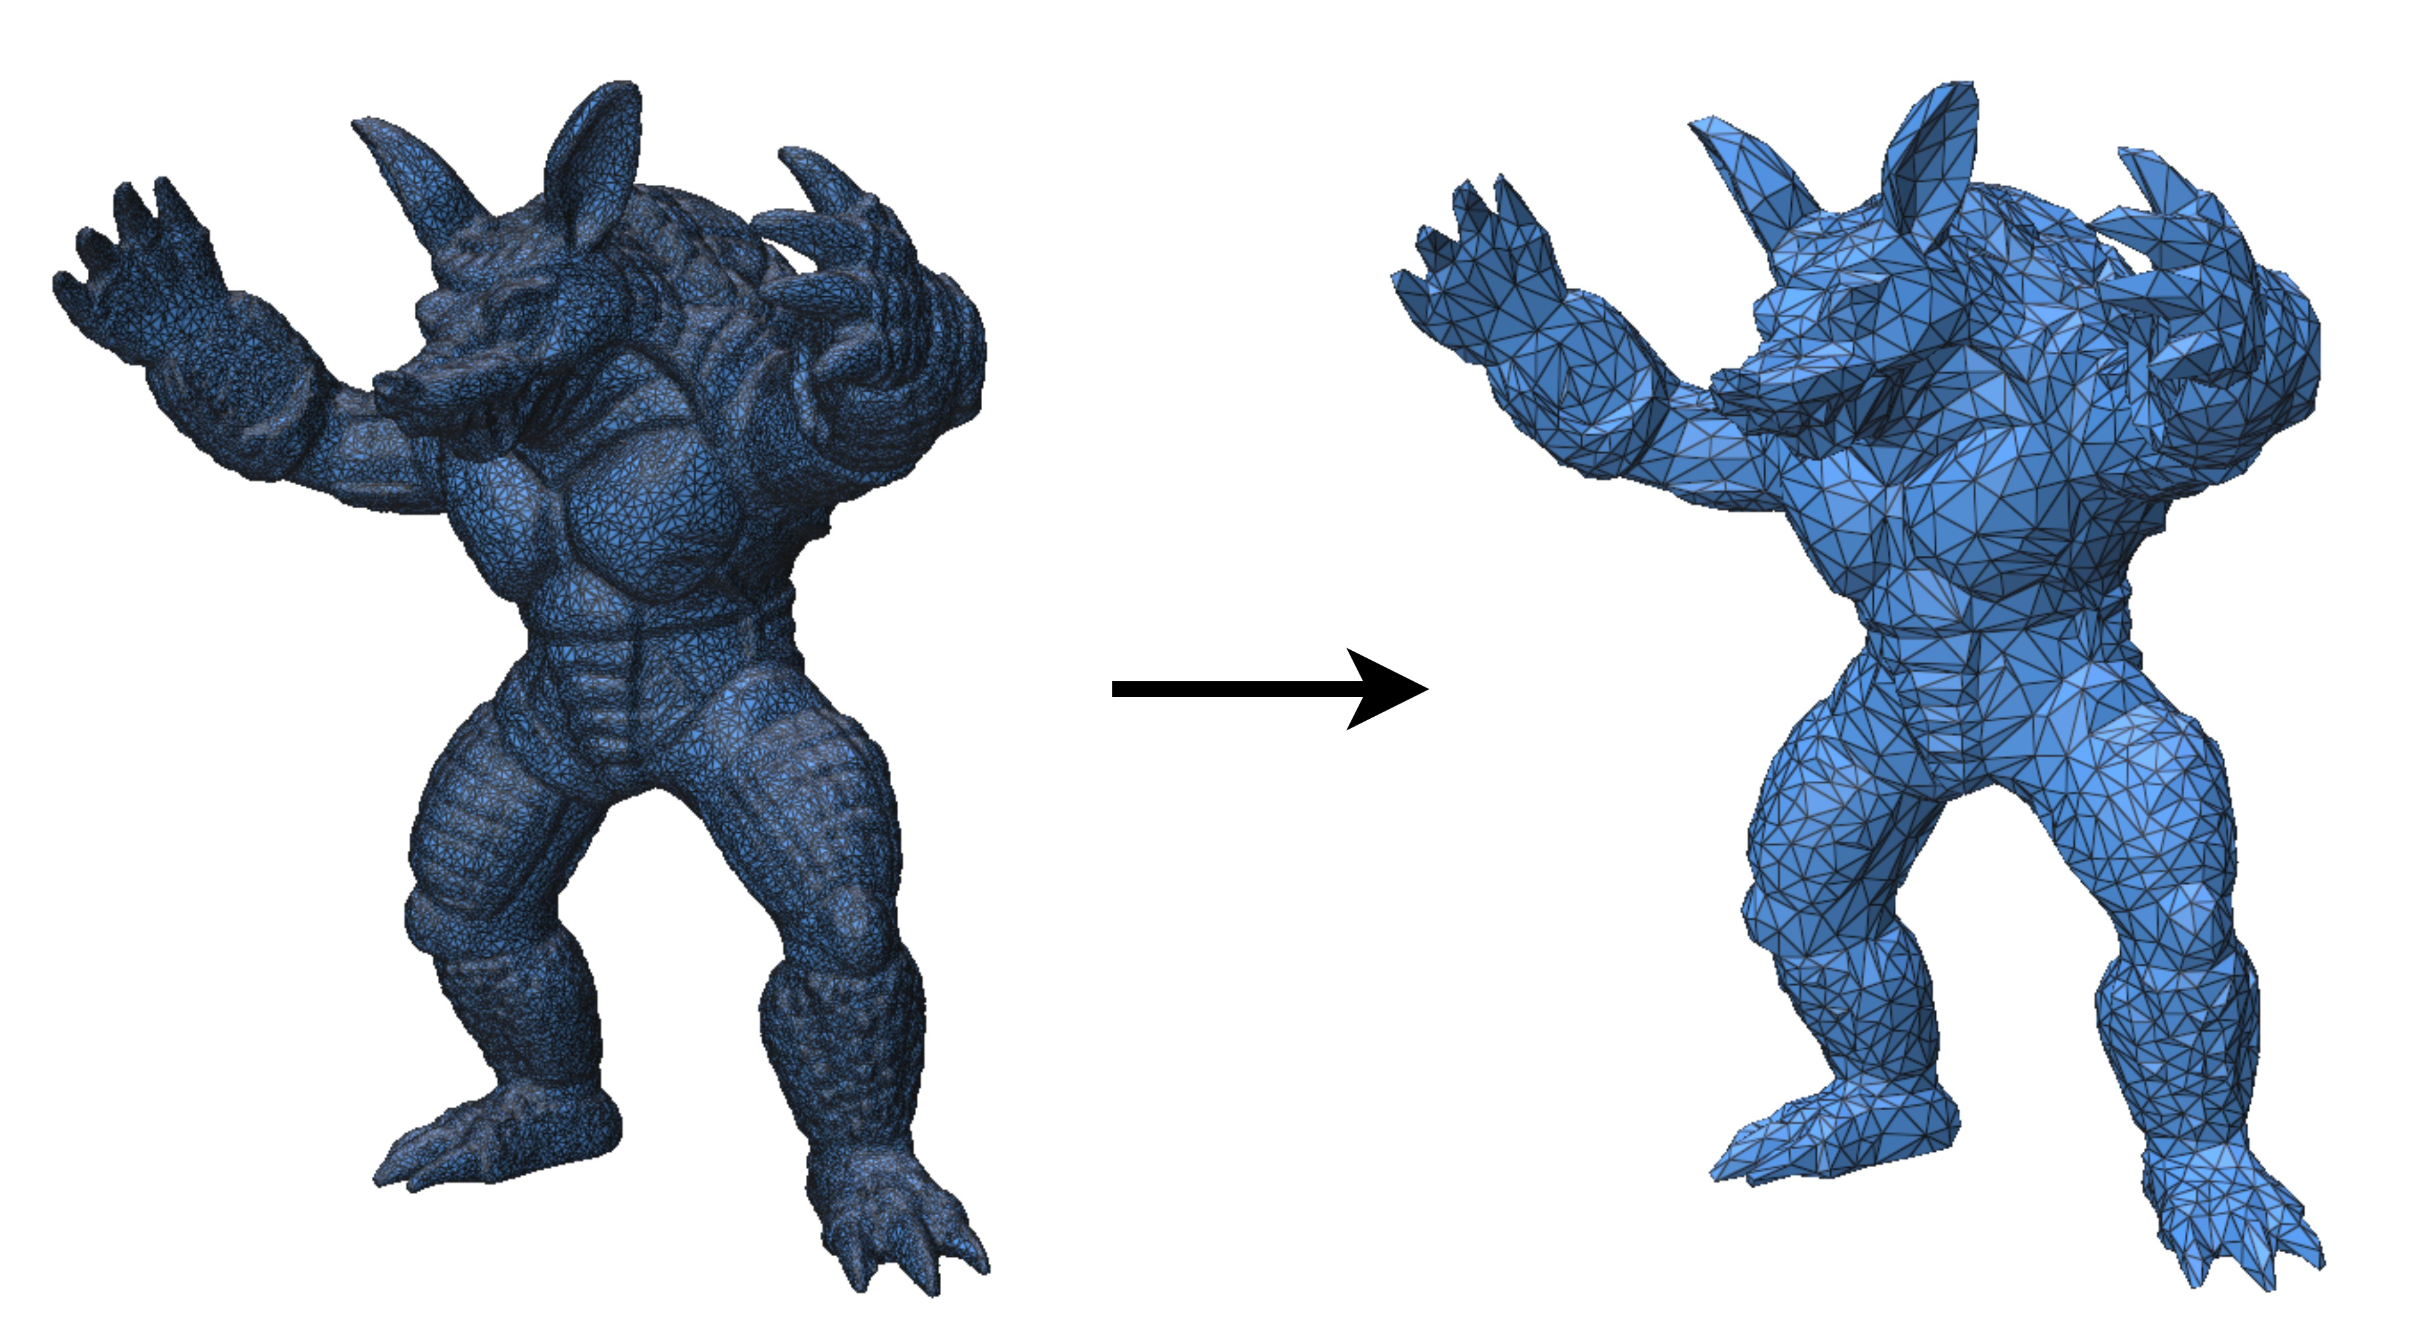
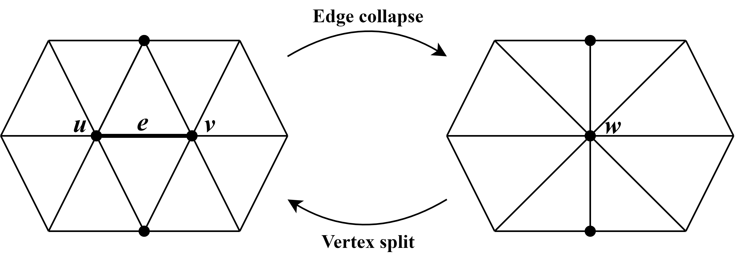
Mesh Simplification
A series of edge collapse operations
18/46
Notes:
//Mesh simplification yields dramatically different graphs despite describing a similar underlying geometry.
We decide to use a series of edge collapses for mesh simplification. Given an edge e joining the vertices u and v, an edge collapse operation removes the edge and replaces the vertices u and v with one of them.
Vertex split is the inverse of edge collapse operation. For our purposes, it is used to invert an edge collapse during the cost assignment step.

Slide 19
Mesh Simplification
A series of edge collapse operations
1 vertex
2 triangles
3 edges
are removed
19/46
Notes:
As far as the implementation goes, an edge collapse removes 1 vertex and 2 triangles, which is obvious. 3 edges are deleted in total, not 1, in order to prevent duplicates in the mesh structure because their existence leads us to an agonizing debugging process. Namely, the 2 verticalish edges get duplicated with the black ones at left when the green triangles shrink to nothing so we must remove them too in addition to the obvious victim e.

Slide 20
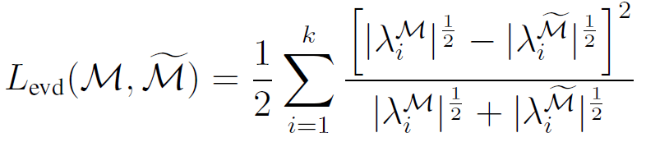


Method
Directly considers eigenvalues, unlike previous methods
Only first k (15) eigenvalues, since high-freq components will not be present on the coarsened mesh anyway
Idea:
: eigenvalues computed on the original mesh
: eigenvalues computed after the edge collapse
20/46
Notes:
So our method directly considers the eigenvalues for the first time in the literature. Only the first k=15 smallest low-frequency are considered because high-freq components will not be present on the coarsened mesh anyway.
Given the set of eigenvalues obtained after a single edge collapse, we compare it with the fixed set of original eigenvalues under some norm.

Slide 21
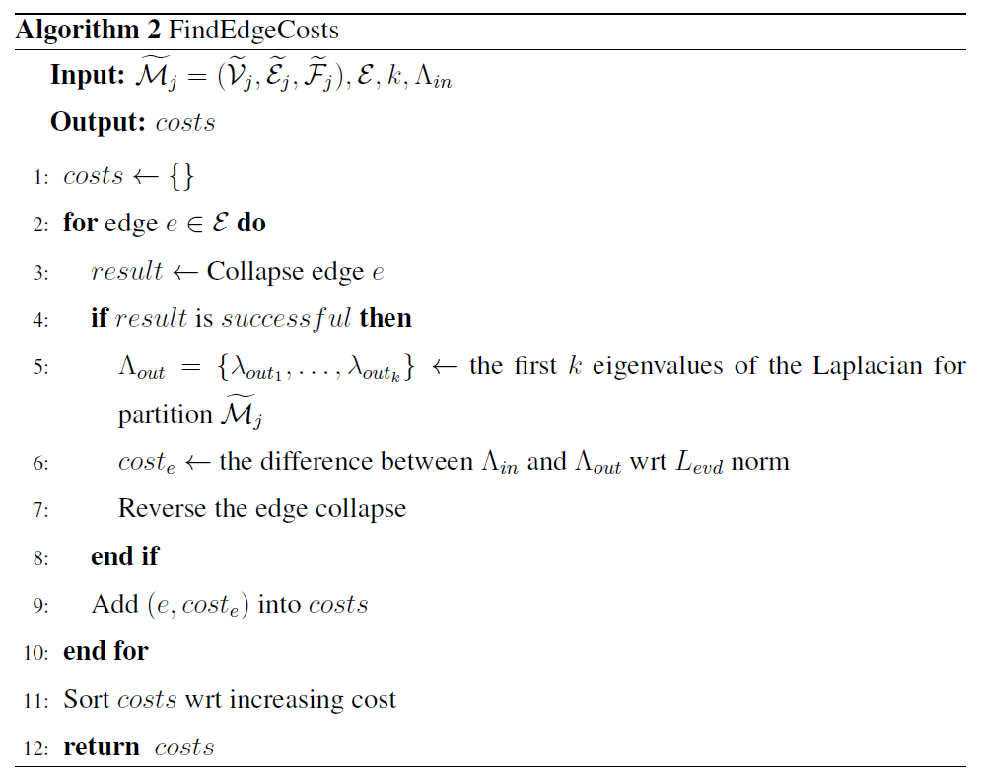
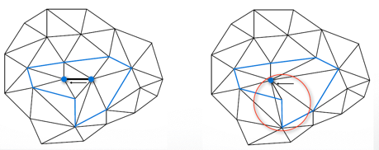
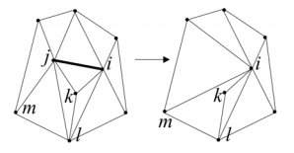
Method
21/46
Notes:
So we put this norm in use as follows. For each edge we first try to collapse it and as some collapses are illegal like the ones causing sudden normal flips and foldovers so in such cases collapse is not succesful and we don’t proceed further. For the successful cases, we obtain the eigenvalues of the Laplacian after the edge collapse and compare it to the originals with the previous norm to compute the desired cost for that edge. We then invert the edge collapse with a vertex split operation.
Obviously, doing this for every edge in the mesh at each step is intractable. So we introduce several solutions to overcome this timing issue. //Here, the eigen-decomposition of the Laplacian takes long time, but we introduced several approaches to overcome this.

Slide 22
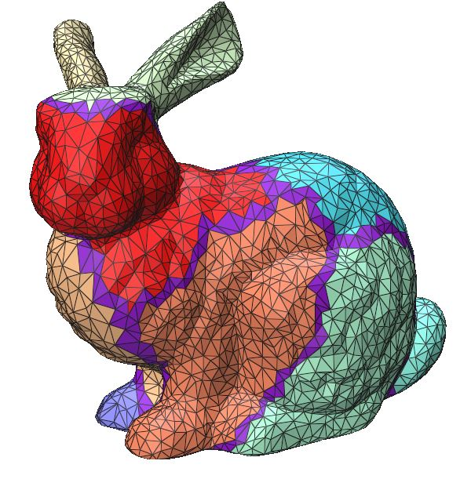
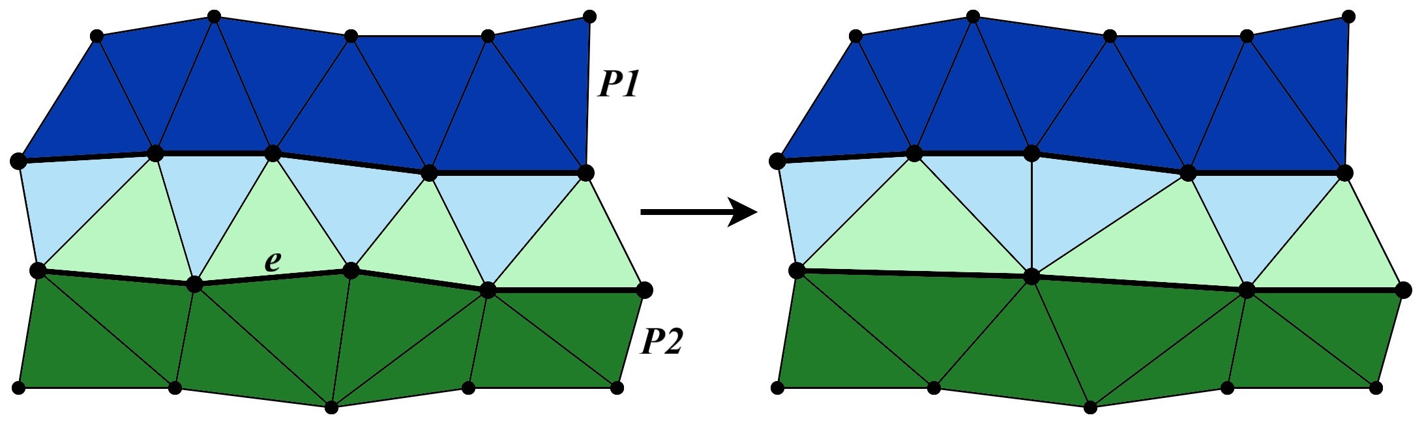
Partitioning
Pros
Laplacian size decreases
Faster eigval decomposition
Fewer edges to consider
Cons
Edge-cut regions
(Purple in Bunny)
22/46
Notes:
The first solution introduced is partitioning. The mesh is divided into smaller partitions and each partition is simplified separately. Thus, we construct the Laplacians within the partition, not for the entire mesh. This effectively decreases the size of the Laplacian operator, leading to much faster eigenvalue computations.
In addition, when each partition is treated separately, there are fewer edges to consider to select the best edge.
We also have donwfall: When each vertex is assigned to a partition, the triangles left between the partition boundaries form the so-called edge-cut region. The edges in these regions are not collapsed directly but they get simplified indirectly by collapsing the edges lying at the partition boundaries, for instance the light green triangle here is removed by the collapse of e at the boundary. So, they are not left with the original resolution but we still need to minimize these regions as we don’t have an explicit control there.

Slide 23
Partitioning
METIS partitioning tool [Karypis & Kumar 1998] is used
  Option to prioritize minimizing edge-cut region while keeping the partition sizes balanced
  Guarantees each edge belongs to only one partition
23/46
Notes:
METIS provides an option to prioritize minimizing the edge-cut regions, specifically the number of edges in the edge-cut regions, while keeping the partition sizes balanced. It also guarantees that every edge belongs to only one partition, so that the partitions do not affect each other.

Slide 24
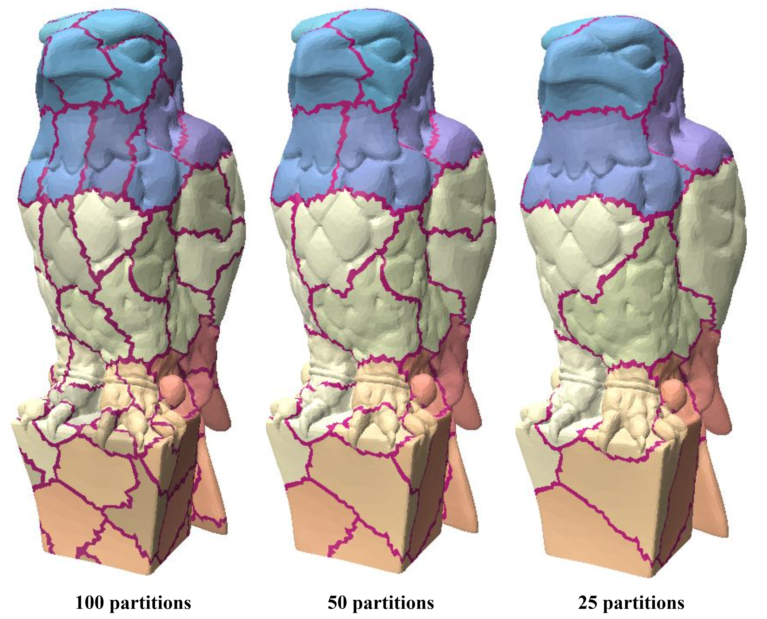
Hierarchical Partitioning
For a proper spectrum preservation, # vertices in each partition on the out mesh should be at least 3k [Liu et al. 2019].
  Bounds the number of vertices that can be removed
Multi-step simplification with hierarchical partitioning
  Simplify the mesh at multiple steps
  At each step, simplification is performed until an intermediate reso
24/46
Notes:
For a proper spectrum preservation, # vertices in each partition on the output mesh should be at least 3k, as demonstrated experimentally by the provious work. This bounds the # vertices removed from each partition and consequently may prevent us from reaching the desired resolution. We can fix the problem via multistep simplification with hierarchical partitioning, ..

Slide 25
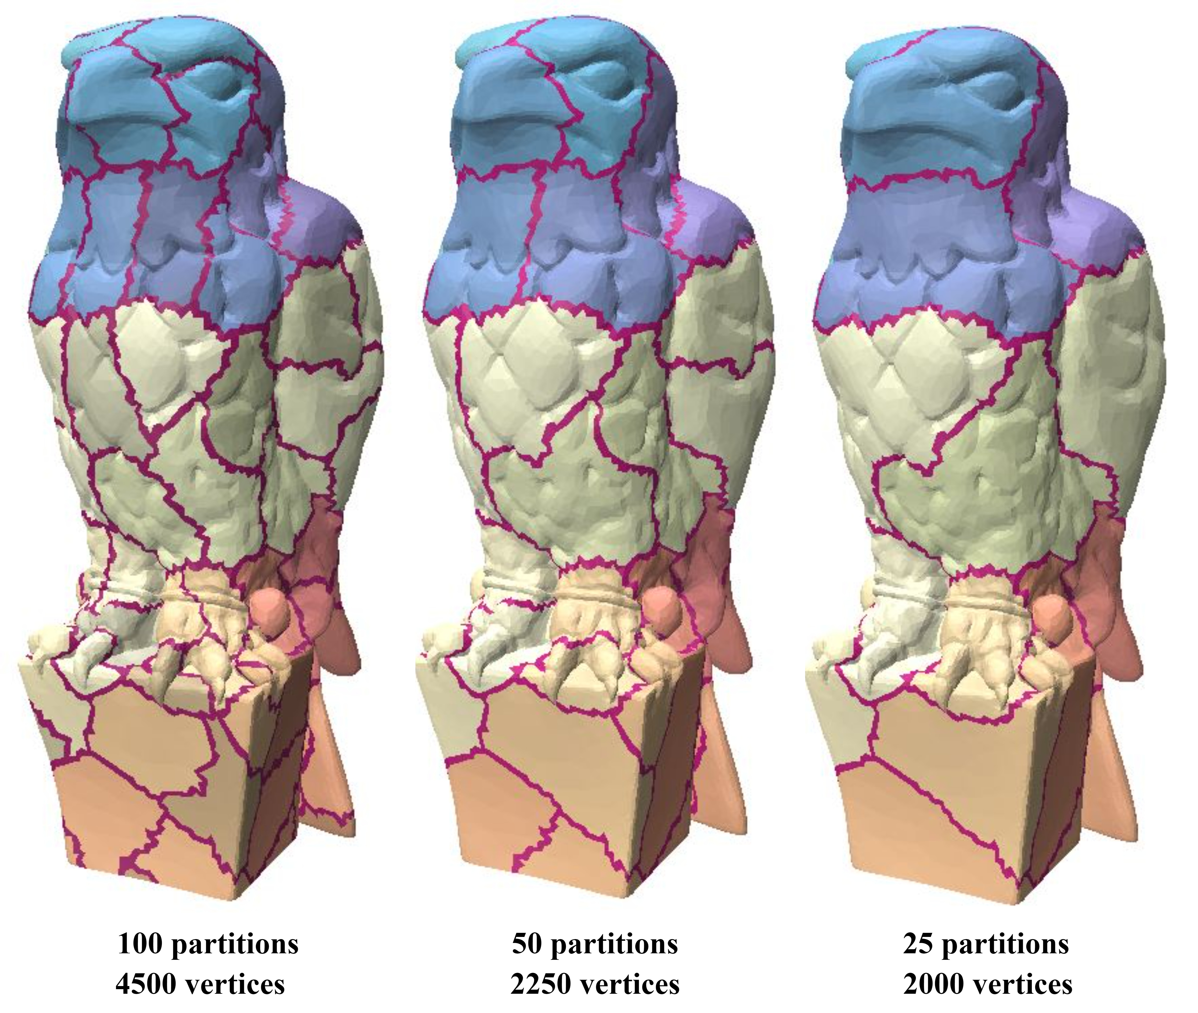
Hierarchical Partitioning
Input size: 25K
Desired output size: 2K
# partitions: 100
# eigvals (k): 15
At least 3x15=45 verts in a partition
  Min output size: 4.5K
Similar to tree structure
Partitioning: ←
Simplification: →
25/46
Notes:
.. which I clarfiy with this example now. Assume that a mesh with 25000 vertices is given and the desired output size is 2000, but with 100 partitions and k=15 eigenvalues to protect, there should be at least 3x15=45 vertices in a partition, so the min output size is 4500, which is higher than our target 2K. To get to the desired resolution we first simplify until 45x100=4500. Then divide the coarser 4.5K mesh into 50 partitions (big partitions --due to less # partitions-- will no longer cause big timing problems on coarser models) and simplify it until 45x50=2250 vertices. Here existing partitions are divided into two in a binary tree structure so to understand partitioning you should look from right to left, but simplification proceeds from left to right. We finally divide this 2250-vertex mesh into even bigger 25 partitions and simplify until the desired 2000.

Slide 26
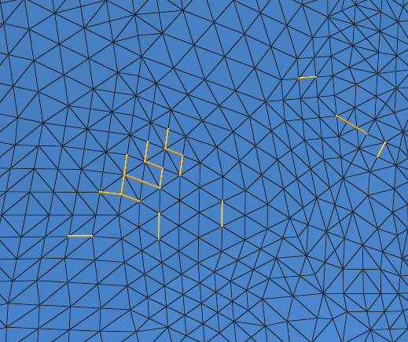
Similar Edge Elimination
Edges whose removal affect the spectrum similarly
Consider the best n edges
For the upcoming x steps, select the best edge among the top n edges found in the previous step
  Consider all edges in a partition once every x steps
  For the remaining steps we select the edge from the top n edges
n = 20, x = 4
26/46
Notes:
Another solution for speedup is similar edge elimination.
Here, similar edges term stands for the edges, whose removal affects the spectrum as close as possible to each other.
Normally, the costs are calculated for all the edges in a partition. So, instead of choosing the best edge with the lowest cost, we can select the top n edges. However, we do not collapse these top n edges, because collapsing them successively without any checks might result with a worse spectrum preservation. Instead, for the upcoming x steps, we select the best edge among these top n edges found in the previous step, instead of all the edges in the partition.
In this way, we consider all edges in a partition once every x steps. And for the remaining steps we select the edge from the top n edges. Some of the n edges will be removed indirectly through other edge collapses in this subset. In all tests, we select n as 20 and x as 4. Here we highlight 20 similar edges for a partition.

Slide 27
Threading
Each partition is simplified separately
  Ready to be parallelized
Each thread runs a partition
Running all partitions at once causes race conditions
  Soln: Only run partitions concurrently if they aren’t direct neighbors
27/46
Notes:
The final solution we introduce is threading. Since the mesh is already divided into partitions and they are all simplified separately, we can parallelize the process. However, if all of the partitions are run at the same time, the neighboring partitions affect each other causing race conditions.
As a race condition example, when e is collapsed from left to right, green vertex is removed and replaced with the blue as the new vertex of the pink triangle. Simultaneous collapse of the pink edge is problematic as pink triangle’s vertex indices have changed now.
At this point we did not prefer utilizing concurrency control mechanisms like mutexes, because they would introduce unnecessary complications. To overcome this, we only run the partitions that are not direct neighbors of each other concurrently.

Slide 28
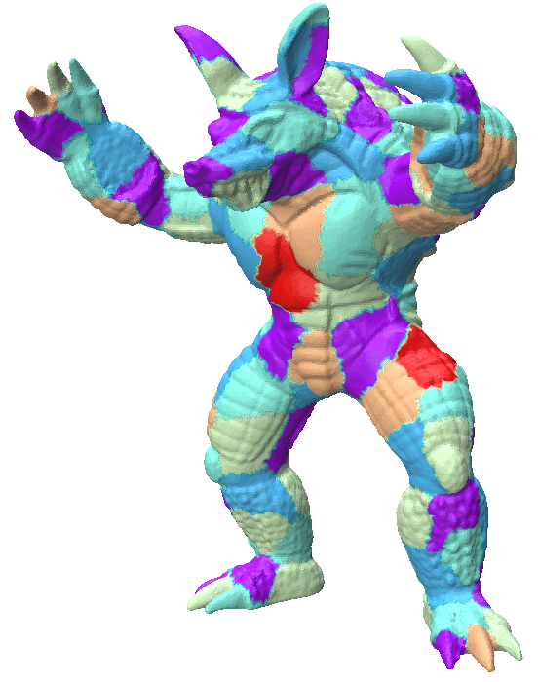
Threading
Run threads/partitions batch by batch
  E.g., purple batch, then red batch, and so on
Assigning partitions to batches ~ graph coloring problem
Partitions ~ vertices
Batches ~ colors
Max # batches ≤ max degree+1
28/46
Notes:
And to achieve that we run threads, or equivalently partitions, batch by batch. Like we first complete the purple batch by running all its threads/partitions concurrently, then do the red batch, then the cyan and so on. So the purple ones must not be direct neighbors and we can satisfy this request by switching to the well-known graph coloring problem.

Slide 29
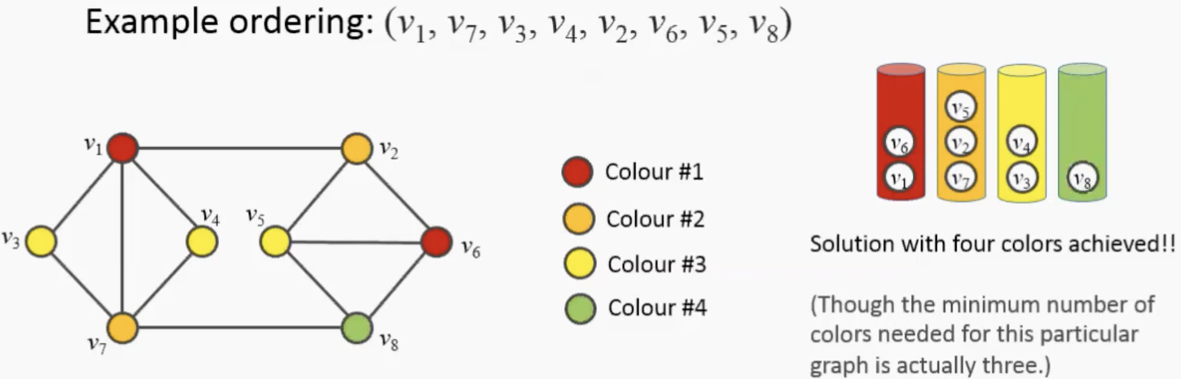
Threading
Run threads/partitions batch by batch
  E.g., purple batch, then red batch, and so on
Assigning partitions to batches ~ graph coloring problem
Partitions ~ vertices
Batches ~ colors
Max # batches ≤ max degree+1
29/46
Notes:
We employ a greedy coloring algorithm that assigns the lowest legal color to the next vertex in the ordering. Here for instance v1 gets the color1, and then v7 gets color2 not color1 to respect the coloring rule: neighbor vertices must have different colors. Them v3 gets color3 and so on. We use an descending order of vertex degrees to get an upper bound on the max # colors/batches we use.

Slide 30
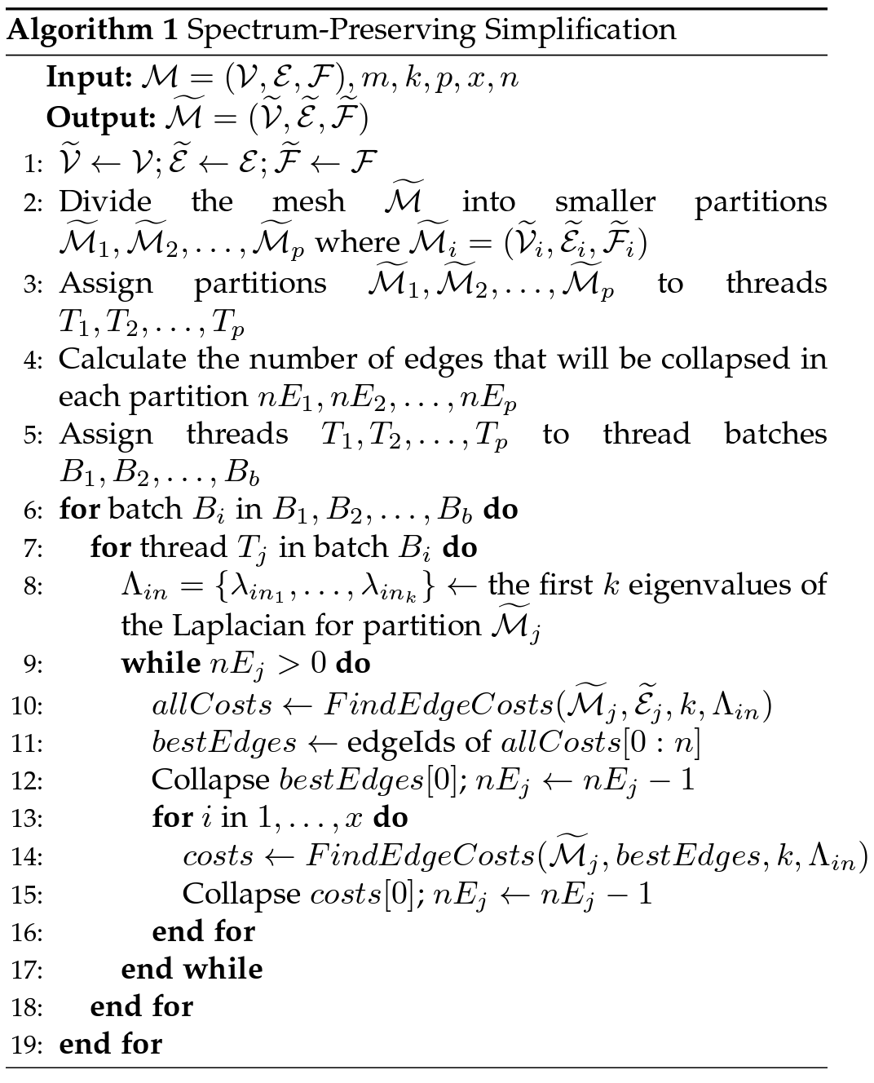
Complete Algorithm
Input parameters:
m : # vertices in the simplified mesh
k : # eigenvalues to preserve
p : # partitions
x : # similar edge elimination steps
n : # edges to consider for the similar edge elimination
30/46
Notes:
Here is the complete algorithm that runs on 5 parameters in total. Note that batches are processed sequentially, whereas the threads in a given batch are concurrent.

Slide 31
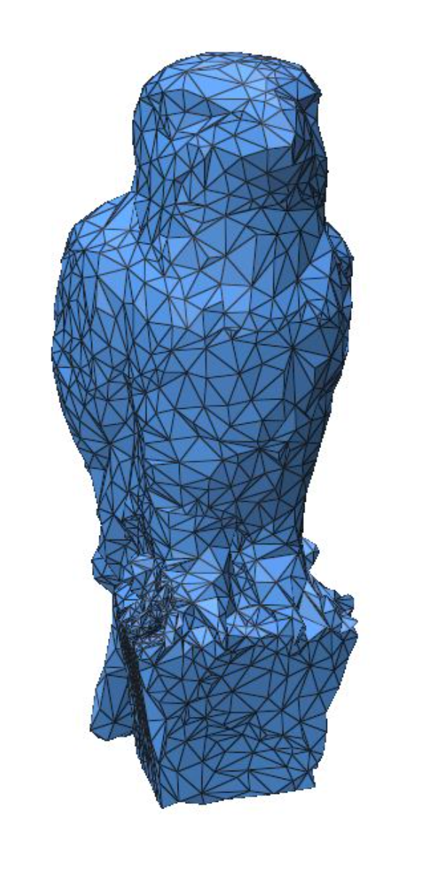
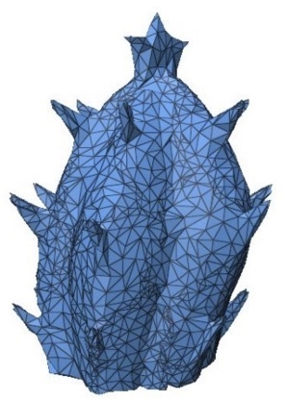
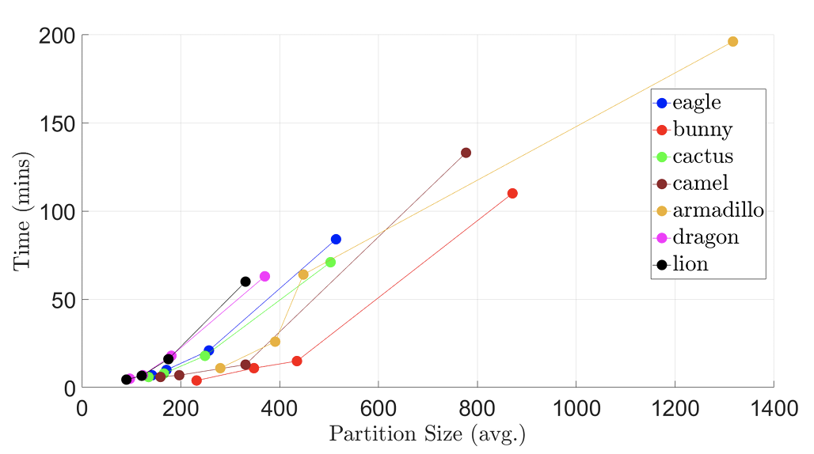
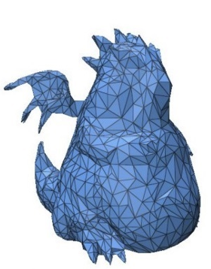
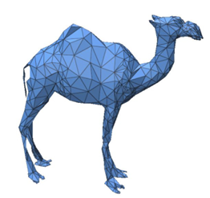
Results: Effect of Parameters
Time vs. Partition Size
  Partition size Laplacian Eigendecomp Hence time
~92% vertices removed
31/46
Notes:
Let’s see some results. In this one as well as the upcoming ones about 92% vertices are removed. We see that as the average partition size is increased, the sizes of the Laplacians get larger, and it takes more time to compute the eigenvalues. This increases the overall simplification time.

Slide 32
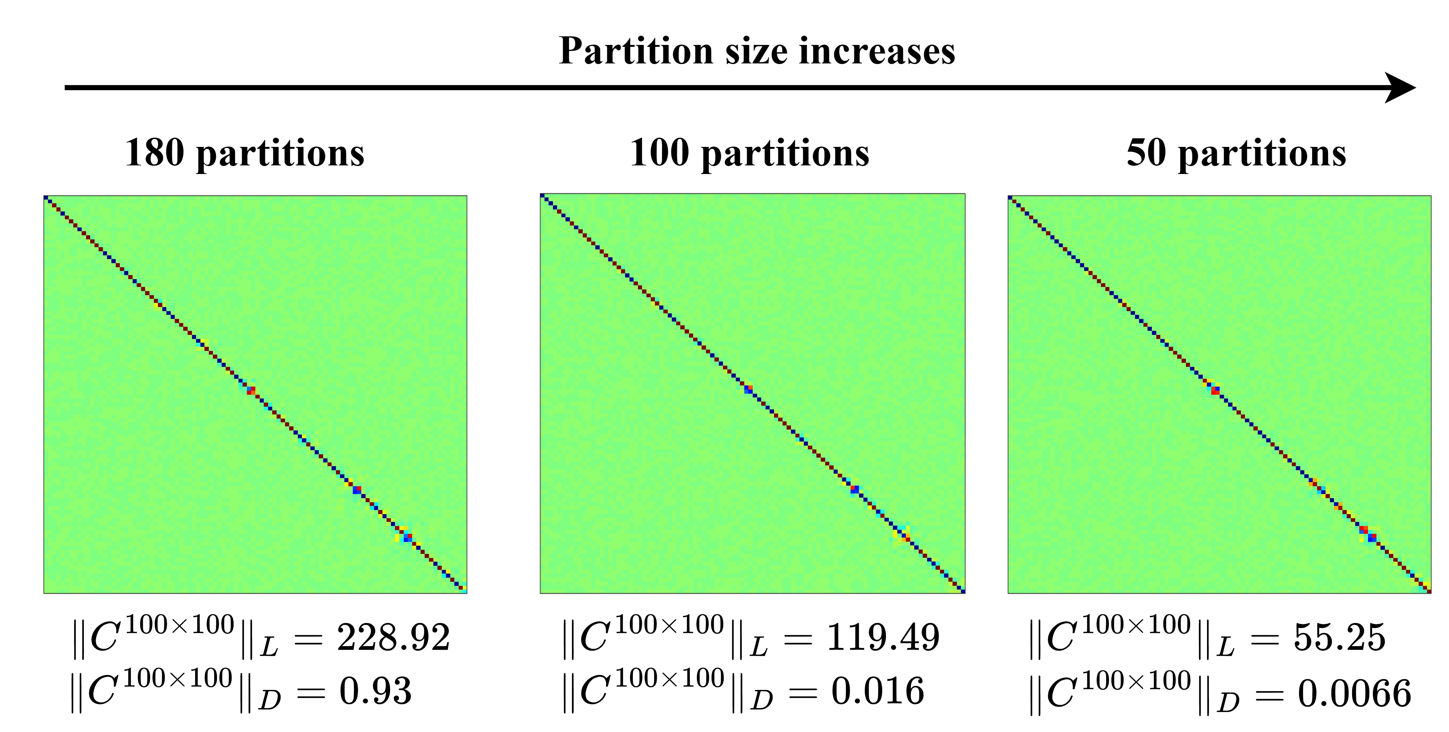
Results: Effect of Parameters
Accuracy vs. Partition Size
  Partition size Representation Hence accuracy
32/46
Notes:
Here from left to right, the number of partitions is decreased, so the partition sizes increase. We can see that as the partition size increases, the norms we import from existing works become smaller leading to a better spectrum preservation. This is because as the partition size is increased, it becomes more and more capable of representing the overall neighborhood. //So, for each mesh, the partition sizes should be adjusted so that we obtain sufficient timing improvements without sacrificing spectrum preservation.

Slide 33
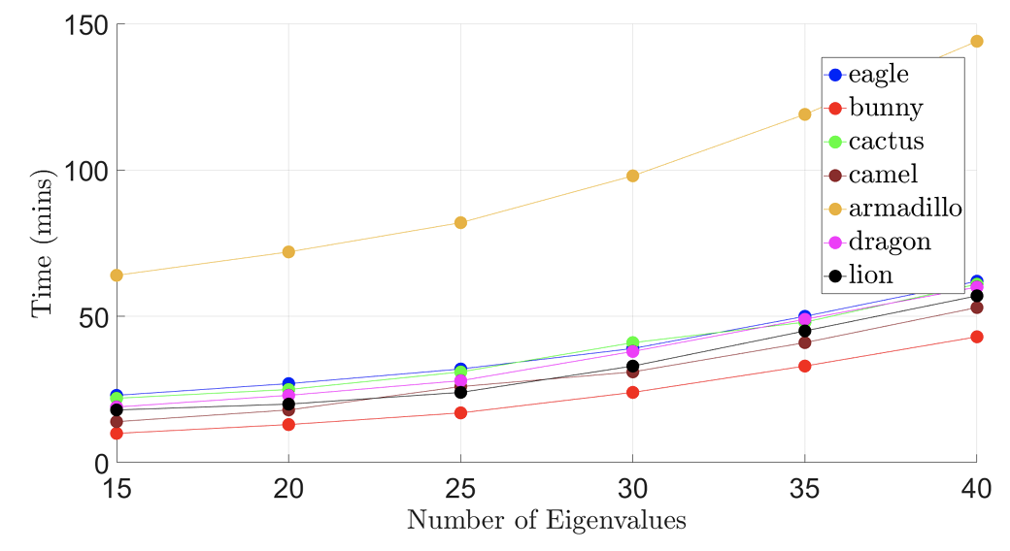
Results: Effect of Parameters
Time vs. # Eigenvalues
  k Eigendecomp Hence time
33/46
Notes:
Let’s now consider this plot, time vs number of eigenvalues to preserve. As the number of eigenvalues is increased, we can see that the overall simplification time also increases. Because, while considering more eigenvalues, the eigendecomposition of the Laplacian at each step takes longer time than before.

Slide 34
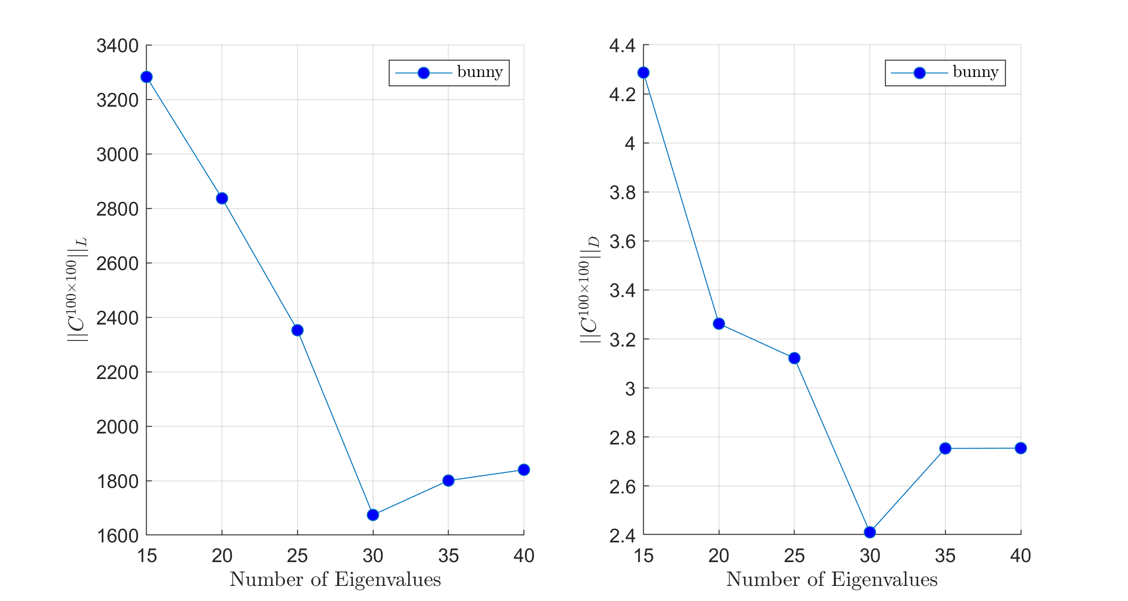
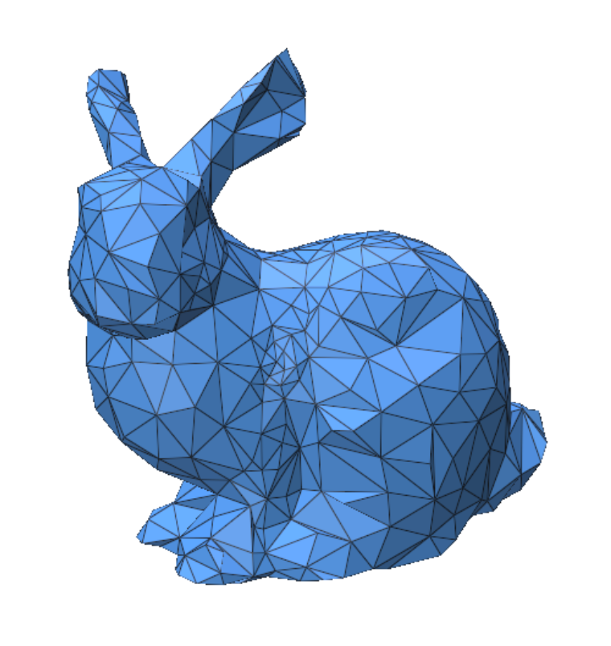
Results: Effect of Parameters
Accuracy vs. # Eigenvalues
  k Accuracy up to a point
34/46
Notes:
These plots show that both the norms imported from previous work tend to decrease, as the number of eigenvalues to preserve is increased.
This is because increasing the number of eigenvalues results with a better spectrum preservation for the higher frequency components. However, this only holds up to a point. After that, it only introduces additional computational cost to the method.

Slide 35
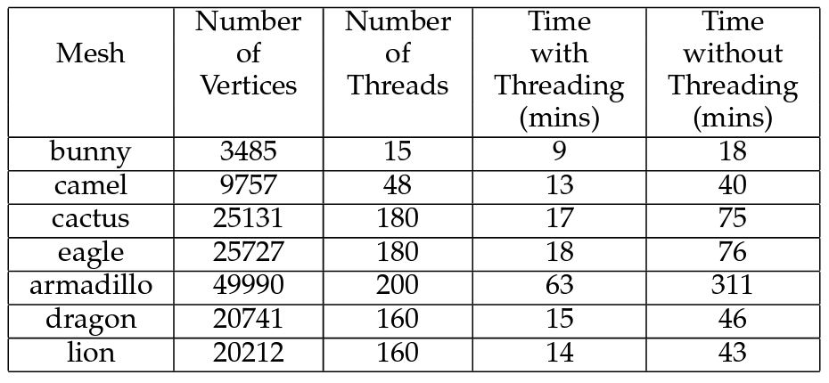
Results: Effect of Parameters
Time vs. Threading
  # Partitions # Threads Hence time
35/46
Notes:
Since threads or equivalently partitions are run concurrently, as the number of partitions increases, simplification time decreases. Using only one partition, i.e., no partitioning at all, corresponds to the sequential run w/o threading which is terribly slow. So threading brings significant time improvement.

Slide 36
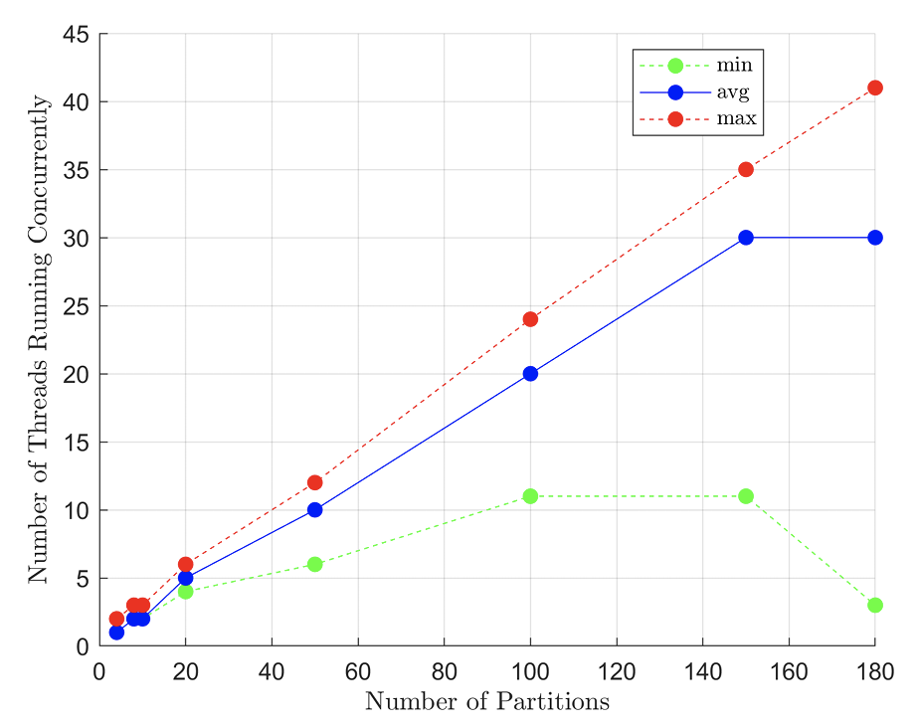
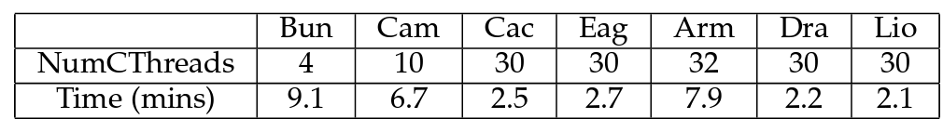
Results: Effect of Parameters
Time vs. Threading
  Since not all threads run concurrently (race), no linear relationship between # threads/partitions and amount of acceleration
  E.g., if there are 100 partitions, avg # threads per batch is ~30
  6-node cluster for higher parallelization (~7x speedup)
    Elimination of context switches and interleaving of ~30 threads over the 4 cores of a single PC //4 cores require about 7 passes (4x7 + 2), avoided via clustering
36/46
Notes:
However, since not all threads run concurrently, due to race condition prevention, there is no linear relationship between the # threads and acceleration amount. For instance, if there are 100 partitions, average # threads per batch is about 30.
To eliminate context switches and interleaving of ~30 threads over 4 cores of our single PC, we also utilize a 6-node cluster, obtaining about 7 times speedup. This is because our 4-core PC requires about 7 passes to reach 30 whereas cluster already has that many physical cores. Note that, Bunny model does not improve at all as our original 4-core PC is already capable of allocating 1 core to each of the 4 concurrent threads.

Slide 37

Results: Comparisons
37/46
Notes:
We now compare with the existing 3 methods, last 2 of which do not produce a mesh. They simply highlight the samples they selected to live on the simplified domain. Lescoat, on the other hand, is the closest work as it does proudce a mesh like we do. The similar the functional map matrices to being diagonal, the better the spectrum preservation is. Similarly. The closer the 2 norms below to zero, the better the preservation is. With these in mind, we outperfom the others here and in general.

Slide 38

Results: Comparisons
38/46
Notes:
Results in the same format for a different model. //The closer the functional map to a diagonal matrix, the better the spectrum is preserved. Similarly, the closer the norm values are to zero, the better the spectrum is preserved.

Slide 39

Results: Comparisons
39/46
Notes:
The first 100 eigenvalues of the Laplacian operator obtained on the original reference mesh and its coarsened versions by different methods including ours, which is the best performer.

Slide 40

Results: Comparisons
Although we explicitly preserve 15 eigenvalues, remaining eigenvalues are also preserved as a by-product (100 here and prev)
40/46
Notes:
L2 difference between the original 100 eigenvalues and their simplified versions. We, the blue, are always the smallest so outperform the others. Note that we explicitly preserve 15 eigenvalues but remaining ones are also preserved as a by-product.

Slide 41

Results: Comparisons
Laplacian eigvalues are provably related to surface area
41/46
Notes:
Since Laplacian eigenvalues are related to surface area, we compare our area preservation with Lescoat et al. The other 2 competitors are not eligible here as they don’t produce a surface mesh.
//Although extraction of surface areas from the Laplacian eigenvalues is possible, e.g., through Eq. 41 in Shape-DNA paper, this operation requires extremely high-resolution discretization, which defeats our purpose. We, however, still show the relationship by showing surface area preservation capabilities of us and the only eligible competitor that is able to produce a surface mesh.

Slide 42

Results: More Apps (Eigvals Only)
Shape-DNA descriptor distances into Euclideans via MDS
42/46
Notes:
Let me show you the spectral applications we implemented in order to demonstrate that our coarse spectrum still performs good in low-resolution.
This one uses Laplacian eigenvalues only, to describe each model with Shape-DNA descriptor, which is essentially a list of 15 smallest eigenvalues.
2D MDS embeddings based on our eigenvalues from the simplified models (spheres) and ground-truth eigenvalues from the original models (cylinders). Five models from each class are in use. Representative models simplified to about 1K vertices by our method are shown at left with matching colors. Note also that our algorithm deals well with sharp creases such as the cuboid here.

Slide 43

Results: More Apps (Eigvecs Only)
Spectral clustering (Red-Green), Laplacian Eigenmap and Laplacian embedding (Blue). Original – Ours – Lescoat.
43/46
Notes:
These applications use Laplacian eigenvectors only. Note that our results, middles in triplets, are always more similar to the originals than Lescoat et al.’s results.

Slide 44



Results: More Apps (Eigvals&vecs Both)
Biharmonic distance & HKS w.r.t. green reference vertex
Nodal
sampling:
44/46
Notes:
Finally, here are applications that use both eigenvalues and eigenvectors. Namely distance, descriptor, and sampling applications that still work well with our simplified models.
//Nodal sampling is from the ENIGMA Edelstein paper.

Slide 45
Conclusion and Future Work
Novel spectrum-preserving mesh simplification method
  Considers only eigenvalues
  Considers only a small # eigenvalues
  Proceeds in partitions via threading and elimination for efficiency
  Produces a mesh as output
  Outperforms Liu, Lescoat, Chen in direct eigenvalue comparisons
  Outperforms Liu, Lescoat, Chen in Laplacian commutativity norm
  Chen is best in fmaps eigenvector comparisons, Lescoat fastest
  Slowest even with clustering
Accelerate further via
  Algebraic update rule
  Approximate eigenvalues faster
  GPU implementation
  Parallelize thread batches via synchronization control strategies
Try edge flip and/or different collapse positions
45/46
Notes:
In conclusion, this is the first spectrum-preserving mesh simplification method which is considering the eigenvalues directly, so we believe that this method will benefit the future works built around the eigenvalues.
More concrete future work directions are related to further acceleration and additional remeshing operations for further accuracy.
To reiterate, we considered only eigenvalues, and only a small amount of them. Made the system faster with tricks like partitioning, similar edge elimination, and threading, but still remianed to be the slowest. Lescoat in the comparison suite is the fastest. As far as the accuracy goes, we outperfom all others in direct eigenvalu comparisons and the commutativity norm that uses a compbination of Laplacian eigenvalues and eigenvectors. Functional maps visualizations and the other norm use eigenvectors only and Chen et al. is the best for these metrics.

Slide 46


Thanks
Misranur Yazgan
MS Grad 2022
Yusuf Sahillioğlu
Professor
46/46
Notes:
Here are the people involved Misranur and myself, and thank you for your attention.

