Slide 1
KerGen
‘Kernel Generation’
A Kernel Computation Algorithm for 3D Polygon Meshes
Symposium on Geometry Processing 2024
Merve Asiler and Yusuf Sahillioğlu
Computer Engineering Dept., Middle East Technical University, Turkey

Slide 2
Problem Definition
Kernel of a polygon is the set of points from which all the polygon is visible (line inside)
Sample kernel points.
Non-kernel points.
Any point is in the kernel.
A concave shape with non-empty kernel.
Notes:
Let me first define what the geometric kernel is:
The geometric kernel consists of points within or on the shape boundary that satisfy the following visibility property:
When we draw a line segment from any point within the shape's kernel to any point on the boundary of the shape, the line never exits the shape at any point.
* Since any point in a convex shape can see the whole shape, the kernel of a convex shape euqals to the shape itself. (SHOW a)
* For example, in (b) the red points do not see each other (the line exits the shape), so they are NOT in the kernel.
Yet, the kernel of this concave shape is not empty, since there are the points (like the green point) which can see the whole shape. (SHOW b)
* And in (c), the kernel of the given concave shape is empty since there does not exist any point which can see the whole shape. (SHOW c)
In terminology, we call the shapes whose kernel is non-empty as "star-shaped” shapes.
//The geometric kernel consists of points within or on the shape boundary that satisfy a crucial property:

Slide 3
Problem Definition
Kernel of a polygon is the set of points from which all the polygon is visible (line inside)
Well-studied in 2D. We solve it in 3D for polyhedra.
The shapes whose kernel is non-empty are called star-shaped shapes.
Sample kernel points.
Non-kernel points.
Any point is in the kernel.
(a) A convex shape.
(b) A concave shape with non-empty kernel.
(c) A concave shape with empty kernel.
Notes:
Let me first define what the geometric kernel is:
The geometric kernel consists of points within or on the shape boundary that satisfy the following visibility property:
When we draw a line segment from any point within the shape's kernel to any point on the boundary of the shape, the line never exits the shape at any point.
* Since any point in a convex shape can see the whole shape, the kernel of a convex shape euqals to the shape itself. (SHOW a)
* For example, in (b) the red points do not see each other (the line exits the shape), so they are NOT in the kernel.
Yet, the kernel of this concave shape is not empty, since there are the points (like the green point) which can see the whole shape. (SHOW b)
* And in (c), the kernel of the given concave shape is empty since there does not exist any point which can see the whole shape. (SHOW c)
In terminology, we call the shapes whose kernel is non-empty as "star-shaped” shapes.
//The geometric kernel consists of points within or on the shape boundary that satisfy a crucial property:

Slide 4
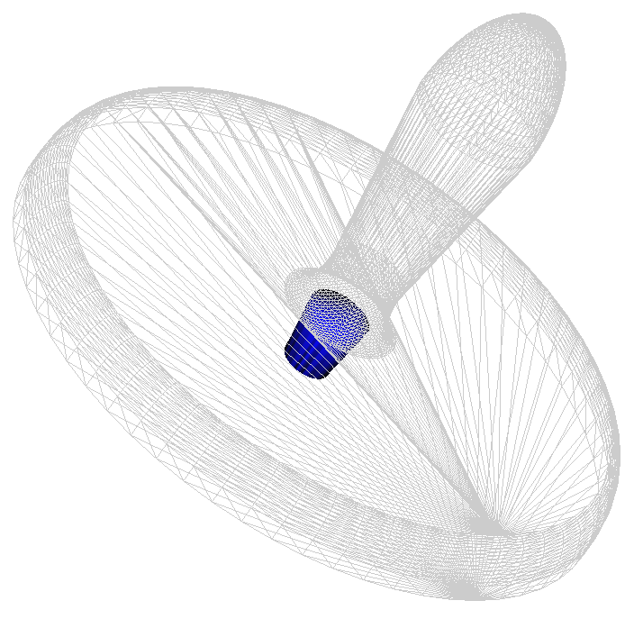
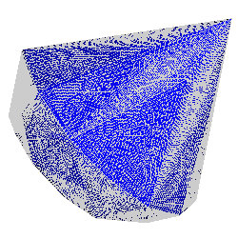
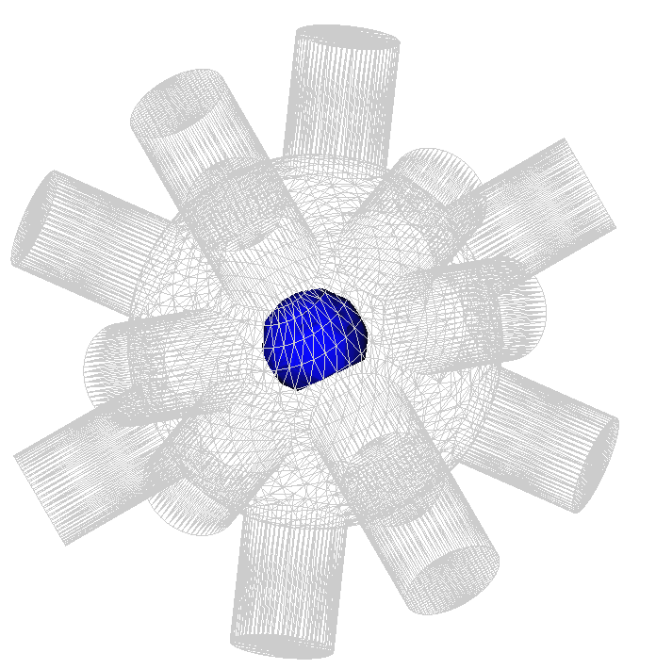
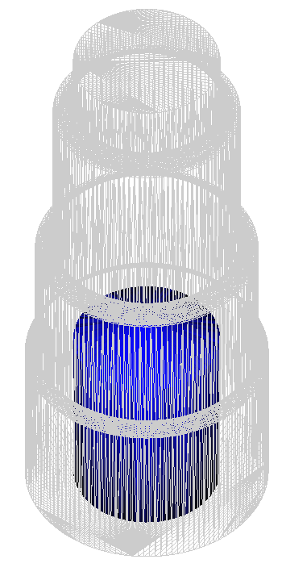
Problem Definition
The blue regions indicate the kernel for each shape.
Notes:
In this slide, the kernels of some meshes embedded into 3D are illustrated. The kernels are colored blue.

Slide 5
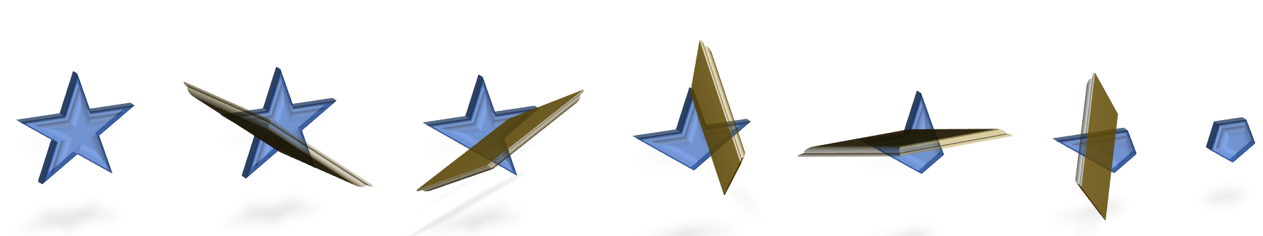
Problem Definition
The kernel is the intersection of the bounding half-spaces of the input mesh.
Notes:
The kernel of a shape is equal to the intersection of all bounding halspaces of the shape.
This property gives us an algebraic definition of the kernel over half-space inequalities.

Slide 6
Applications
KERNEL USAGE
Emptiness Decision
A single kernel point
Different kernel points
Explicit kernel
Self-intersection detection
[Schvartzman et al. 2010]
Star decomposition
[Yu and Li 2011]
Collision-free deformation
[Shapira and Rappoport 1995]
Shape guarding
[Yu et al. 2013]
Spherical parametrization
[Kent et al. 1992]
Planar parametrization
[Livesu 2024]
Polar refinement
in remeshing
[Schneider et al. 2019]
Parametrization Quality
[Praun and Hoppe 2003]
Mesh quality in
FEM & VEM
[Sorgente et al. 2022]
Mesh agglomeration
[Sorgente et al. 2023]
Castable shape
design
[Stein et al. 2019]
Robot Motion
Planning
[Mandal and Bhattacharya 2023]
Notes:
So why is the geometric kernel important? Because it is a very handy tool that can be utilized in solutions of many other geometry processing problems.
It is possible to group kernel-related usecases under 4 categories:
"The decision of whether it is empty or not",
"A single kernel point utilization",
"Using different kernel points" and
"using the explicit kernel representation".
Let’s look at them closer:

Slide 7
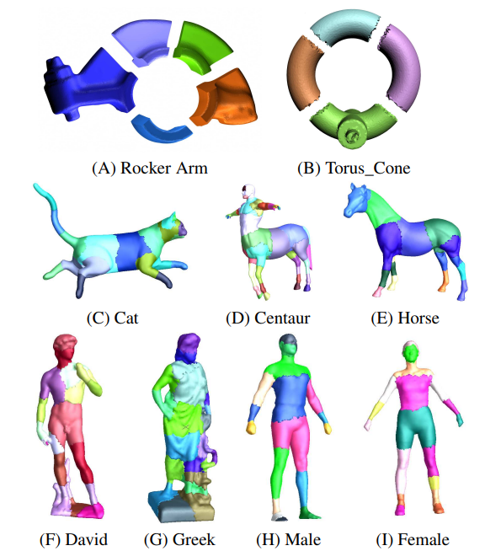
Applications
Use case: Emptiness Decision
Star decomposition
[Yu and Li 2011]
Notes:
While decomposing a shape, boundaries of the decomposed segment could be expanded or shrinked upto the the kernel's existence.

Slide 8
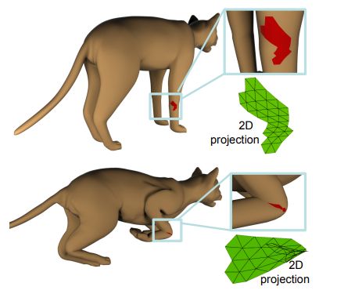
Applications
Use case: Emptiness Decision
Self-intersection detection
over star contours
[Schvartzman et al. 2010]
Notes:
Detection of self-intersection on the shape is one of the examples where the decision of kernel emptiness is applied to.
For instance, in the figure there is shown a 3D object whose boundary mapping onto 2D is given for its two different poses.
In the first pose, there does not exist a self-intersection on the 2D projection and the kernel is non-empty, namely the projection is star-shaped.
However, in the second pose, we see that there is a self-intersection on the 2D projection. This can be deduced from its contours which is not star-shaped.

Slide 9
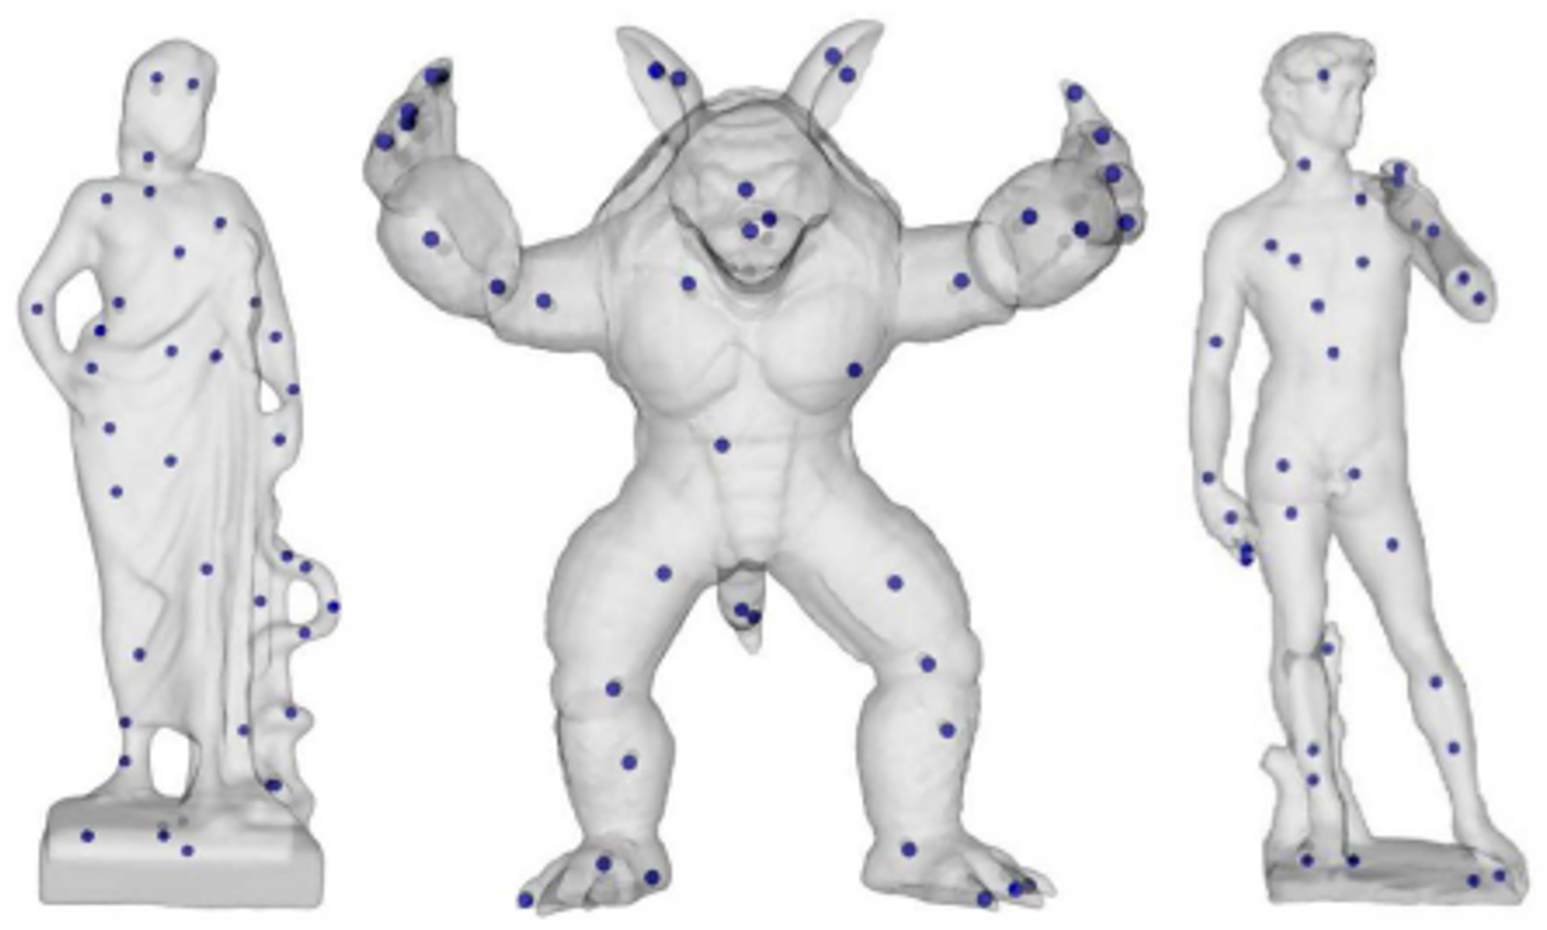
Applications
Use case: A single kernel point
Shape guarding
[Yu et al. 2013]
A single guard (kernel point) for each star segment.
Notes:
As an example to the second category, which is using a single kernel point, we can give the application of shape guarding.
A selected kernel point for each star-piece could be used as a guard by the definition of the kernel.

Slide 10
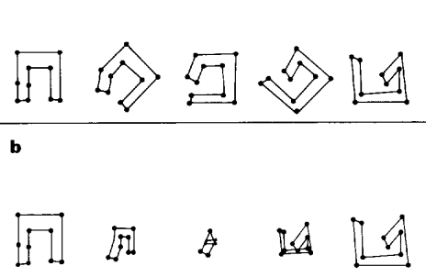
Applications
Source Target
linear vertex interpolation
Use case: A single kernel point
Collision-free deformation
[Shapira and Rappoport 1995]
vertex
interpolation using a single star point for each star segment
distance
angle
kernel point
reference
direction
12
10
5
11
9
4
10
13
3
3
13
12
Defining vertices via a single star point for each star segment preserves angle ordering.
0
1
3
11
9
14
1
2
6
2
14
15
8
15
4
3
2
1
0
1
7
2
5
6
7
8
Notes:
Also, any kernel point in a given shape segment could be used to prevent self-collisions during shape deformation.
It is possible to define each boundary vertex of a shape uniquely over any point in its kernel.
By using the angle from a selected reference direction and the distance from a selected kernel point, we can obtain a unique definition for each vertex.
And when we linearly interpolate this angles and distances during the deformation, the angular ordering between the boundary vertices are preserved.
As a result, we do not see any overlapping vertices or edges (which is caused by the angular ordering is distorted) on the produced animations.

Slide 11
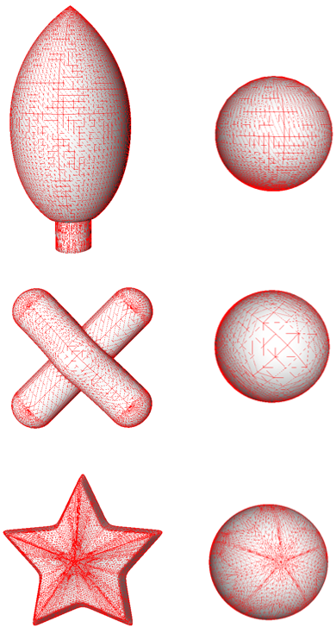
Applications
Use case: A single kernel point
Spherical parametrization
Notes:
Additionally, we can do spherical parametrization of a star-shaped model by using a similar definition of shape vertices over a kernel point.

Slide 12
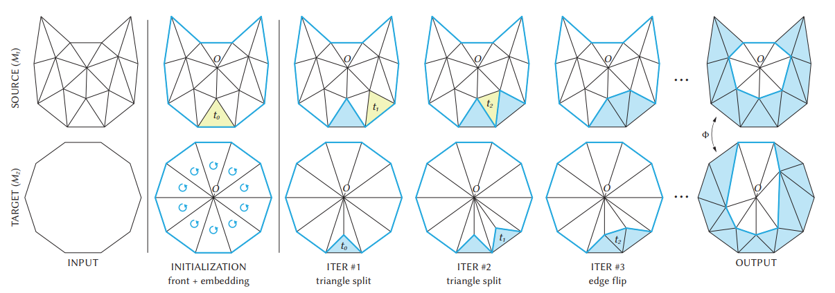
Applications
kernel point
Use case: A single kernel point
Planar parametrization
[Livesu 2024]
Notes:
The similar approach could also be utilized for planar parametrization as shown recently by Livesu.

Slide 13
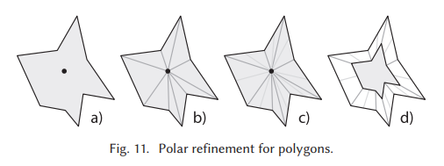
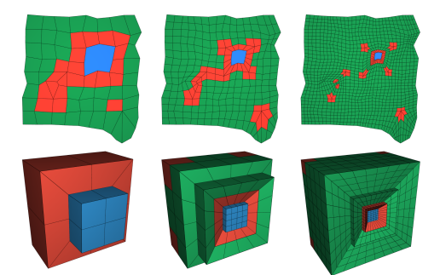
Applications
Use case: Different kernel points
Polar refinement in remeshing
[Schneider et al. 2019]
Notes:
Last 2 applications in fact may also benefit from multiple kernel points as new seed points may be utilized to minimize distortion, like angle distortion
We can similarly see that different kernel points could be used as updated seed points at each iteration for polar refinement in remeshing.

Slide 14
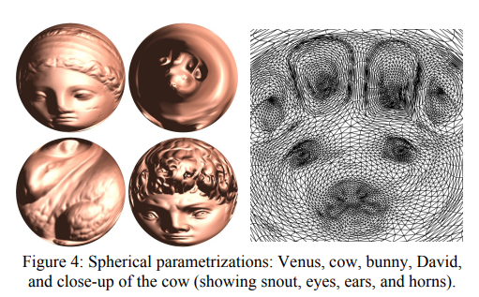
Applications
Use case: Different kernel points
Parametrization Quality
[Praun and Hoppe 2003]
Notes:
Also, a similar approach could be followed to enhance mapping/parametrization and texturing quality.

Slide 15
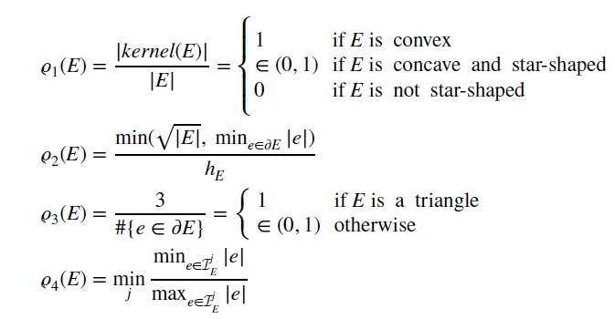

Applications
Use case: Explicit kernel
Mesh quality metric for
FEM, VEM, mesh generation and refinement
[Sorgente et al. 2022]
Notes:
Finally, the kernel itself could be used to define a shape quality metric.
Particularly, Sorgente et al. define a mesh quality metric with kernel size to use in Finite Element Method (FEM) and Virtual Element Method (VEM).
According to this metric, larger kernel indicates a better shape quality. //E: shape, |kernel(E)| is area/volume of the 2D/3D kernel.

Slide 16
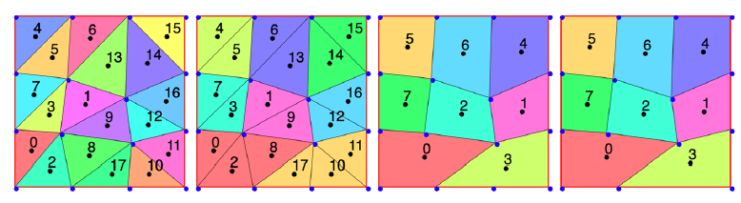
Applications
Use case: Explicit kernel
Mesh agglomeration
[Sorgente et al. 2023]
Notes:
Also, they utilize the same metric in an energy minimization formula for mesh agglomeration, which is essentially a triangle clustering operation.

Slide 17
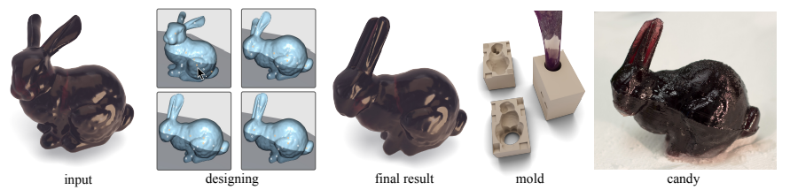
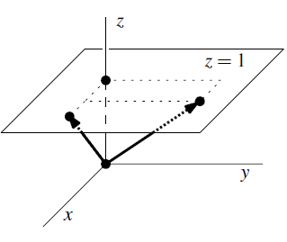
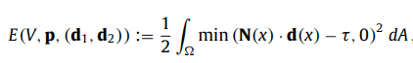
Applications
Use case: Explicit kernel
Castable shape design
[Stein et al. 2019]
N
N
N
N
N
N
N
N
d
N_{x}d_{x} + N_{y}d_{y} + N_{z} ≤ 0.
Notes:
Moreover, we see that castable shape design and kernel definition share a common algebraic framework.
For a shape to be removable freely from its mold in a single direction, the angle between the removal direction and each of the outward face normal of the shape boundary need to be at least 90 degrees.
In order to find a correct direction satisfying this property or re-design the shape to find at least one removal direction, an energy minimization formula could be employed as shown here.
From another perspective, we can transform this setup into kernel computation as follows:
When we consider the plane of cut for a two-piece molding, the removal directions correspond to points on that plane.
For instance let's try to see over the assumption of the cutting plane is the z=1 plane, then the dot product formula turns into a half-plane intersection formula (as you see in the figure).
As a result, finding a removal direction corresponds to finding a point on the kernel's boundary.
Hence, we can build a relation between finding all the possible pairs of "removal direction and cutting point" and the explicit kernel of the shape.

Slide 18
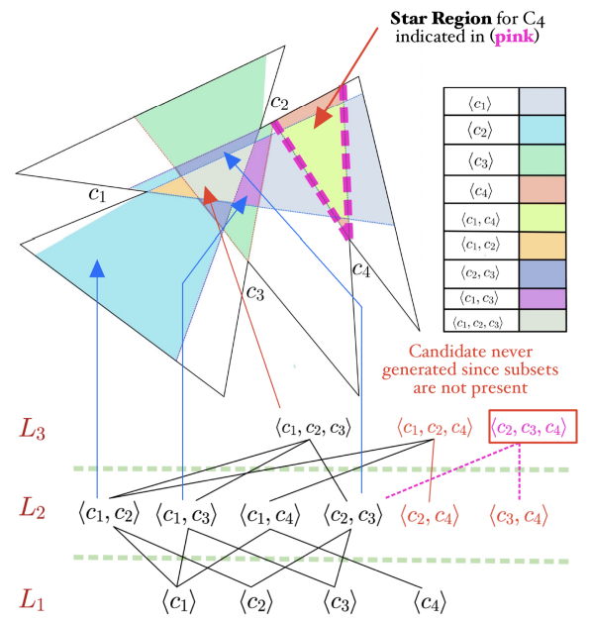
Applications
Use case: Explicit kernel
Robot Motion Planning
[Mandal and Bhattacharya 2023]
Notes:
Lastly, the kernel of a 3D space defines the motion coverage for a robot based on the visibility principal.
Robot's next movements could be determined based on dynamic kernel computations at specific parts of the environment. Also, a kernel-aware space where the robot can move without crashing to any obstacle could be designed over a predefined kernel.

Slide 19
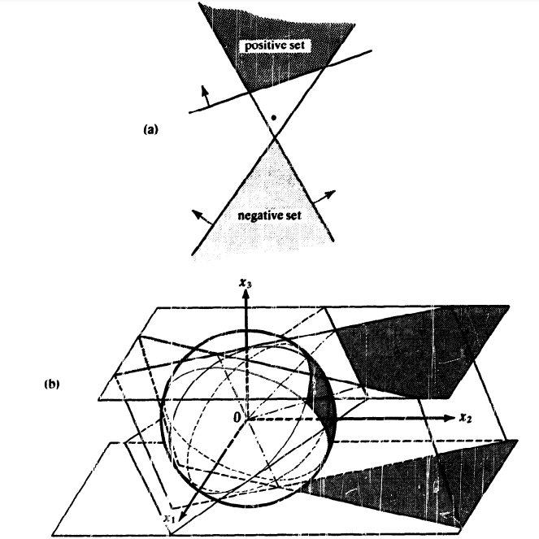
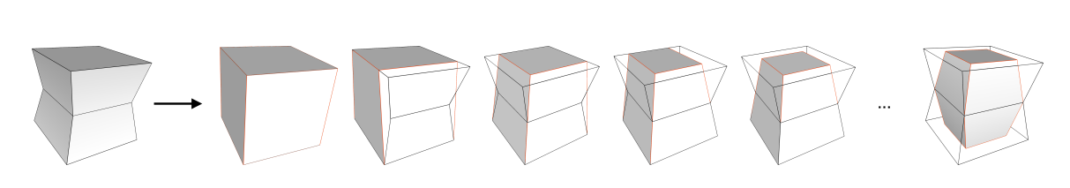
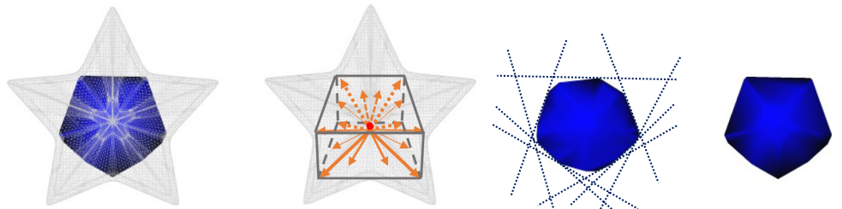
Related Work
Half-space intersection
[Preparata and Muller 1979]
(CGAL)
Algebraic approach
Uses dual conversions
Polyhedron Kernel
[Sorgente et al. 2022]
Subtractive approach
Shrinks the AABB by plane cuts
Kernel Approximation
[Asiler and Sahillioğlu 2024]
Parametric approach
Sends rays and identifies vertices
O(N_{f}logN_{f})
O(N_{f}N_{v})
O(N_{f}N_{r})
Notes:
There exists only a few studies which compute the kernel in 3D:
1. The first study by Preparata and Muller, provides an algebraic algorithm which applies dual conversions between the points and the boundary planes.
The given algorithm has O(N_f log N_f) complexity where N_f is the number of input mesh faces.
2. Another study by Sorgente et al. introduces a geometric approach.
They start from the AABB (axis-aligned bounding box) of the input mesh, and shrink it to the kernel iteratively by cutting with bounding planes of the input mesh.
This subtractive approach has O(N_f N_v) complexity where N_v is the number of mesh vertices.
3. In our very recent study, we present a parameter-based approach, unlike the parameter-free KerGen here.
This one first approximates the kernel surface by sending rays. Next, it aims to identify the kernel vertices by efficient plane-plane intersections in a recursive search.
The complexity is based on the parameter settings:
It has O(N_f N_r) expected time complexity when the search depth is constant and restricted, where N_r is the number of rays.
If we do not put a limit for the recursion depth, in the worst case, its complexity results in O(N_f ^ 3).

Slide 20
Our solution:
KerGen
‘Kernel Generation’
Notes:
In this study, we present a novel algorithm to compute the kernels of polygon meshes in 3D, which is KerGen (short for Kernel Generation).

Slide 21
Overview
KerGen algorithm employs
  Efficient plane-plane and line-plane intersections,
  Point classifications based on their positions relative to planes.
Notes:
KerGen algorithm employs mainly two operations:
1. Efficient plane-plane and line-plane intersections,
2. Point classifications based on their positions relative to planes.

Slide 22
Contributions
KerGen algorithm employs
  Efficient plane-plane and line-plane intersections,
  Point classifications based on their positions relative to planes.
Significantly faster execution times
→ Earlier availability of the kernel
Efficiency
Notes:
Our main contributions are as follows:
1. The experiments show that it is faster than the competitors, CGAL and Polyhedron Kernel.

Slide 23
Contributions
KerGen algorithm employs
  Efficient plane-plane and line-plane intersections,
  Point classifications based on their positions relative to planes.
Significantly faster execution times
→ Earlier avaliability of the kernel
Kernel generation starting from any point and any direction
→ Kernel-aware shape design; given the kernel, how to design a shape?
Efficiency
Flexibility
Notes:
2. It can start the generation at any point. So, from a reverse perspective, based on a desired visibility, one can design a kernel-aware shape by tracing the source kernel.

Slide 24
Contributions
KerGen algorithm employs
  Efficient plane-plane and line-plane intersections,
  Point classifications based on their positions relative to planes.
Significantly faster execution times
→ Earlier avaliability of the kernel
Kernel generation starting from any point and any direction
→ Kernel-aware shape design; given the kernel, how to design a shape?
Incremental addition of kernel vertices and edges
→ Provides partial kernel at any stage and kernel analysis on-the-way
Efficiency
Flexibility
Additiveness
Notes:
3. And KerGen is additive, which discriminates it from the others. This way, KerGen always provides partial kernels at any intermediate step, with which one can analyze the kernel, e.g., minimum dihedral angle so far.

Slide 25
Method
KerGen operates mainly by identifying the largest enclosing 3D, 2D, and 1D ball centered around a given kernel point while remaining within the kernel.
The region which is guaranteed to be in the kernel
F₄
s₄
F₃
F₀
s₀
s₃
p₀
p
s₂
s₁
F₂
F₁
(a) 3D
Notes:
The main idea behind the KerGen is the following:
For a point p in the kernel, its projection to the closest bounding plane is also in the kernel (SHOW figure 4a).
(This is due to the fact that the kernel is intersection of all the bounding planes.)

Slide 26
Method
KerGen operates mainly by identifying the largest enclosing 3D, 2D, and 1D ball centered around a given kernel point while remaining within the kernel.
The region which is guaranteed to be in the kernel
F₄
F₄
s₄
F₃
F₀
F₀
s₄
s₃
s₀
s₃
s₂
p₀
p
p₀
F₃
s₁
s₂
F₂
F₁
p₁
s₁
F₁
F₂
(a) 3D (b) 2D
Notes:
It is also possible to snap the same idea to a plane (2D):
We establish the largest kernel neighborhood on a plane by selecting the minimum distance among the shortest distances to intersecting planes (SHOW figure 4b).

Slide 27
Method
KerGen operates mainly by identifying the largest enclosing 3D, 2D, and 1D ball centered around a given kernel point while remaining within the kernel.
The region which is guaranteed to be in the kernel
F₄
F₄
F₅
s₄
F₀
F₄
F₃
F₀
F₃
F₀
s₃
F₂
s₀
s₃
s₄
p₀
p
s₂
F₃
p₀
p₂
s₁
p₁
s₂
F₂
F₁
p₁
F₁
s₁
F₁
l_{0,1}
F₂
(a) 3D (b) 2D (c) 1D
Notes:
And similarly in 1D, we apply the same idea on a line to identify the largest neighborhood along the line by considering the closest distance among the common points of intersecting planes with the line (SHOW figure 4c).
In KerGen, we mainly use this 1D version of the idea given here while tracing the kernel lines, namely the lines on which the kernel edges stand.
(You can find its proof in the paper.)

Slide 28
Method
n_{SIDE}
The idea in 1D is the ‘main strategy’ that we apply throughout the algorithm:
For each kernel vertex:
  Label the generator planes as F_{BASE}, F_{SIDE} and F_{BACK}.
  For each pair of F_{BASE} and F_{SIDE:}
    Trace their intersection line to the opposite direction of F_{BACK}.
    Conclude the traversal at the nearest intersection point, which becomes another kernel vertex.
n_{BACK}
F_{SIDE}
n_{BASE}
F_{BACK}
the line to be traced
n_{BACK}
F_{BASE}
v
n_{BASE}
Initial kernel vertex [Berg et al. 1997]
Notes:
As long as it is not desired to form the kernel of the shape, or a segment of it, to be formed around a specific point of the shape, the 2D & 3D versions of the main idea could be eliminated.
Therefore, in our implementation we begin with selecting an initial kernel vertex using Berg et al.'s incremental linear programming algorithm.
Subsequently, we identify the generator planes passing through the vertex and trace the intersection lines of these planes.
(For the below part SHOW Figure 5 one-by-one:)
For each kernel vertex (SHOW vertex v):
Label the generator planes as FBASE, FSIDE and FBACK, alternatingly.
For each pair of FBASE and FSIDE:
Trace their intersection line to the opposite direction of FBACK (SHOW the green arrow).
Conclude the traversal at the nearest intersection point, which becomes another kernel vertex (SHOW immediately the next slide).

Slide 29
Method
n_{SIDE}
Use Shewchuk’s predicates [Shewchuk 1997] to find the direction to trace and the nearest intersection point on the line.
For the newly discovered vertices, apply the same procedure.
Iteratively generate all the kernel boundaries by tracing the edges adjacent to kernel vertices.
  Enabling to confine the exploration solely to the kernel's surface,
  Efficiently traversing the kernel boundaries,
  Avoiding from intersection operations in non-kernel regions of the mesh.
n_{closest}
n_{BACK}
F_{SIDE}
n_{BASE}
F_{closest}
F_{BACK}
the line to be traced
n_{closest}
n_{BACK}
v_{closest}
F_{BASE}
v
n_{BASE}
Output-sensitive
O(N_{f}K_{e})
Notes:
Here you see the the closest plane on the traced direction (SHOW green F_closest).
In this operation, the important thing is, we use Shewchuk’s predicates to find both the direction to trace and the nearest intersection point on the line.
Thanks to this approach, it enables KerGen implementable in a totally robust way, which is a future plan (by the way).
In the rest of the algorithm, for the newly discovered vertices (SHOW the green vertex v_closest), we apply the same procedure.
In this way, we iteratively generate all the kernel boundaries (by tracing the edges adjacent to kernel vertices).
As it is seen, this approach provides:
Confining the exploration solely to the kernel's surface,
and so, efficiently traversing the kernel boundaries by avoiding from intersection operations in non-kernel regions of the mesh.
We traverse all the kernel edges only once. And for each edge we check as many line-plane intersections as the number of input mesh faces.
Therefore, we can conclude that the complexity of KerGen is output-sensitive. It is (?expected time?) O(N_f K_e) where K_e is the number of kernel edges.

Slide 30
Method
If there are > 3 generators:
  For each candidate pair of F_{BASE} and F_{SIDE}:
    Use two test points on their common line, one per each side of the vertex.
    F_{BASE} and F_{SIDE} are valid if at least one of the two points should fall to the front side of each other generator.
    Choose F_{BACK} among from the other generators which separate the test points to the different sides.
F₂
F₂
F₃
F₃
F₄
F₀
F₄
F₀
l_{2,3}
l_{0,4}
l_{3,4}
l_{0,2}
l_{1,2}
v
v
l_{1,2}
l_{1,3}
l_{1,3}
l_{1,4}
l_{1,4}
F₁
F₁
Planes intersecting along a line
(b) Planes coinciding
at a single point
Notes:
Also, we take into consideration the edge-cases where there are more than three generators for a vertex:
In those cases, for each candidate pair of FBASE and FSIDE:
We use two test points on their common line, one per each side of the vertex (SHOW any green direction vector in Figure-6, SHOW its upper and lower parts, referencing v).
We can consider that the current FBASE and FSIDE are valid if at least one of the two test points falls to the front side of each other generator planes.
Then we choose FBACK among from the other generator planes which separate the test points to the different sides.
(We give the proof of why this idea works in the paper.)
(SHOW on Figure-6)
For example, in the figure F_1 and F_4 could be labeled as FBASE and FSIDE. And F_0 could be selected as F_BACK for this configuration while following the line l_1,4 in the given direction.

Slide 31
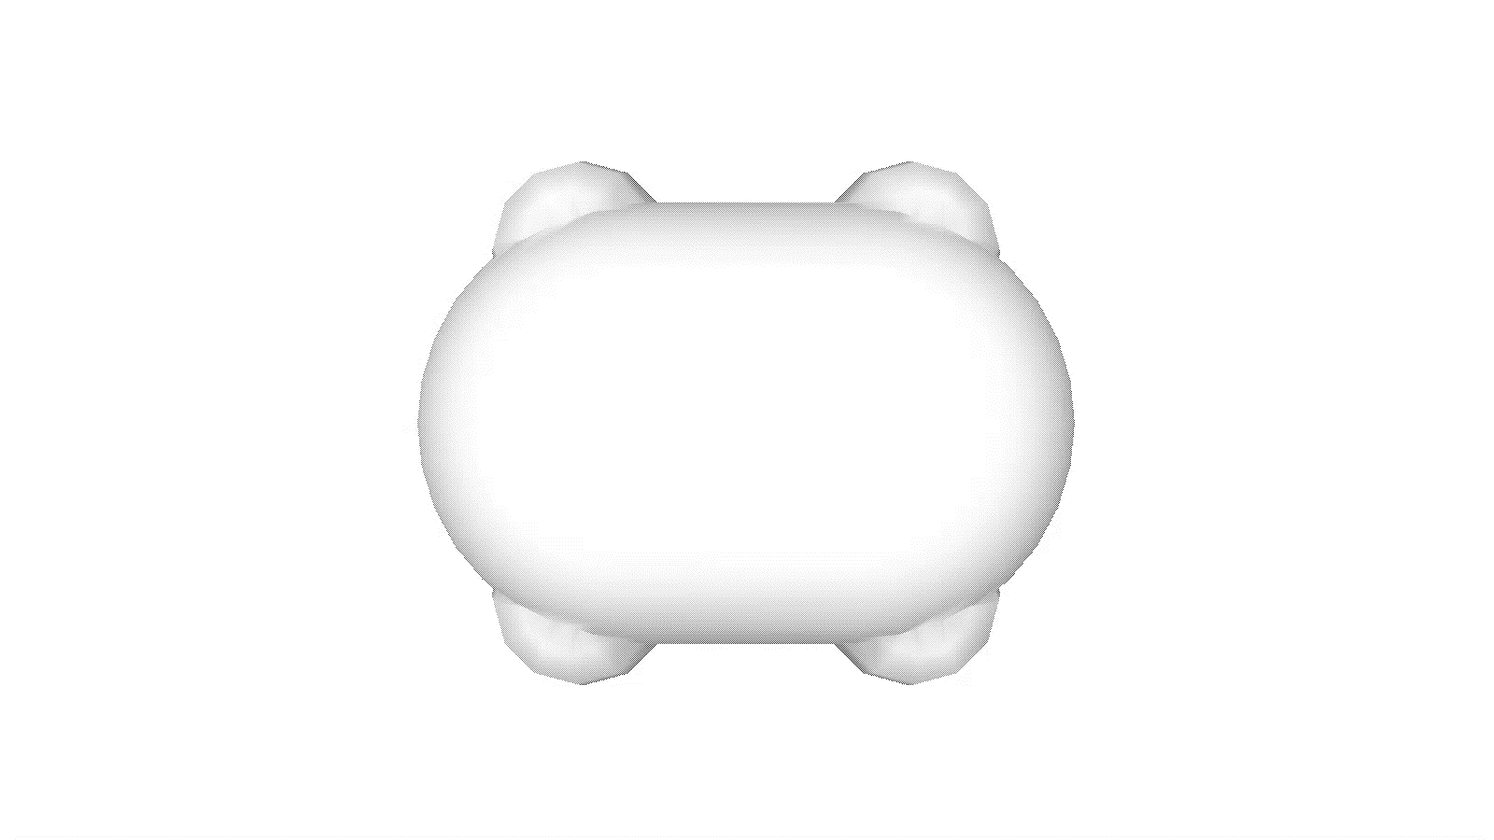
KerGen’s Iterative Progress
Model: Flex
Notes:
Here you see iterative (additive) edge tracking progress on various models.

Slide 32
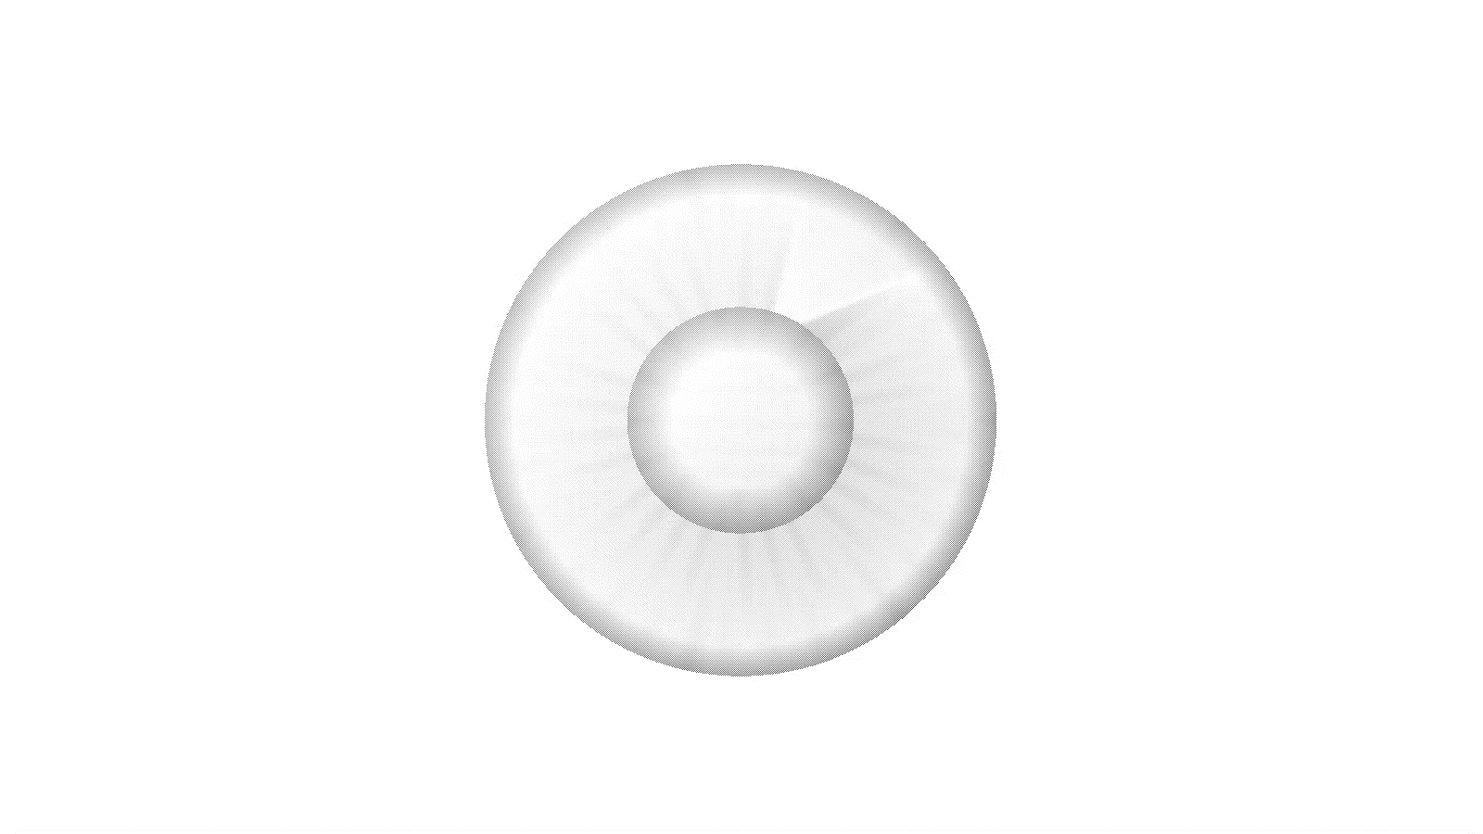
KerGen’s Iterative Progress
Model: Bot Eye
×4 times
accelerated

Slide 33

KerGen’s Iterative Progress
Model: Super Ellipse
×3 times
accelerated

Slide 34
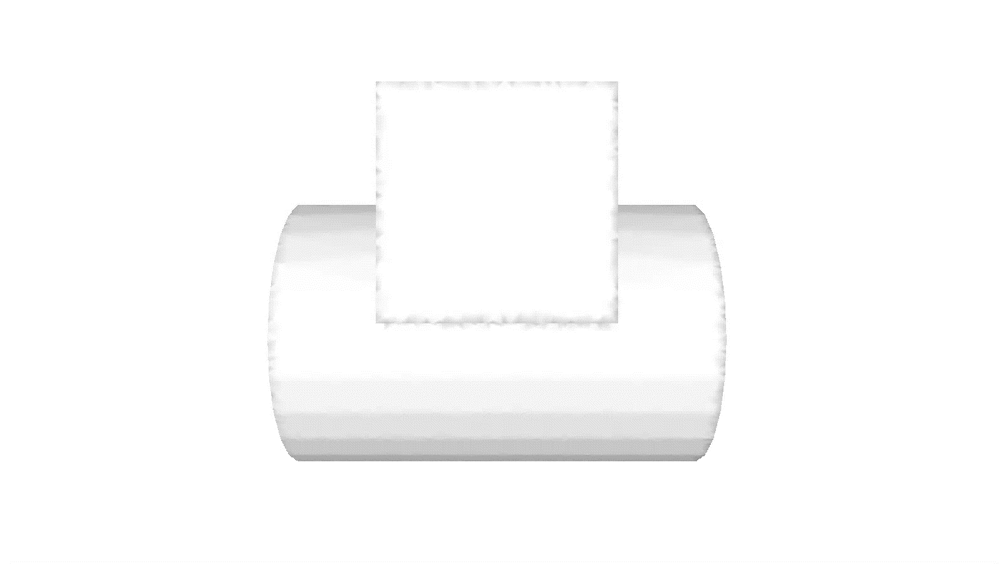
KerGen’s Iterative Progress
Model: Cube on Cylinder
×2 times
accelerated

Slide 35
Experiments
Notes:
Now, let me show you the experimental results of KerGen.

Slide 36
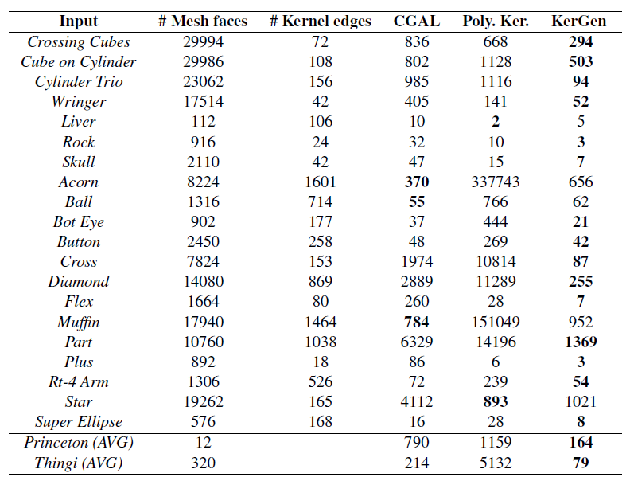
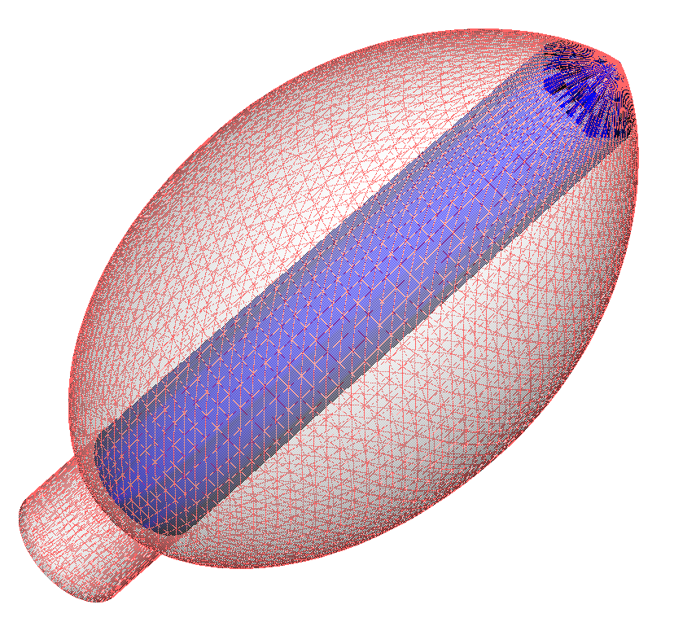
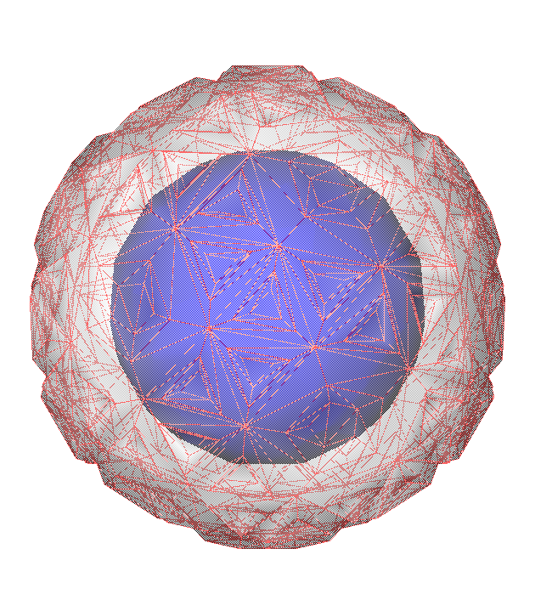
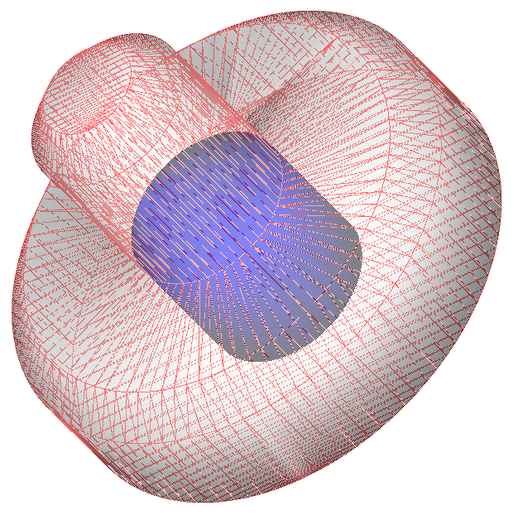
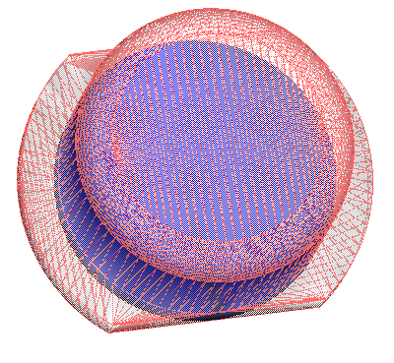
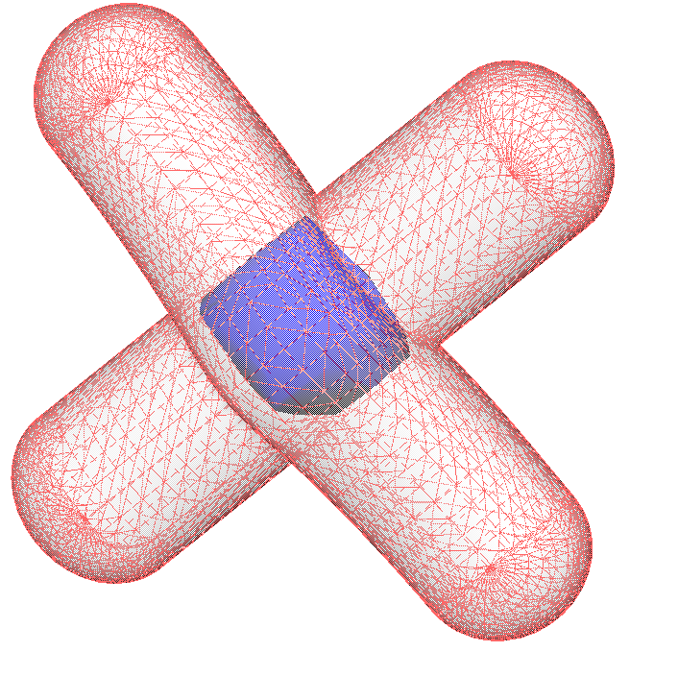
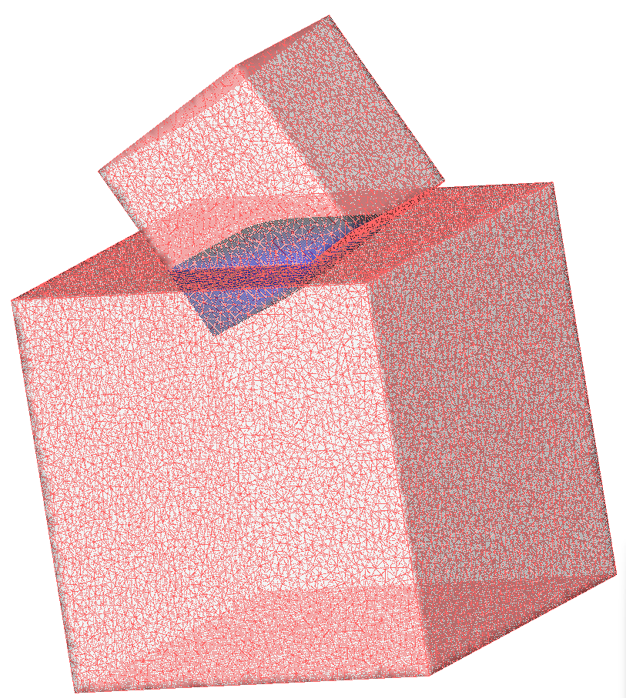
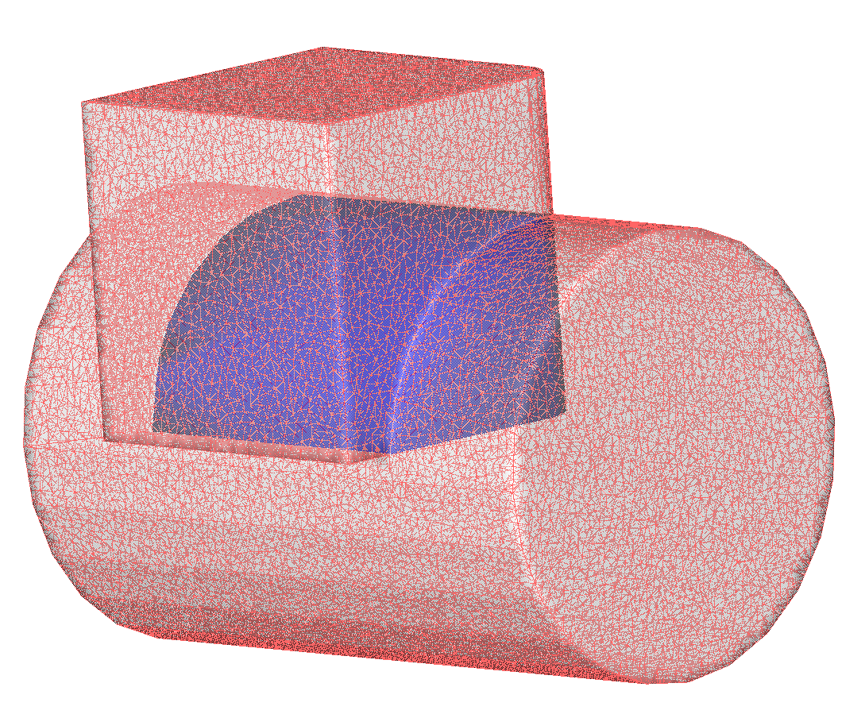
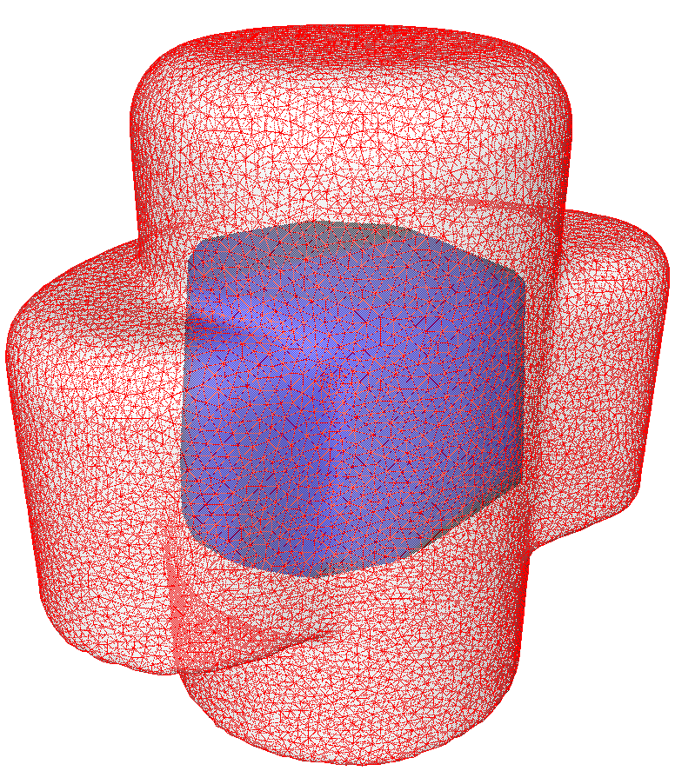
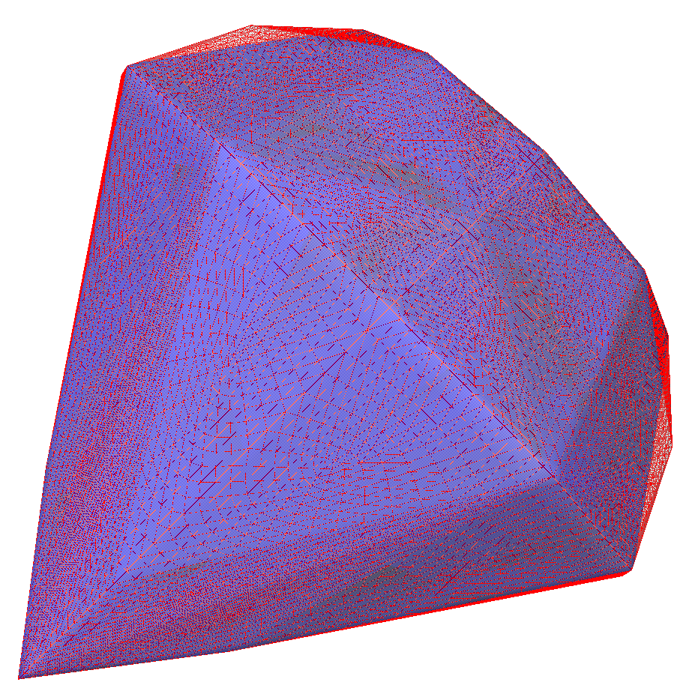
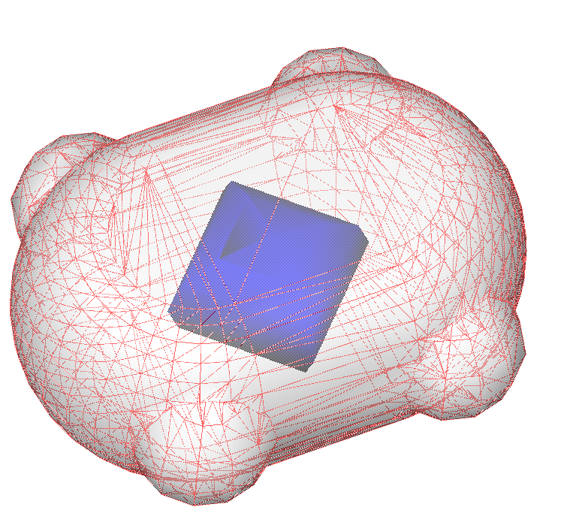
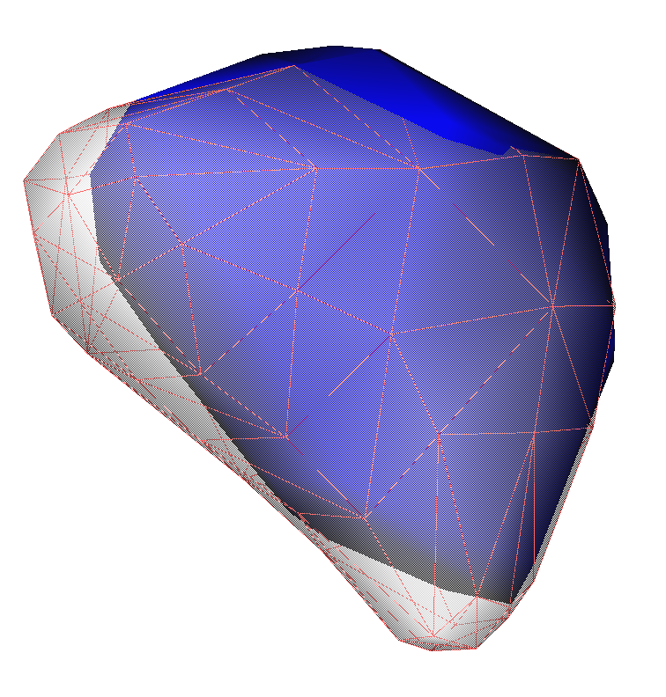
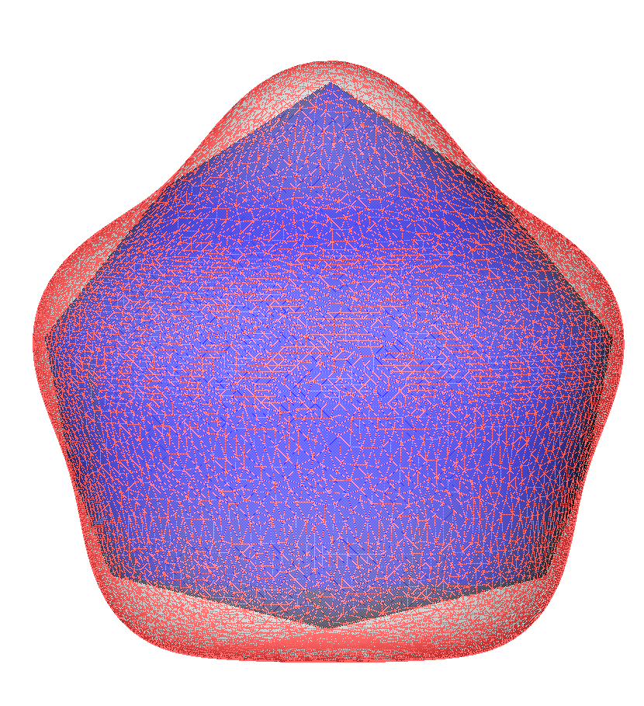
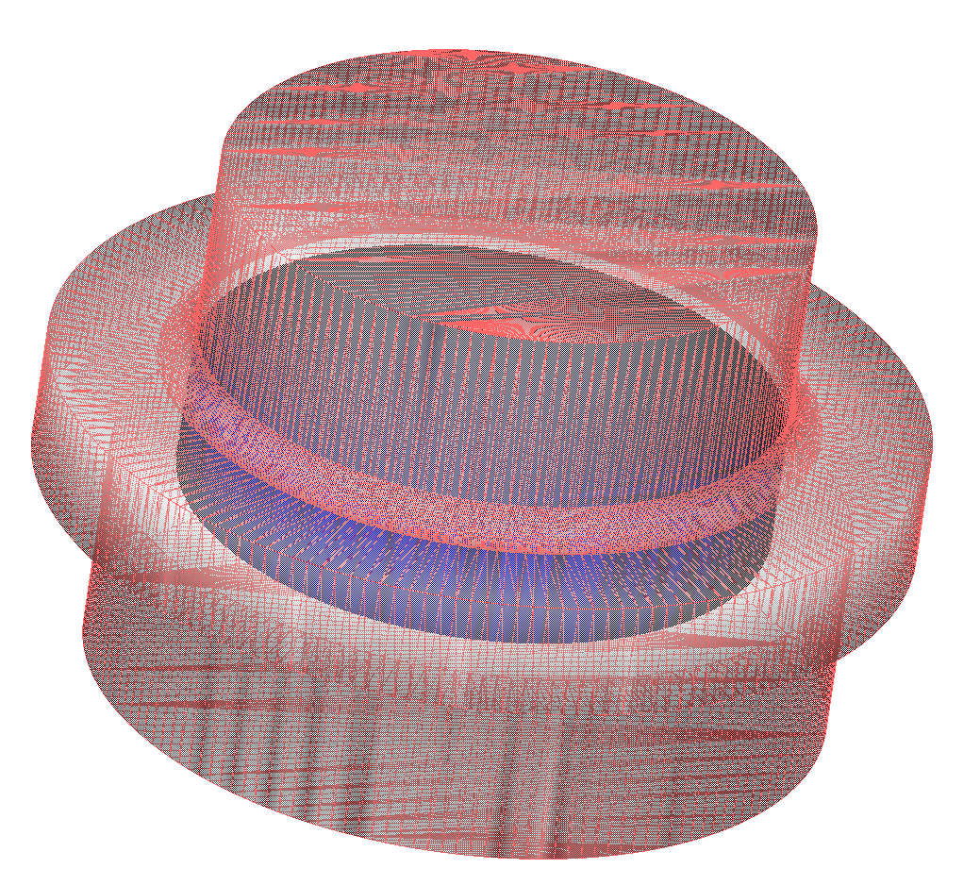
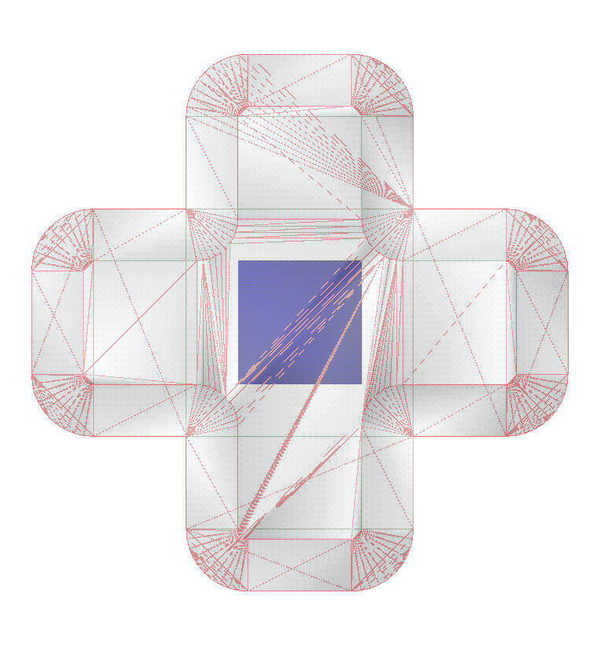
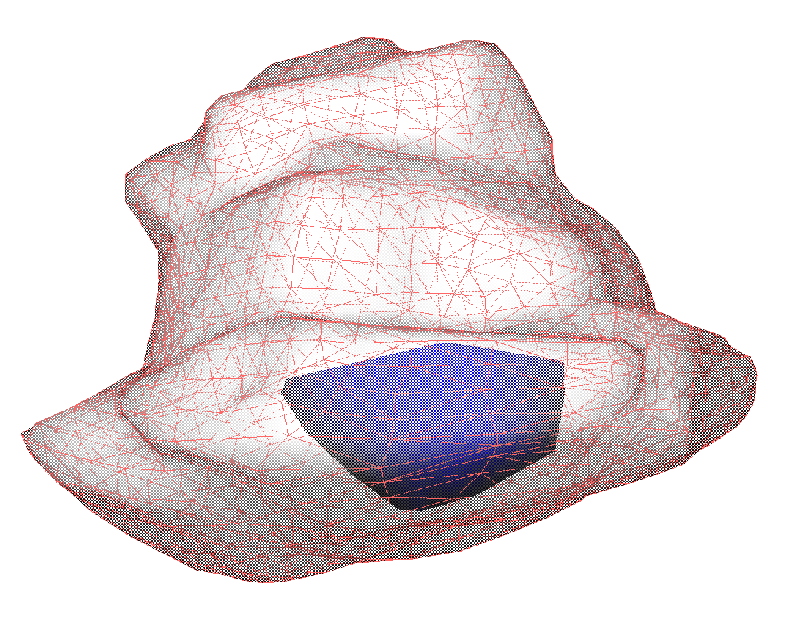
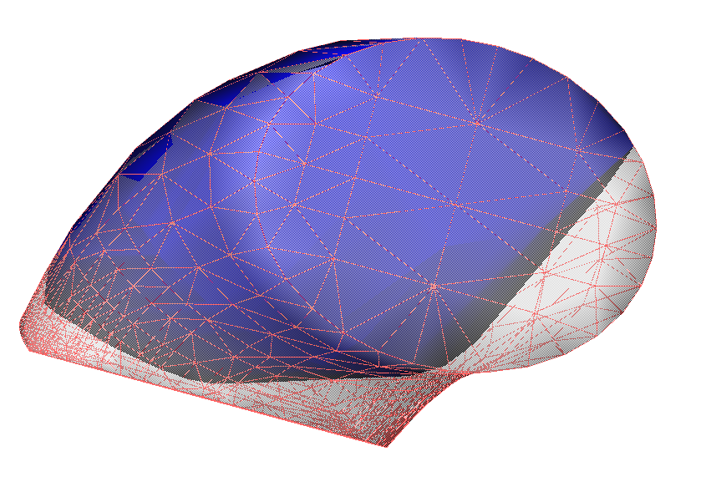
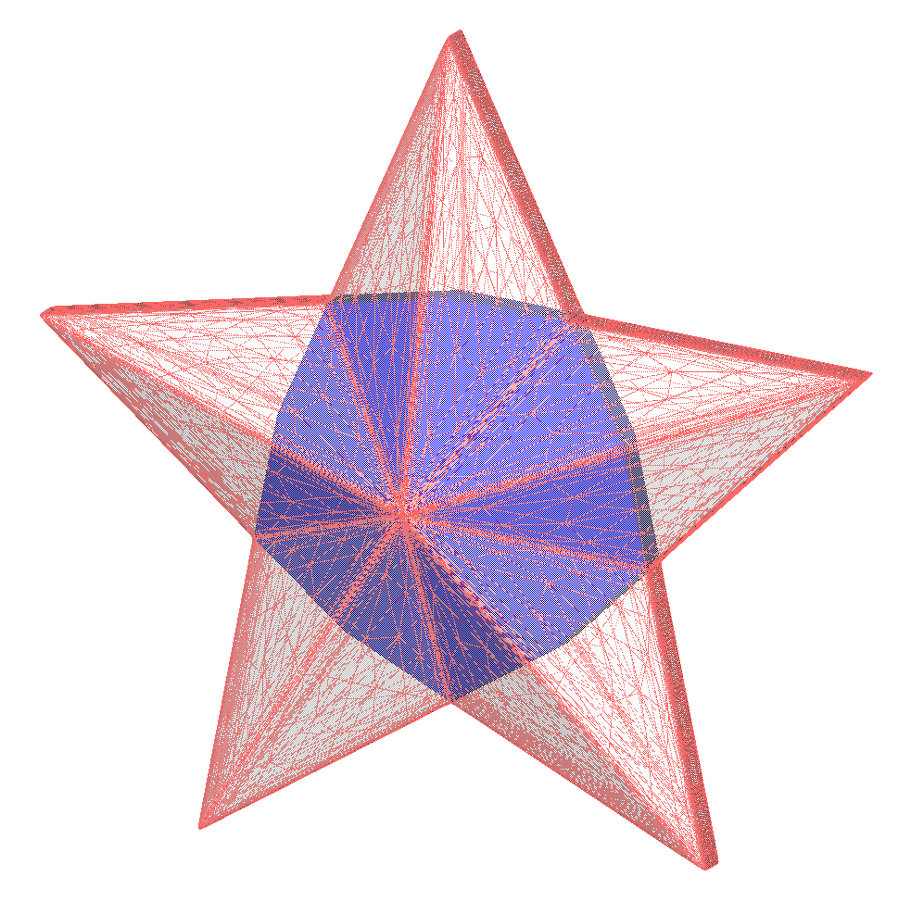
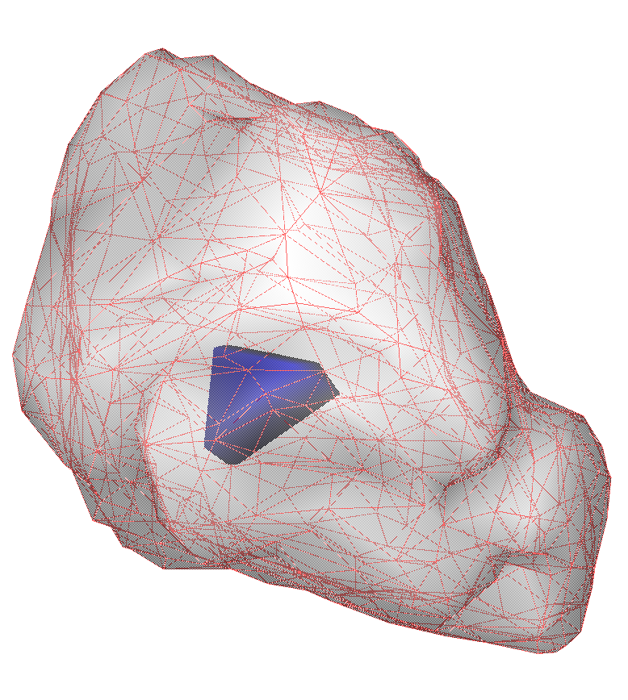
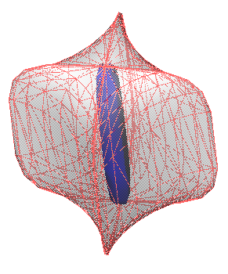
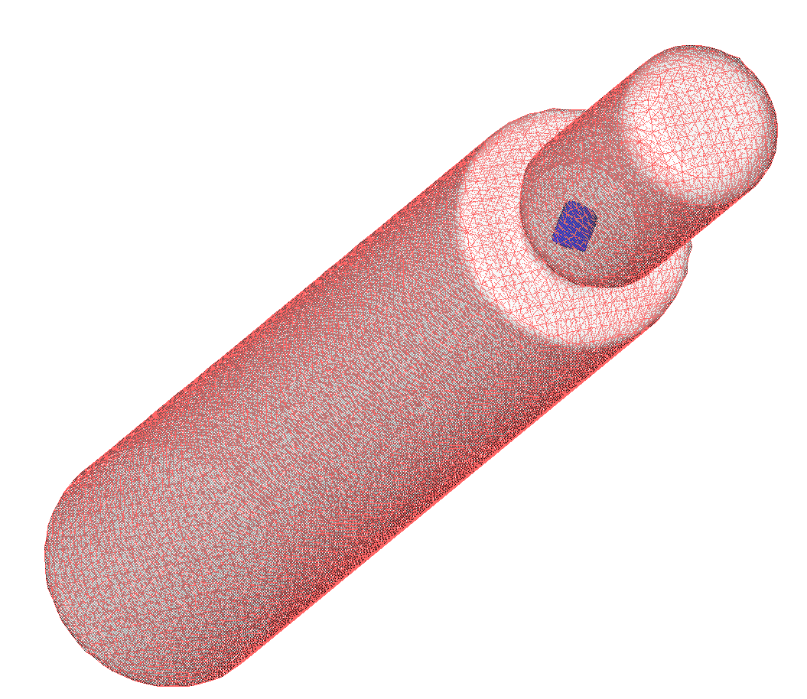
Timing Performance
Acorn Ball Bot Eye Button Cross
Crossing Cubes Cube on Cylinder Cylinder Trio Dimond Flex
Liver Muffin Part Plus Rock
Rt-4 Arm Star Skull Super Ellipse Wringer
Timing results (ms) for various star-shapes.
Representative kernels computed by KerGen.
Notes:
The table shows the timing comparisons for CGAL, Polyhedron Kernel and KerGen (SHOW Table-1).
And, the corresponding models with their computed kernels by KerGen are shown in the figure (SHOW Figure-7)
It is clearly seen that KerGen outperforms the other two algorithms for most of the input meshes.
We can say that the performance of kernel computation algorithms is significantly affected by the geometry of the input mesh and output kernel, as well as the number of bounding planes.
Polyhedron Kernel exhibits an advantage for small-sized meshes (SHOW liver model) and large sized meshes with many co-planar faces (SHOW star model).
And CGAL is preferable for meshes whose kernel features a rounded shape (SHOW acorn, ball, muffin models).
However, KerGen generally outperforms both algorithms, particularly for input meshes with small-sized kernels as a result of its efficient output-sensitive structure.
(By the way, the results given here belong to the implementations which employ inexact constructions with inexact predicates for all of the three algorithms - namely floats/doubles.
For all the three algorithms, we observed 1e-5% of volumetric difference and Hausdorff distance on the outputs, in average.)
While we do timing comparisons with CGAL's single_precision<double> configuration (namely inexact constructions and inexact predicates), we use its exact_predicates_exact_constructions configuration for ground truth.

Slide 37
Timing Performance
Thingi [Zhou et al. 2016, Sorgente et al. 2022]
Princeton [Chen et al. 2009]
10⁴
10³
10²
1
Time (ms)
10⁴
10³
10²
1
Time (ms)
10 10² 10³ 10⁴
10³ 10⁴ 10⁵
# Faces
# Faces
Notes:
And in this slide, you see the overall performance of all the mentioned algorithms along Thingi and Princeton datasets.
Again, it is possible to see KerGen's superior performance on both datasets.

Slide 38
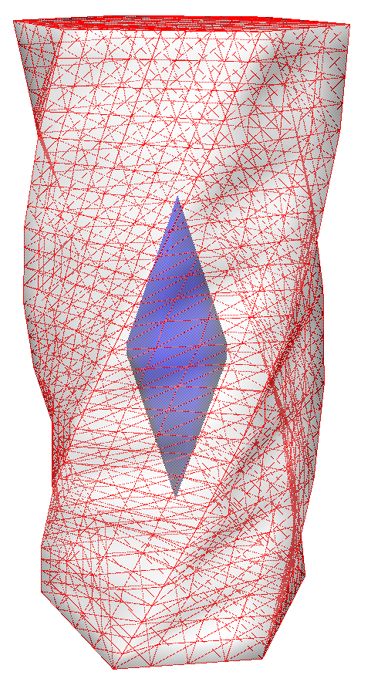
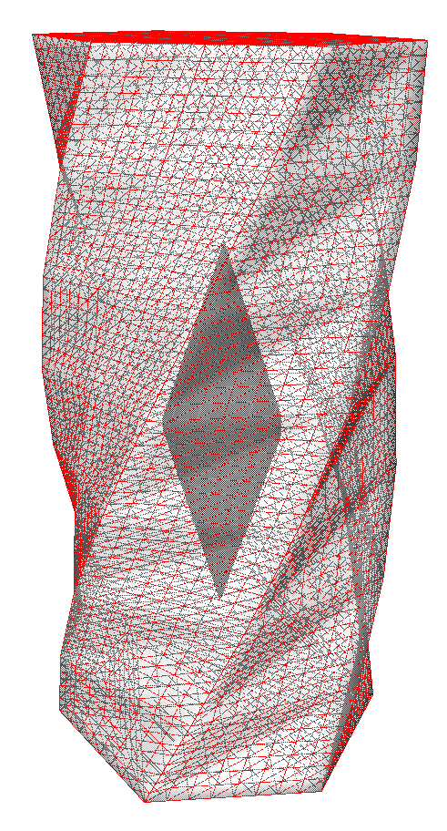
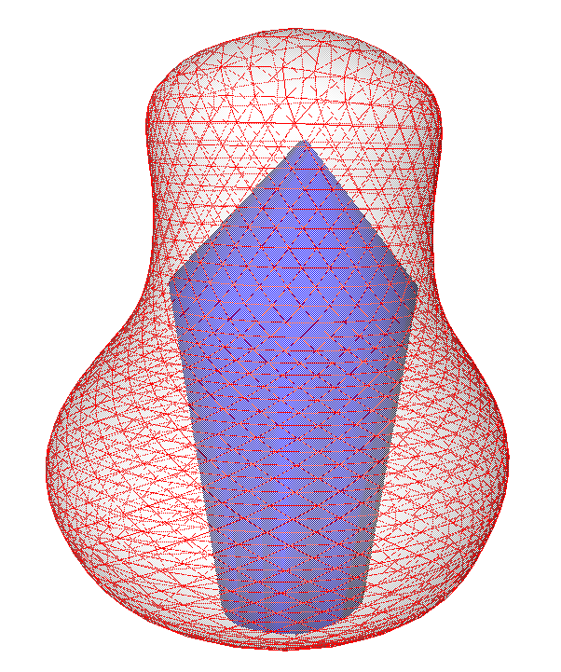









Timing Performance
Spiral
Vase
10⁴
10²
1
10⁶
10⁴
10²
1
Time (ms)
Time (ms)
10² 10⁴ 10⁶
10² 10⁴ 10⁶
# Faces
# Faces
Timing comparisons for the refinements of Spiral and Vase models.
Notes:
Also, we observed the performance changes along the refinements of the same models.
Each refinement is obtained increasing the number of mesh faces approximately 4 times more than the previous.
(For refinements of spiral model each plane is divided into 4, while for vase model Loop's subdivision is used.)
Clearly, you can see that the performance of all the three algorithms show an almost linear increase when the number of mesh faces increase.
KerGen is again faster than the other two for the refinements.

Slide 39

Timing Performance
Thanks to our efficient approach, our additive algorithm, initiated with a kernel point, immediately determines non-star-shaped input at the first stage.
We utilize [Berg et al. 1997]’s linear programming solution for this stage, which runs instantly.
In contrast, competitor algorithms like CGAL and Polyhedron Kernel, which rely on algebraic transformations and carving-based subtractions, respectively, reach this determination at a later stage.
Average timing results (ms) for non-star-shapes.
Notes:
On the other hand, for non-star shapes, KerGen can immediately determine empty kernel.
Since we initiate KerGen with an initial point inside the kernel, it terminates in case that such a point does not exist.
On the other hand, the other algorithms (CGAL and Polyhedron Kernel) proceed their regular schedules until reaching an empty set.
As we said, in order to find a kernel point we utilize Berg et al's method. The table shows the average timings for all algorithms (SHOW Table-2)

Slide 40

Visual Comparisons
Model: Rock
Ground Truth
KerGen
Notes:
Here we illustrate the high accuracy of KerGen on various models.
(As the ground truth, we use CGAL with its exact configurations, this time).

Slide 41

Visual Comparisons
Model: Muffin
Ground Truth
KerGen

Slide 42

Visual Comparisons
Model: Flex
Ground Truth
KerGen

Slide 43

Visual Comparisons
Model: Cross
Ground Truth
KerGen

Slide 44
Discussions
Risk: Current configuration is not robust.
  Inexact predicate checks and plane intersections may result in:
  Incorrect point classifications and plane labeling
  False line generations and tracings,
  Gaps, non-manifold edges, or divergences.
  These are also the possible cases for current experimented configurations of CGAL and Polyhedron Kernel.
(Despite non-robust settings, we have not observed any significantly distorted output (1e-5%) in our tests.)
Solution: Use exact configurations OR indirect predicates [Attene, 2020]
Apply the predicates in kernel line and vertex constructions.
Notes:
KerGen’s current configuration relies on inexact computations, which may pose concerns regarding robustness.
This is because inexact predicate checks and plane intersections may result in:
Incorrect point classifications and plane labeling
False line generations and tracings,
Gaps, non-manifold edges, or divergences.
These are also the possible cases for current experimented configurations of CGAL and Polyhedron Kernel.
By the way, despite non-robust settings, we have not observed any significantly distorted output (1e-5%) in our tests.
As a potential efficient solution Attene's indirect predicates could be employed.
Those predicates could used in operations dependent on line generating intersections.
Although those predicates support one level of indirection, the kernel line and vertex constructions employed in KerGen can be defined solely based on the generator planes.
And the identifications of the generator planes are not affected by cascading computations.
We believe that with this approach, KerGen offers high-performance results while preserving robustness.

Slide 45
Conclusions
In conclusion:
Our findings highlight the notable quality of our approach, characterized by
  High accuracies,
  Fast executions, outperforming both CGAL and Polyhedron Kernel.
Thanks to its ‘additive’ structure, we believe that KerGen has significant potential in various computer graphics applications such as:
  Star-shape decomposition,
  Castable shape reconstruction,
  Kernel-aware shape design,
  Robot motion planning.
Notes:
Just could be readable from the slide.

Slide 46


Thanks…
Merve Asiler
Looking for a PostDoc
Prof. Yusuf Sahillioğlu
Supervisor
Research & Teaching Assistant at Computer Eng.
BS degrees in Mathematics and Computer Eng.
MS degree in Computer Eng.
PhD degree in Computer Eng.
Middle East Technical University, Turkey
Professor at Computer Eng., Middle East Technical University

