Slide 1
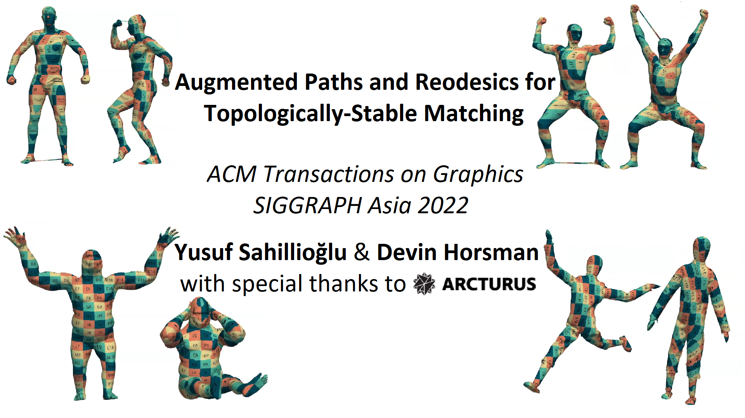

Slide 2
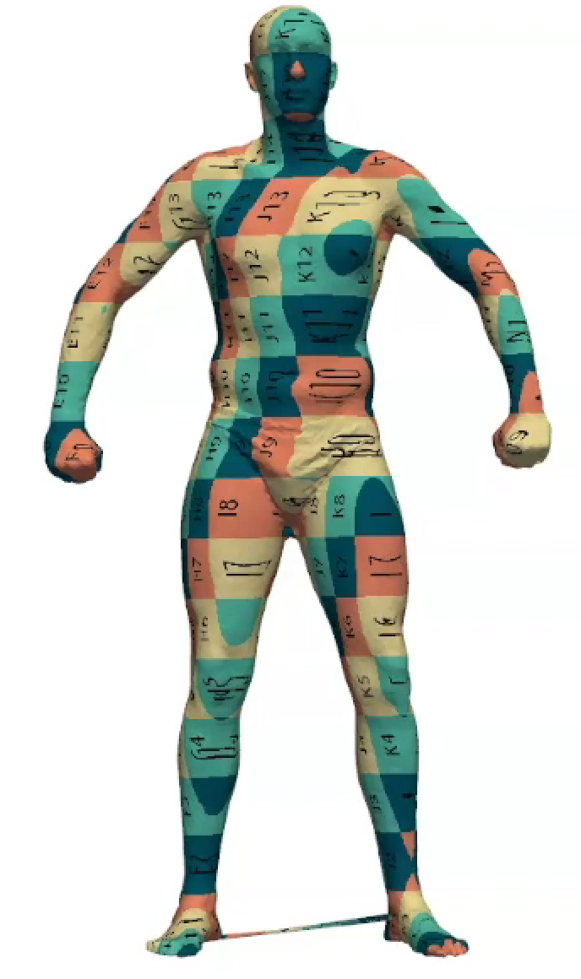
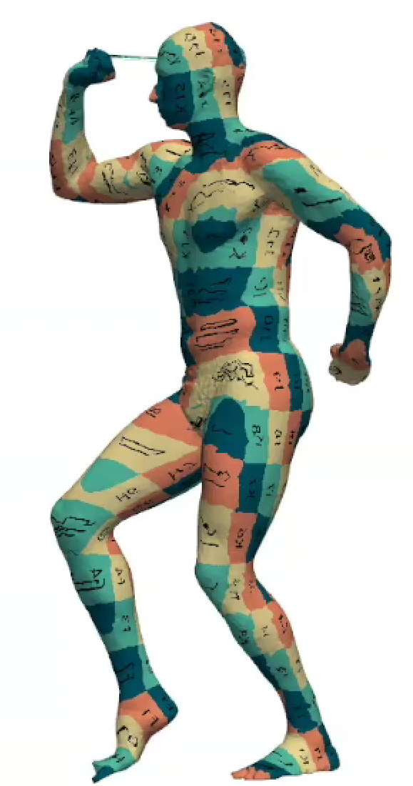
Problem Statement
Goal: Find point-to-point dense correspondences between a pair of (nearly) isometric shapes under topological noise.

Slide 3
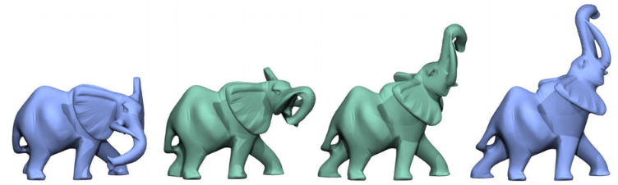
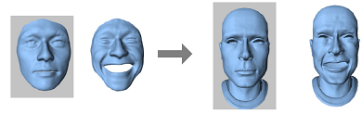
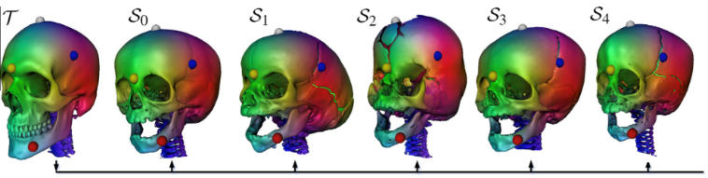


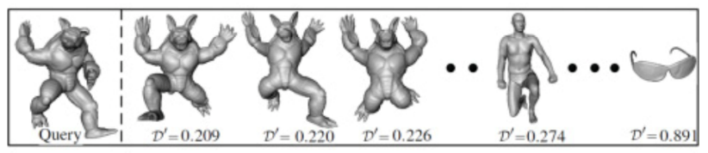
Applications
Correspondence information needed in many apps such as
Shape interpolation:
Deformation transfer:
Attribute transfer:
Shape registration:
Statistical analysis:
Shape retrieval:
[Kilian et al. 2007]
[Sumner & Popovic 2014]
[Sahillioğlu & Kavan 2015]
[Chang & Zwicker 2008]
[Allen et al. 2003]
[Sahillioğlu & Kavan 2016]

Slide 4
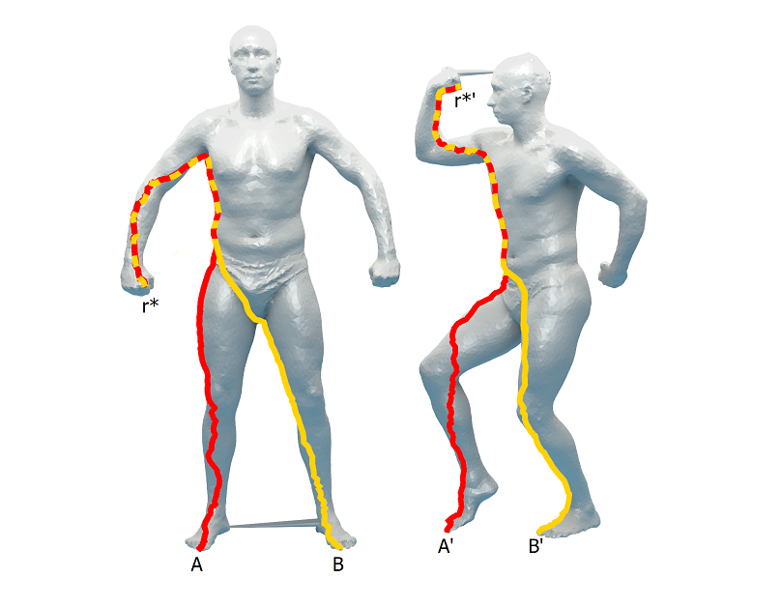
Contributions
Reodesics (Robust Geodesics)

Slide 5
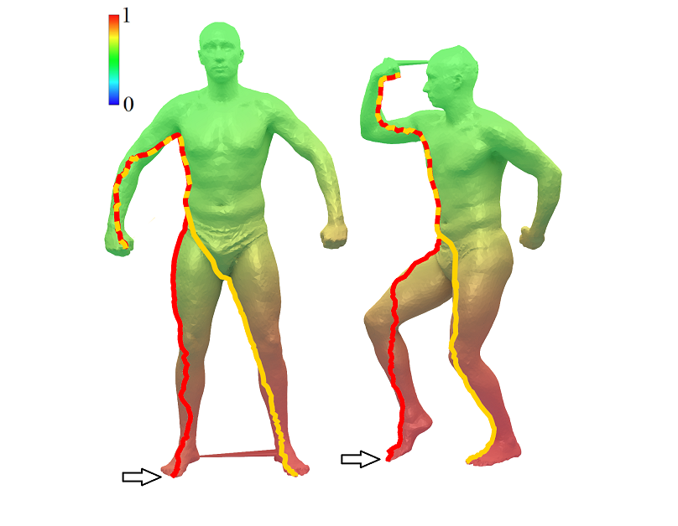
Contributions
Reodesics (Robust Geodesics)

Slide 6
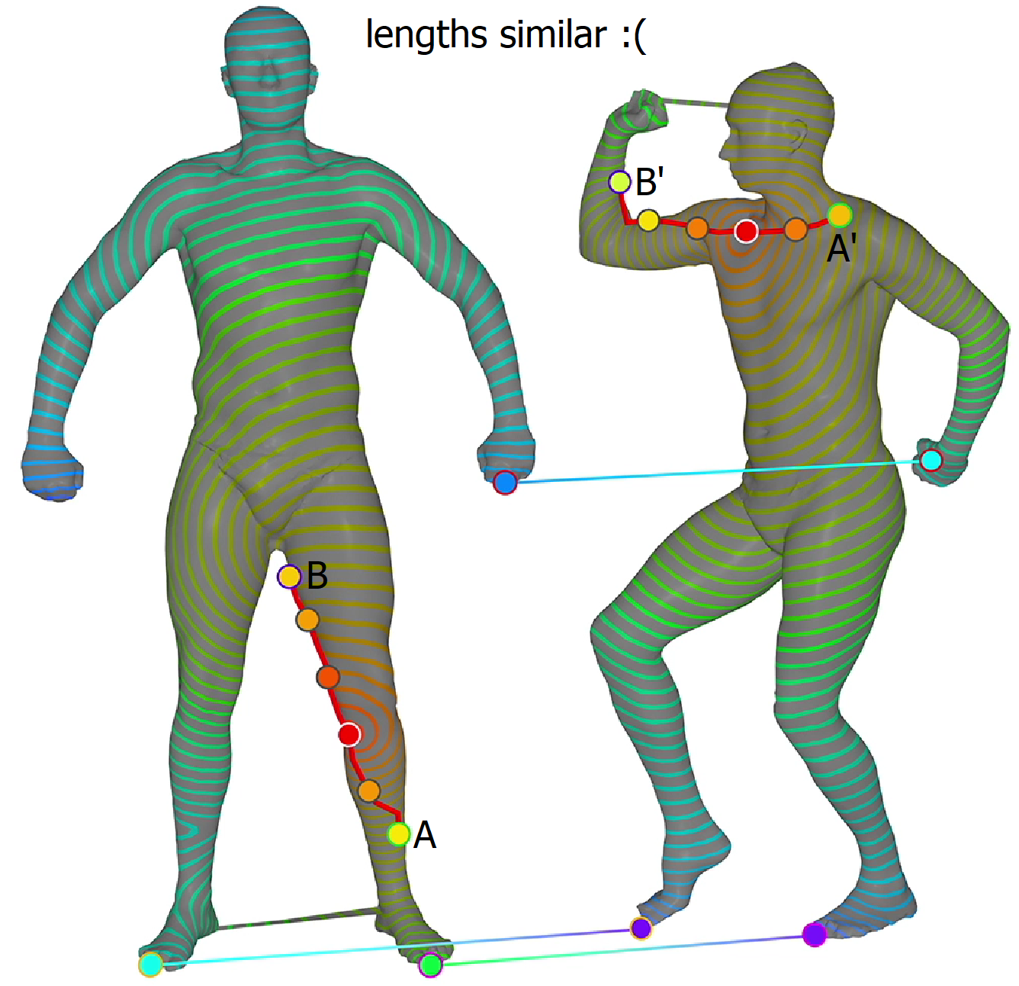
Contributions
Augmented Paths

Slide 7
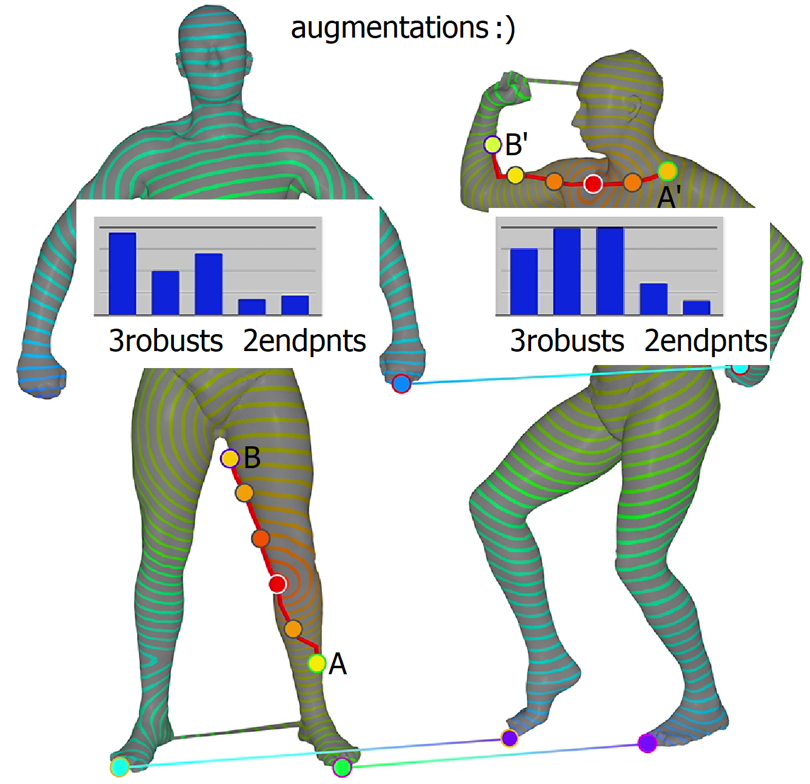
Contributions
Augmented Paths

Slide 8
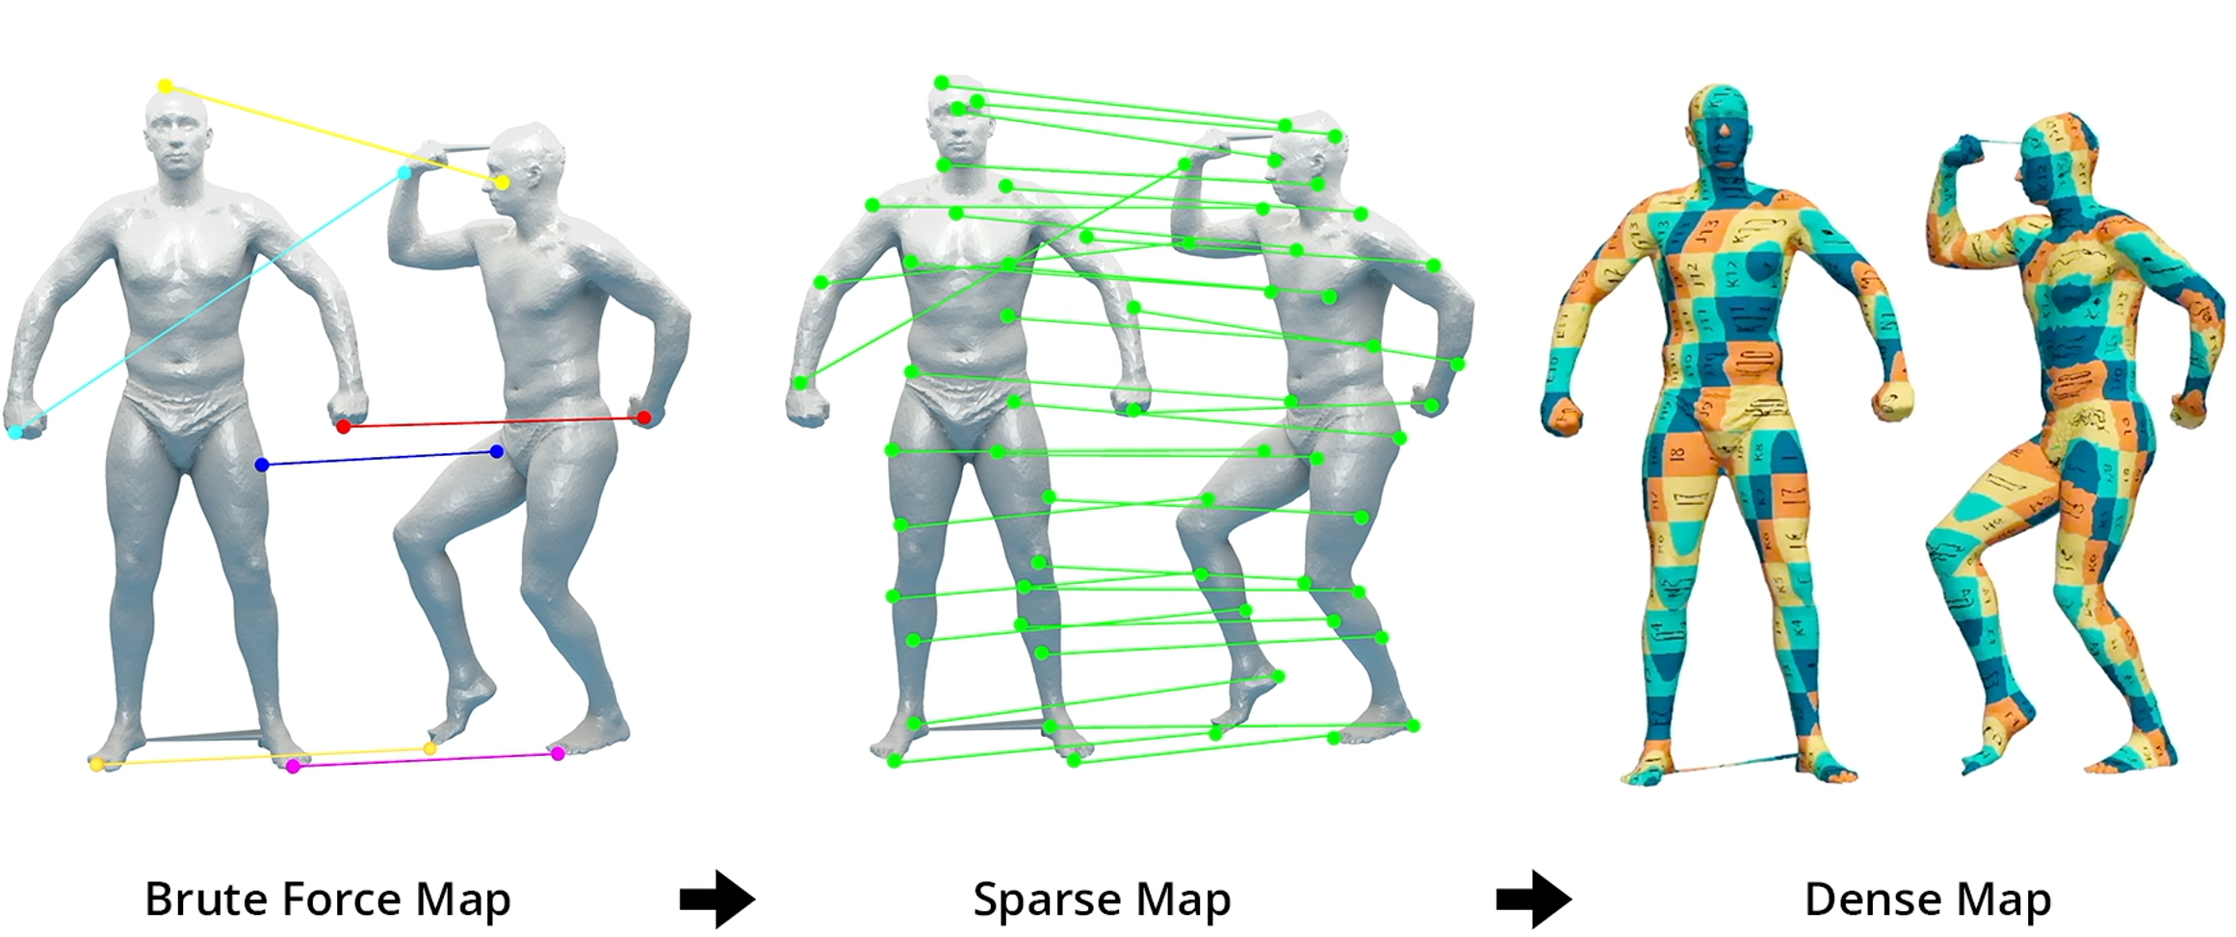
Method Overview
Coarse-to-fine approach

Slide 9
Method Overview
Coarse-to-fine approach

Slide 10
Method Overview
Coarse-to-fine approach

Slide 11
Method Overview
Coarse-to-fine approach
Coarse-to-Fine Combinatorial Matching For Dense Isometric Shape Correspondence, S., Yemez, SGP’11.
Smooth shells: Multiscale shape registration with functional maps, Eisenberger, Lahner, Cremers, CVPR’20.

Slide 12
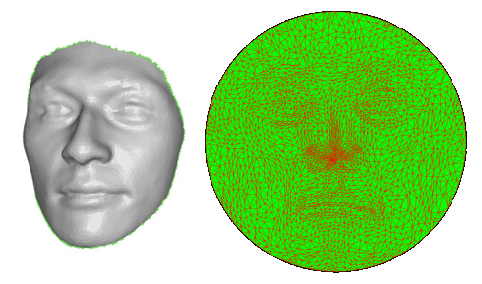
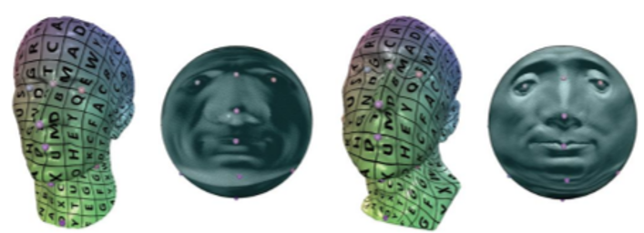
Related Work
Deformation-based: Embed + Closest
Elastic correspondence between triangle meshes, Ezuz et al., EG’19
Möbius registration, Baden et al., SGP’18
Spherical orbifold tutte embeddings, Aigerman et al., SIG’17
Point registration via efficient convex relaxation, Maron et al., SIG’16
..
[Aigerman]

Slide 13
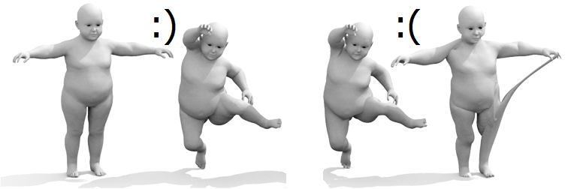
Related Work
Deformation-based: Embed + Closest
Regularization term may prevent proper unfolding around noisy regions
Order-dependent (cheese pull effect)
[Aigerman]
[Eisenberger]

Slide 14
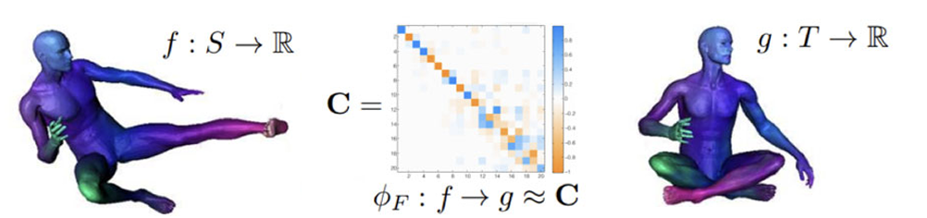
Related Work
Similarity-based: Extract + Closest
Functional maps: a flexible representation of maps between shapes, Ovsjanikov et al., SIG’12
Unsupervised learning of dense shape correspondence, Halimi et al., CVPR’19
A genetic isometric shape correspondence algorithm with adaptive sampling, S., TOG’18
..

Slide 15
Related Work
Similarity-based: Extract + Closest
Operators (Laplacian) and features (geodesic) are sensitive to noise.

Slide 16
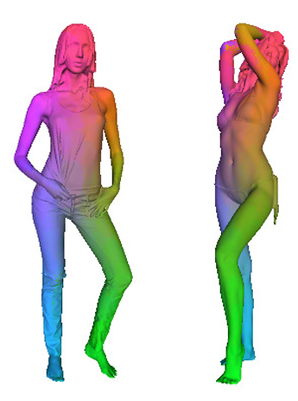
Related Work
Under topological noise: less-studied
  Small tunnel: shortcut noise or model feature?
Learning-based
  Dense human body correspondences using
  convolutional networks, Wei et al., CVPR’16
    Training and generalization
Geodesic replacement
  Entropic metric alignment for correspondence problems, Solomon et al. SIG’16
  A Gromov-Hausdorff framework with diffusion geometry for topologically-robust non-rigid shape matching, Bronstein et al., IJCV’10
  Biharmonic distance, Lipman et al., TOG’10
    We had difficulty reproducing
[Wei]

Slide 17
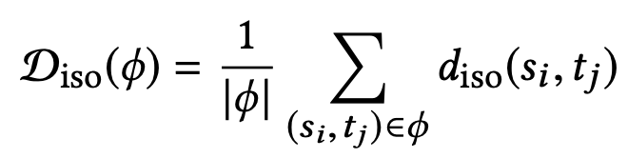
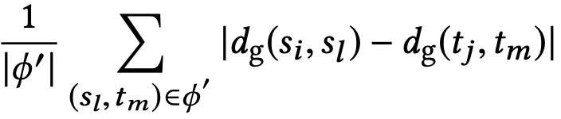
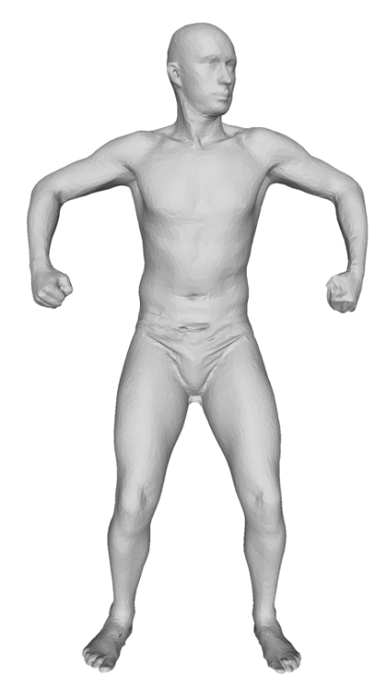
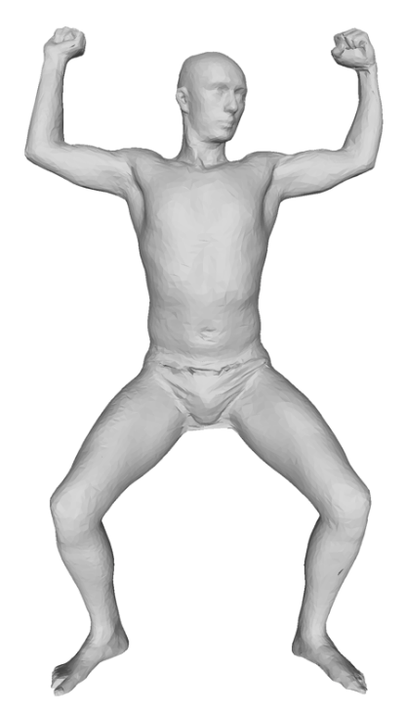
Distortion
s_{i}
t_{j}
t_{m}
|.35 - .95| = .6
|.34 - .48| = .14
s_{l}
s_{i}
s_{l}
Map evaluation during brute and sparse maps
Geodesics for demonstration (reodesics in use)
t_{m}
t_{j}
A bad/high-distortion map.

Slide 18
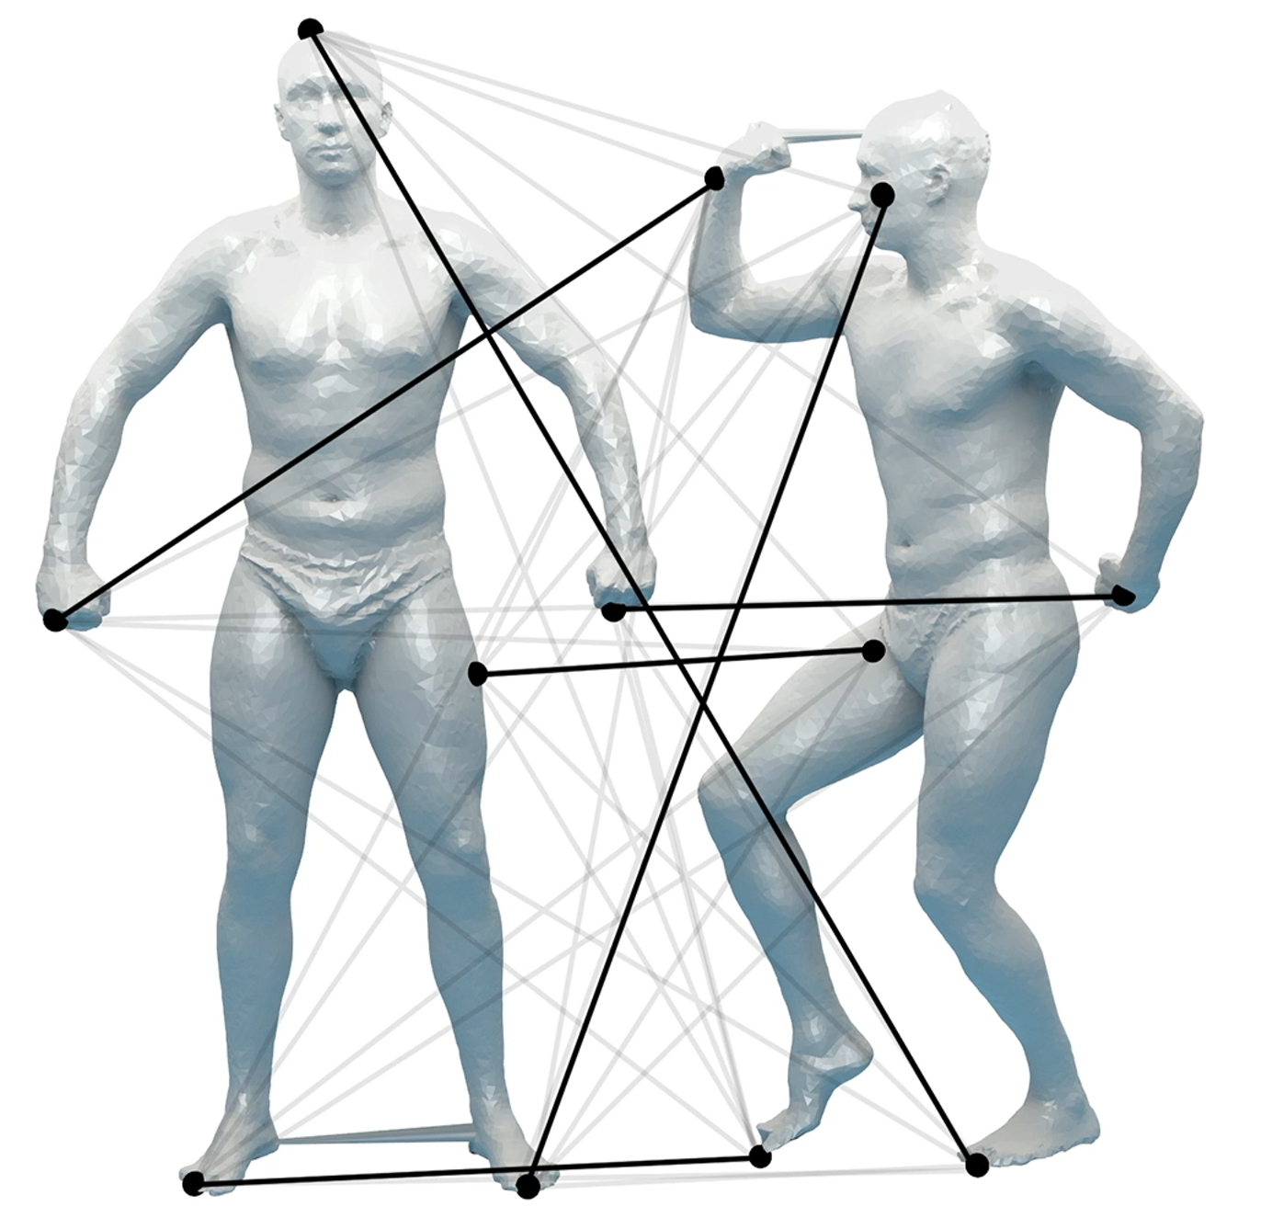
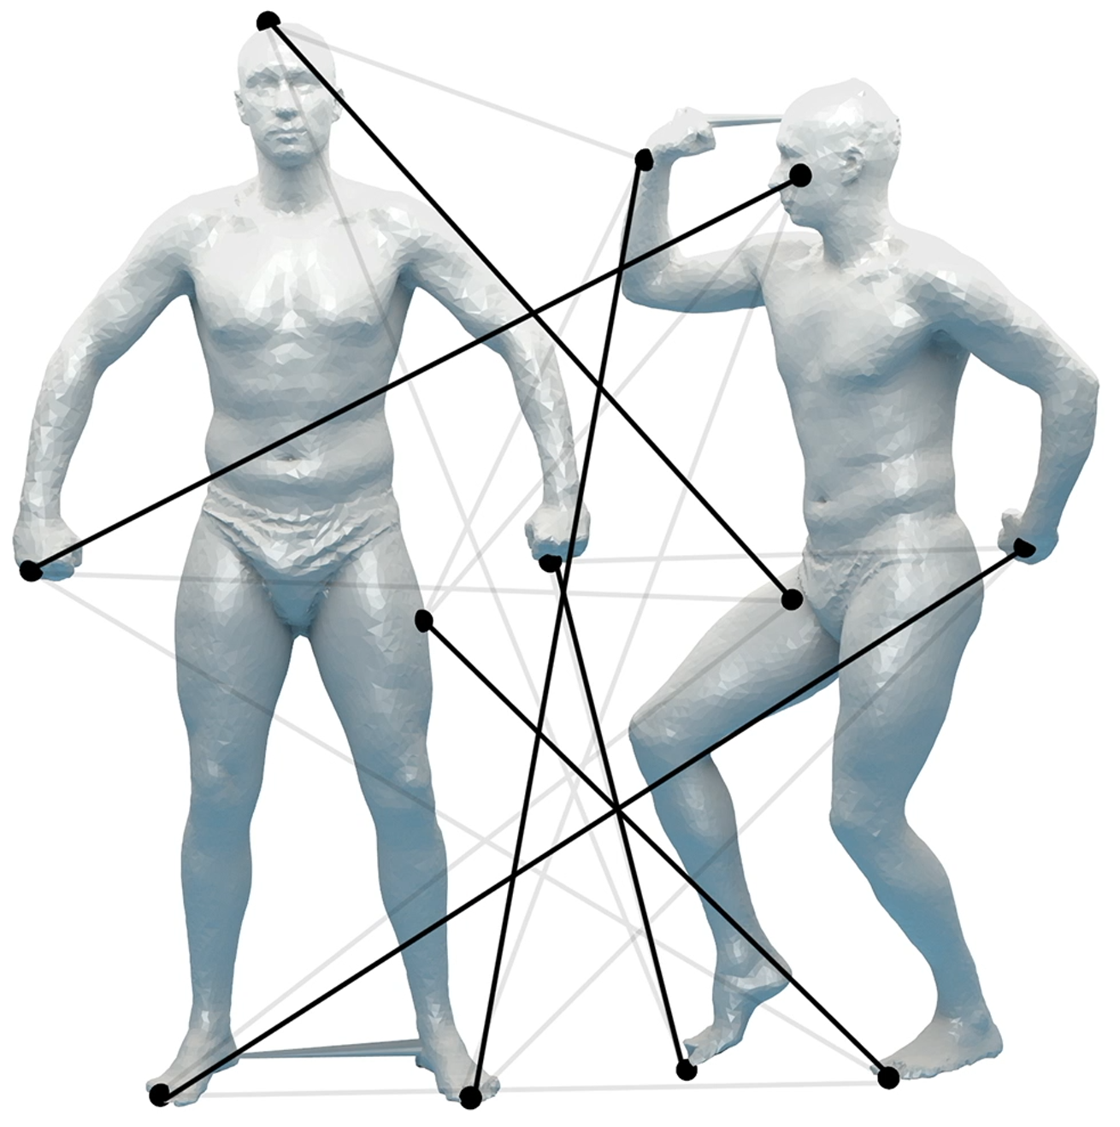
Brute-Force Map
. . .

Slide 19
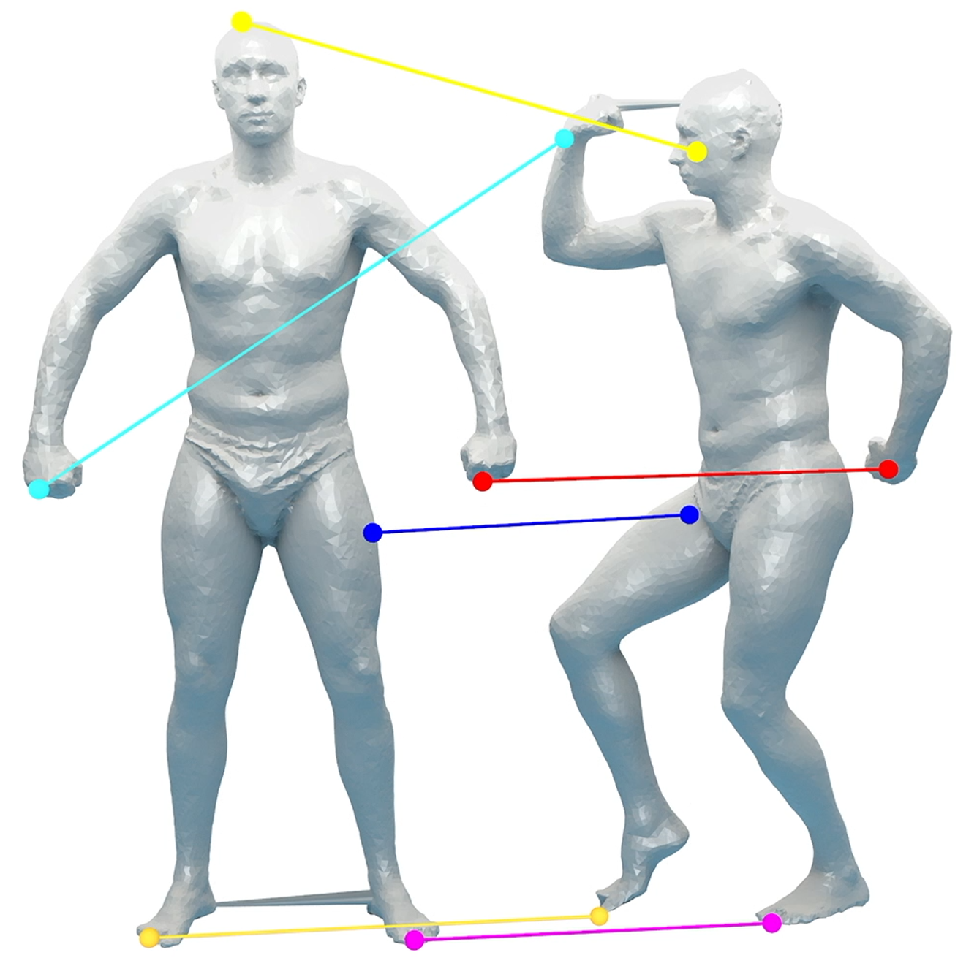
Brute-Force Map

Slide 20
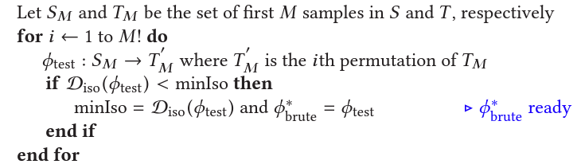
Brute-Force Map

Slide 21
Sparse Map
3robusts: current match triplet from the brute-force map
Augmented paths to generate fuzzy votes for path endpnts

Slide 22
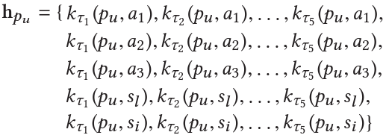
Sparse Map
Heat vectors

Slide 23
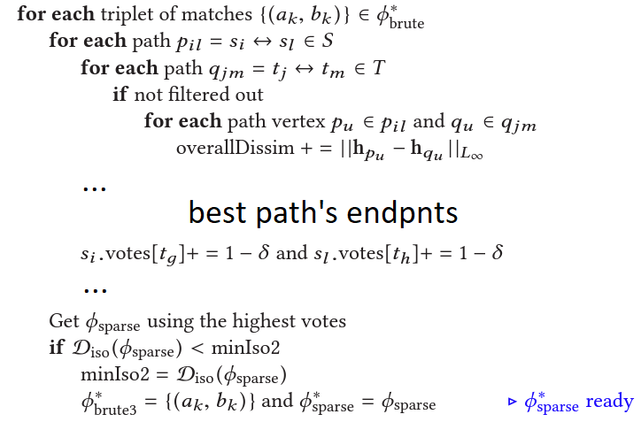
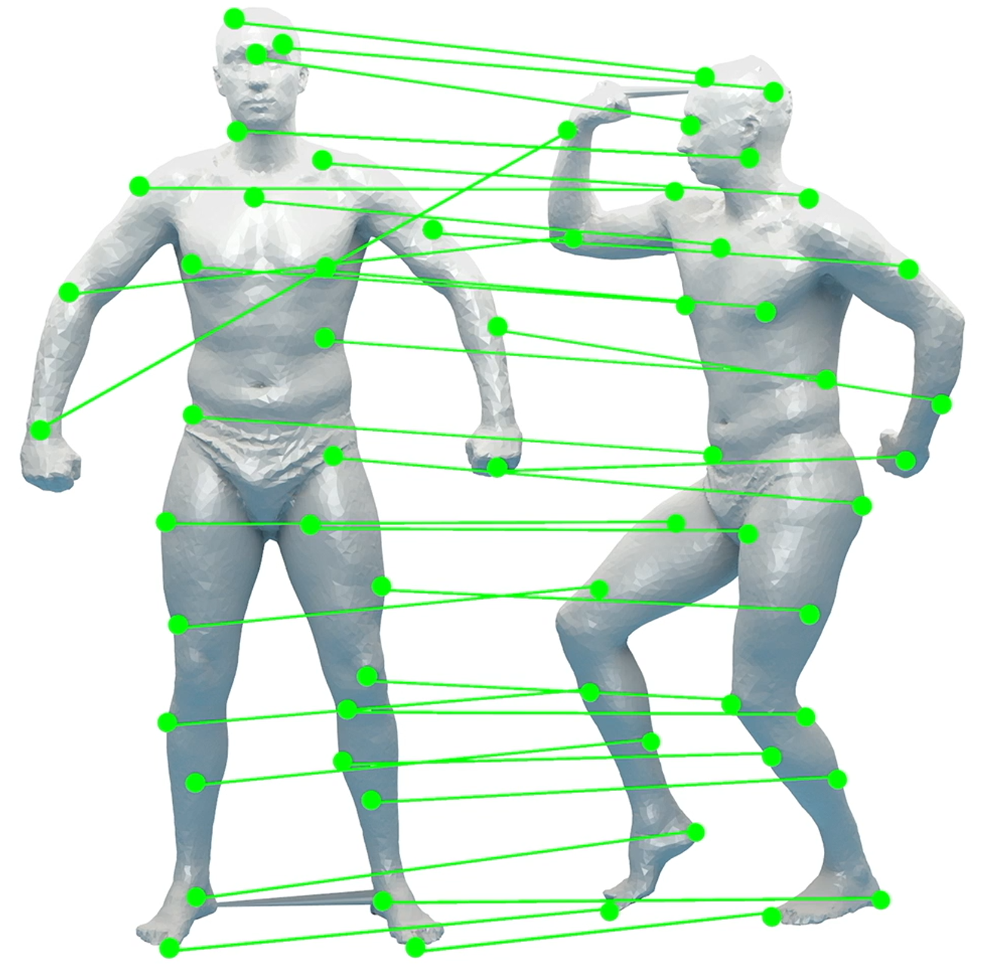
Sparse Map

Slide 24

Sparse Map
Reodesics in use
Reodesics in use

Slide 25
Sparse Map
Vote to 1-to-1 map conversion

Slide 26
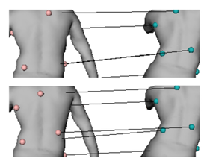
Sparse Map
Refinement via 3robusts

Slide 27
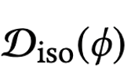
Sparse Map
Symmetric Flips
  Check distortion of the sparse maps created by the 1st triplet and its flips
  Proceed w/ the flipped superset if it leads to a lower distortion sparse map
Accuracy
  Similar multi-initialization
  Repeat sparse mapping c times w/ the first c brute-maps after sort by

Slide 28
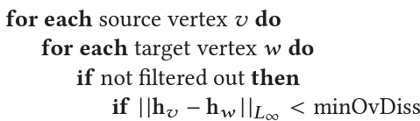
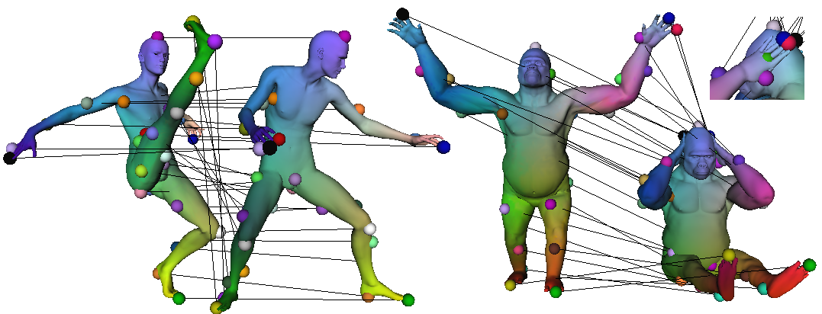
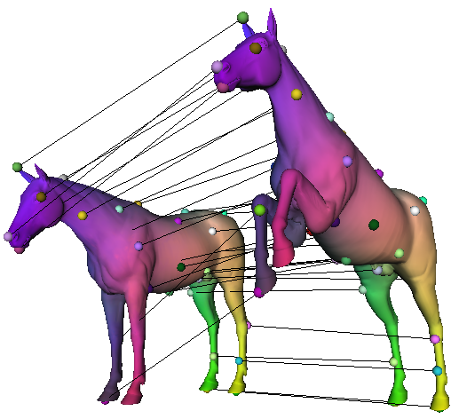
Dense Map
Use sparse map as landmarks for heat vector comparisons
More landmarks that attract heat
Reodesics in use

Slide 29
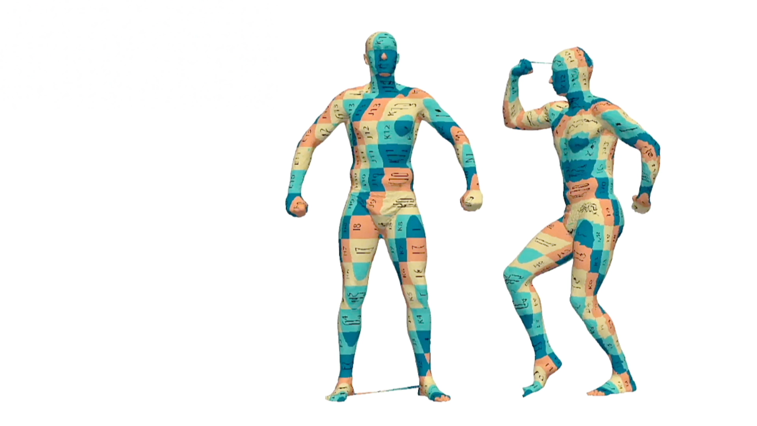
Results
SCAPE, SCAPET, TOSCA, TOPOKIDS, SHREC19, FAUST

Slide 30
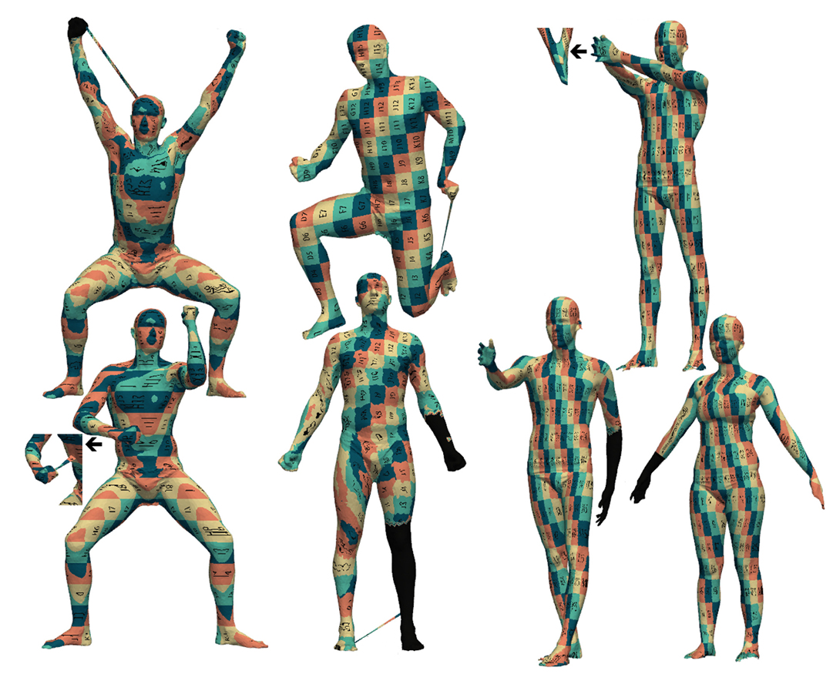
Results

Slide 31
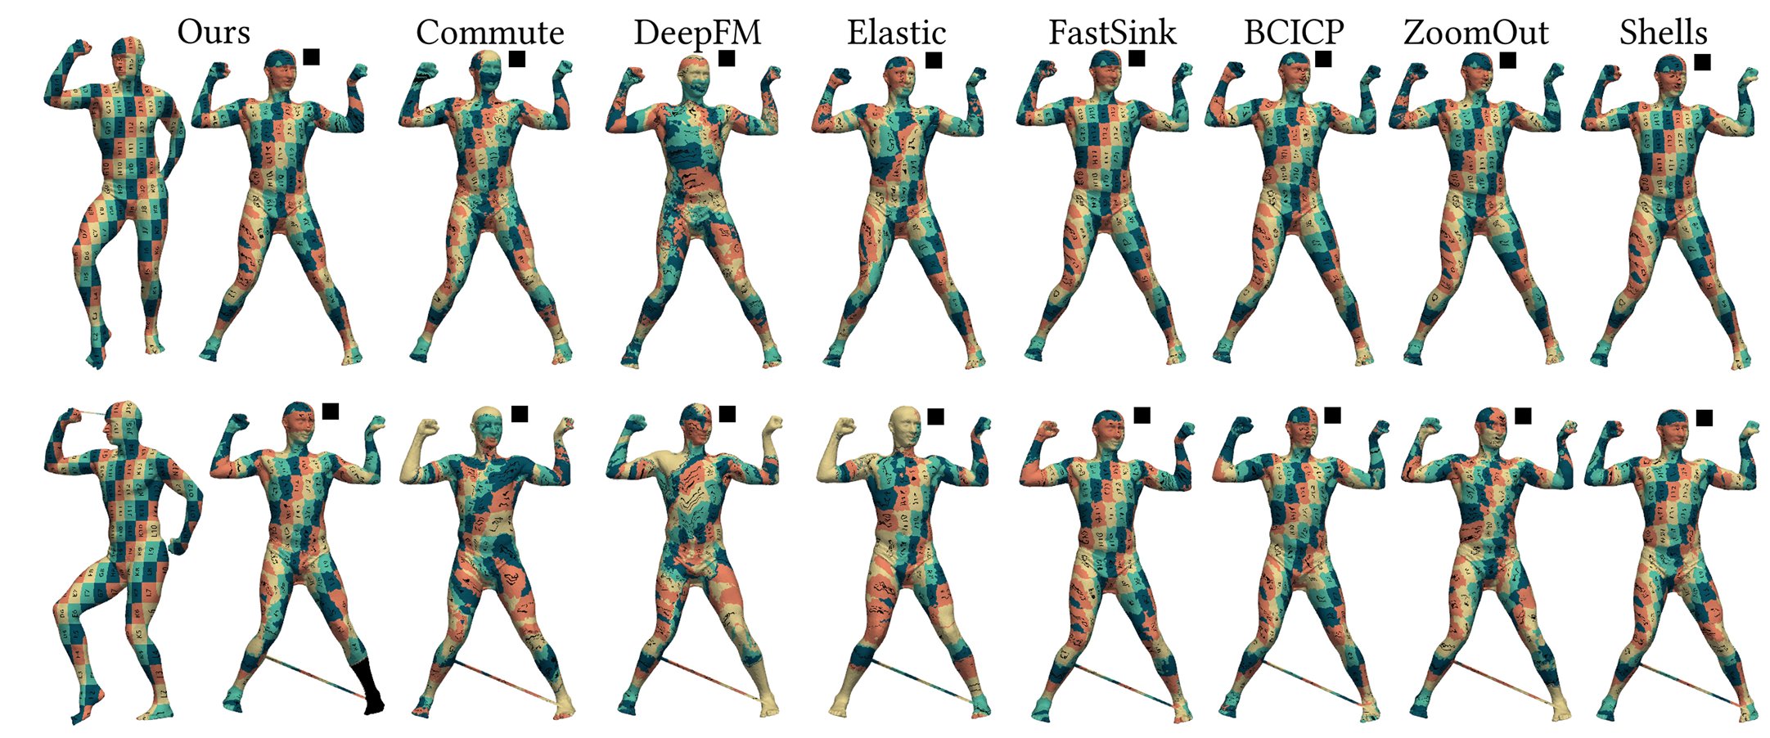
Results
Isometric clean: comparable w/ SOTA
Isometric noisy: better

Slide 32
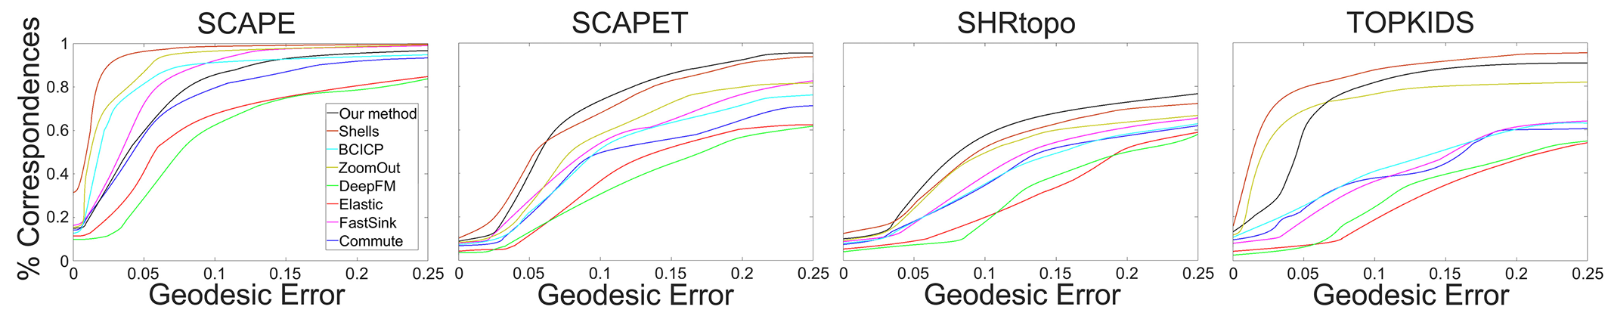
Results
Isometric clean: comparable w/ SOTA
Isometric noisy: better
25/35 online FAUST server evaluation

Slide 33
Results
Isometric clean: comparable w/ SOTA
Isometric noisy: better
25/35 online FAUST server evaluation
Dataset | Laplacian | Eig15 | Sampling | Sparse Map | Dense Map | Total
SCAPE 12.5k | 0.05s | 0.17s | 0.4s | 4.5s | 6.8s | 11.92s
Cat 28k | 0.05s | 0.17s | 0.4s | 5.1s | 17.8s | 22.9s

Slide 34
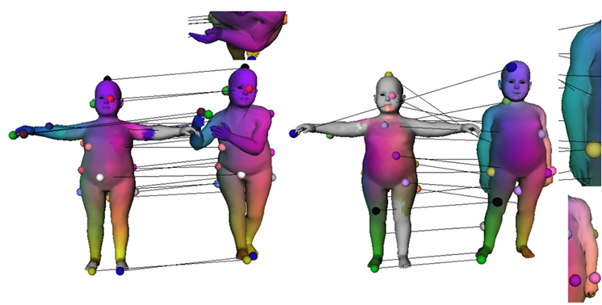
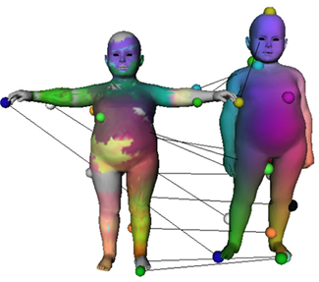
Limitations
Large glues (unlike tunnels)
Reodesics (inconsistent through verts) Pure geodesics

Slide 35
Future Work
Non-isometric correspondence
Partially-isometric correspondence
Collection-wise consistent correspondence

Slide 36
Conclusion
Isometric shape correspondence via augment & reodesics
More suitable for the shortcut tunnel noise which can potentially hurt the geodesic paths
Insensitive to the source mesh selection
Free of embedding errors, e.g., no parameterization
Requires no initial input matches, no genus restrictions
Robust against triangulation quality, mild topological noise

Slide 37
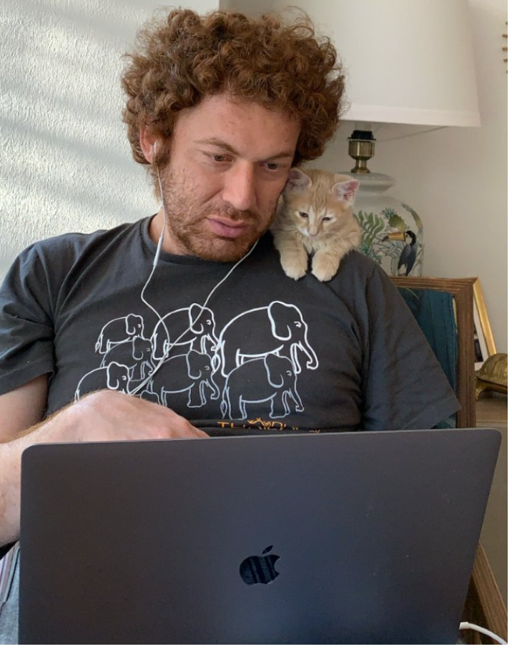
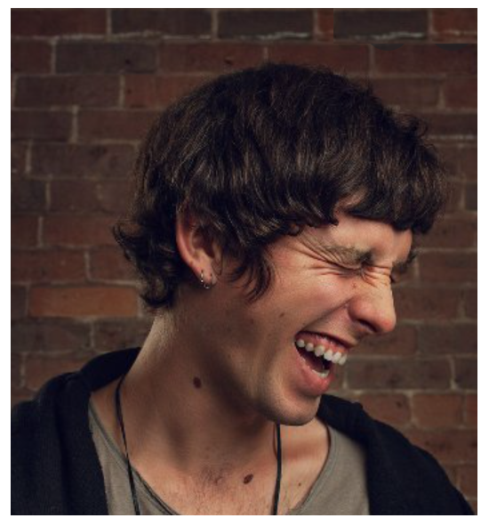


Thanks!
Yusuf Sahillioğlu
Assoc. Prof.
Devin Horsman
CTO / Founder

