Slide 1
Content-Based Image Retrieval
Selim Aksoy
Department of Computer Engineering
Bilkent University
saksoy@cs.bilkent.edu.tr

Slide 2
Image retrieval
Searching a large database for images that match a query:
What kind of databases?
What kind of queries?
What constitutes a match?
How do we make such searches efficient?

Slide 3
Applications
Art Collections
Fine Arts Museum of San Francisco
Medical Image Databases
CT, MRI, Ultrasound, The Visible Human
Scientific Databases
Earth Sciences
General Image Collections for Licensing
Corbis, Getty Images
The World Wide Web
Google, Microsoft, Flickr

Slide 4
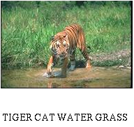
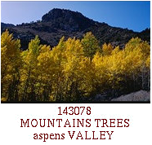
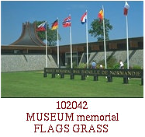
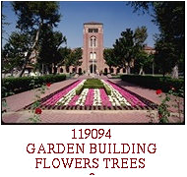
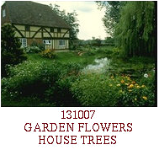
Corel data set
60,000 images with annotated keywords

Slide 5
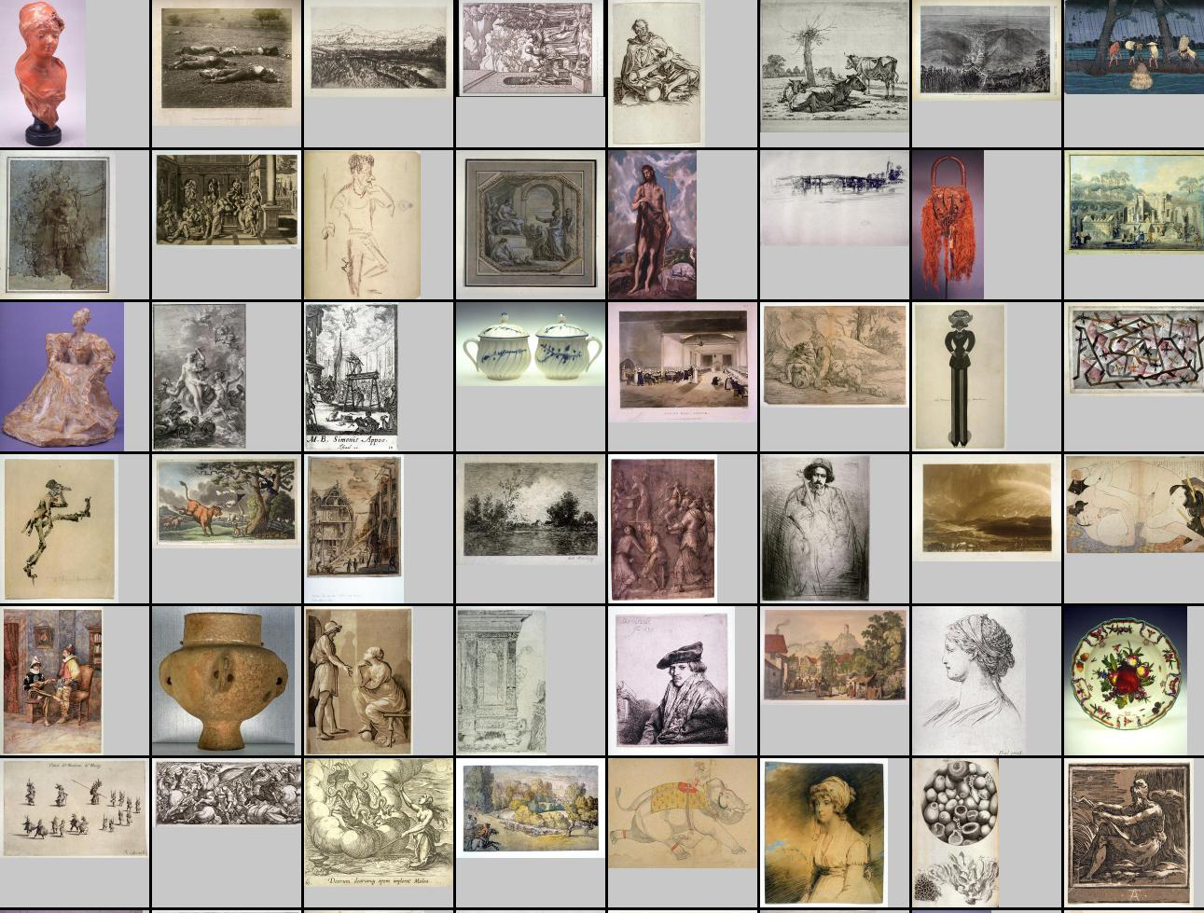
Fine Arts Museum of San Francisco
80,000 images

Slide 6
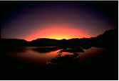
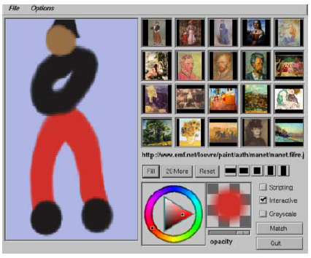
Query formulation
Text description (keywords)
Query by example
Query by sketch
Symbolic description (man and woman on a beach)
Relevance feedback

Slide 7
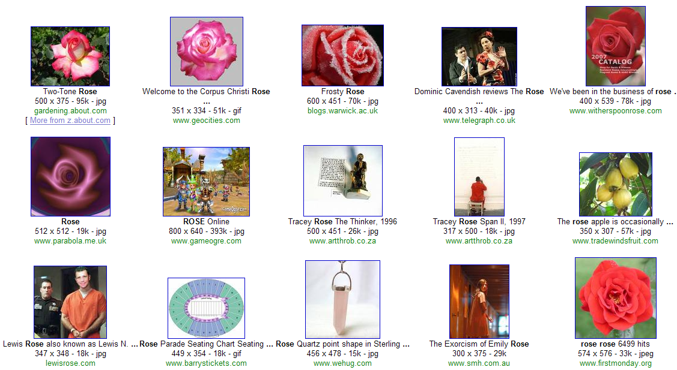
Google query on “rose”

Slide 8
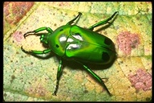
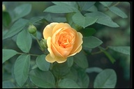
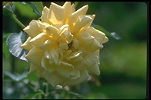
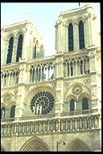
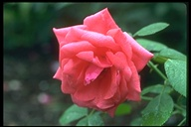
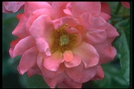
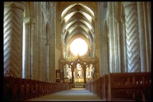
Corel query on “rose”

Slide 9
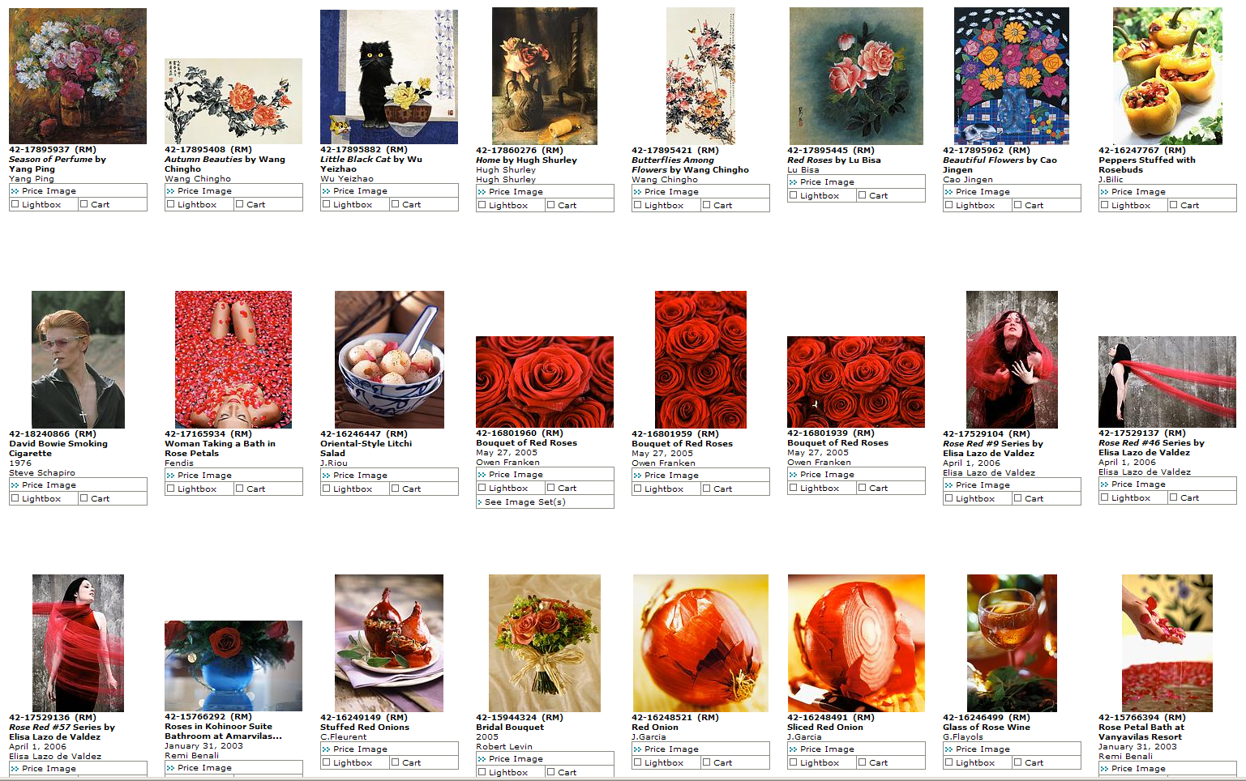
Corbis query on “rose”

Slide 10
Difficulties with keywords
Images may not have keywords.
(An image is worth … how many key-words?)
Query is not easily satisfied by keywords.
“A casually dressed couple gazing into each others eyes lovingly with dramatic clouds in the background.”
“Pretty girl doing something active, sporty in a summery setting, beach - not wearing lycra, exercise clothes - more relaxed in tee-shirt. Feature is about deodorant so girl should look active - not sweaty but happy, healthy, carefree - nothing too posed or set up - nice and natural looking.”
Content-based image retrieval (CBIR)

Slide 11
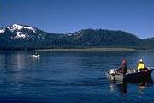
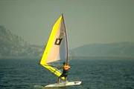
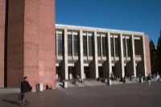
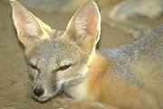
Content-based image retrieval
Query Image
Retrieved Images
User
Image Database
Distance Measure
Images
Image Feature Extraction
Feature Space

Slide 12
Image representations and features
Image representations:
Iconic
Global
Region-based
Object-based
Image features:
Color
Texture
Shape
Objects and their relationships (this is the most powerful, but you have to be able to recognize the objects!)

Slide 13
Image similarity
Distance measures:
Euclidean distance
Other L_{p} metrics
Histogram intersection
Cosine distance
Earth mover’s distance
Probabilistic similarity measures:
P( relevance | two images )
P( relevance | two images ) / P( irrelevance | two images)

Slide 14
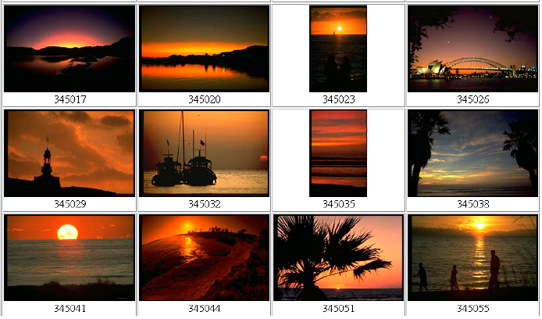
Global histograms
Searching using global color histograms

Slide 15
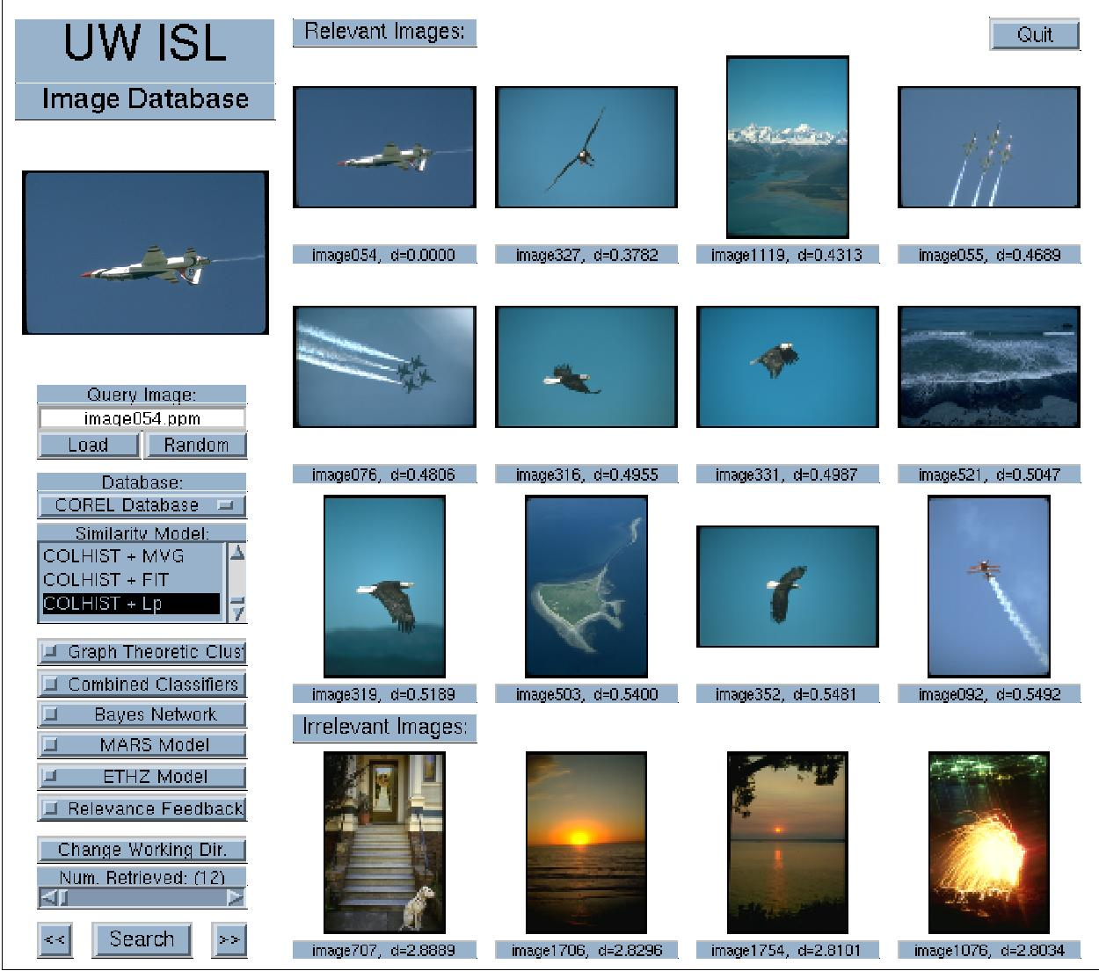
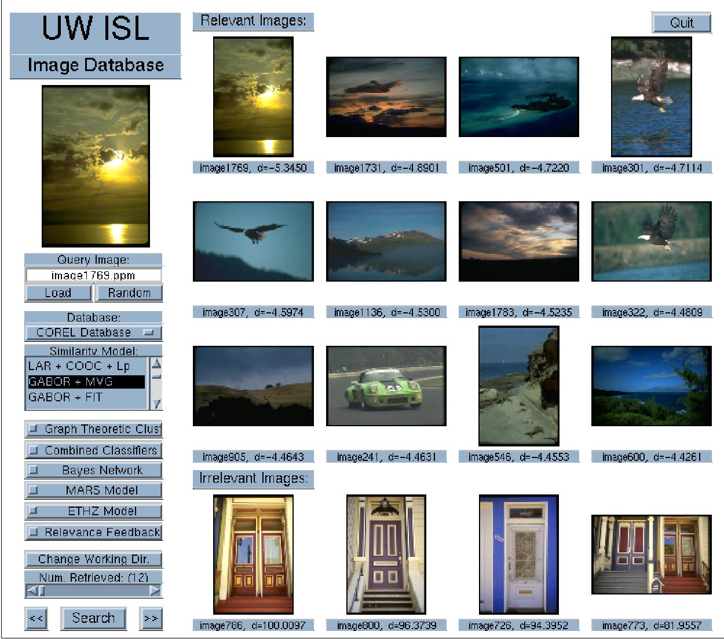
Global histograms
“Airplanes” using color histograms (4/12)
“Sunsets” using Gabor texture (3/12)

Slide 16
Query by image content (QBIC)

Slide 17
Color histograms in QBIC
The QBIC color histogram distance is:
d_{hist}(I,Q) = (h(I) - h(Q))^{T} A (h(I) - h(Q)).
h(I) is a K-bin histogram of a database image.
h(Q) is a K-bin histogram of the query image.
A is a K x K similarity matrix.
R G B Y C V
1 0 0 .5 0 .5
0 1 0 .5 .5 0
0 0 1
1
1
1
R
G
B
Y
C
V
?
How similar is blue to cyan?
?

Slide 18
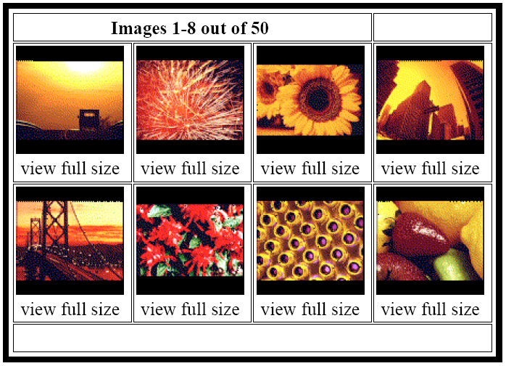
Color percentages in QBIC
%40 red, %30 yellow, %10 black

Slide 19
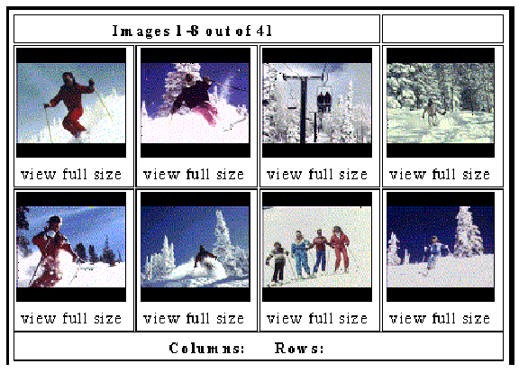
Color layout in QBIC

Slide 20
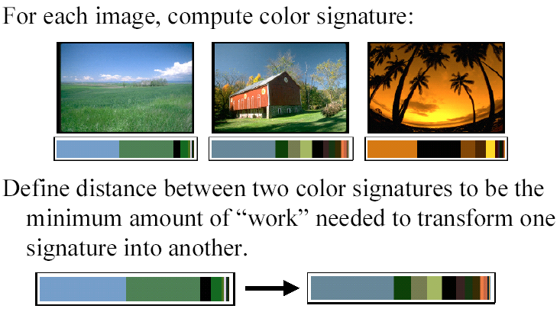
Earth mover’s distance

Slide 21
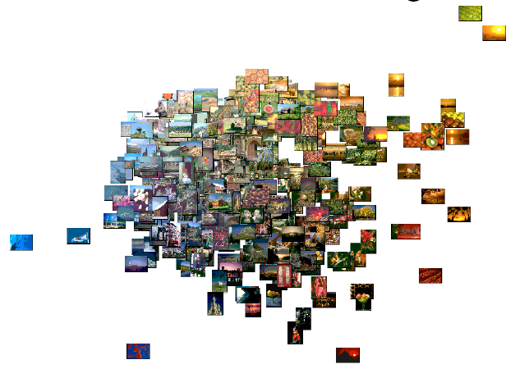
Earth mover’s distance
Visualization using EMD and multidimensional scaling

Slide 22
Probabilistic similarity measures
Two classes:
Relevance class A
Irrelevance class B
Bayes classifier
Assign (ξ_{i},ξ_{j}) to
Discriminant function for classification
Rank images according to posterior ratio values based on feature differences.

Slide 23
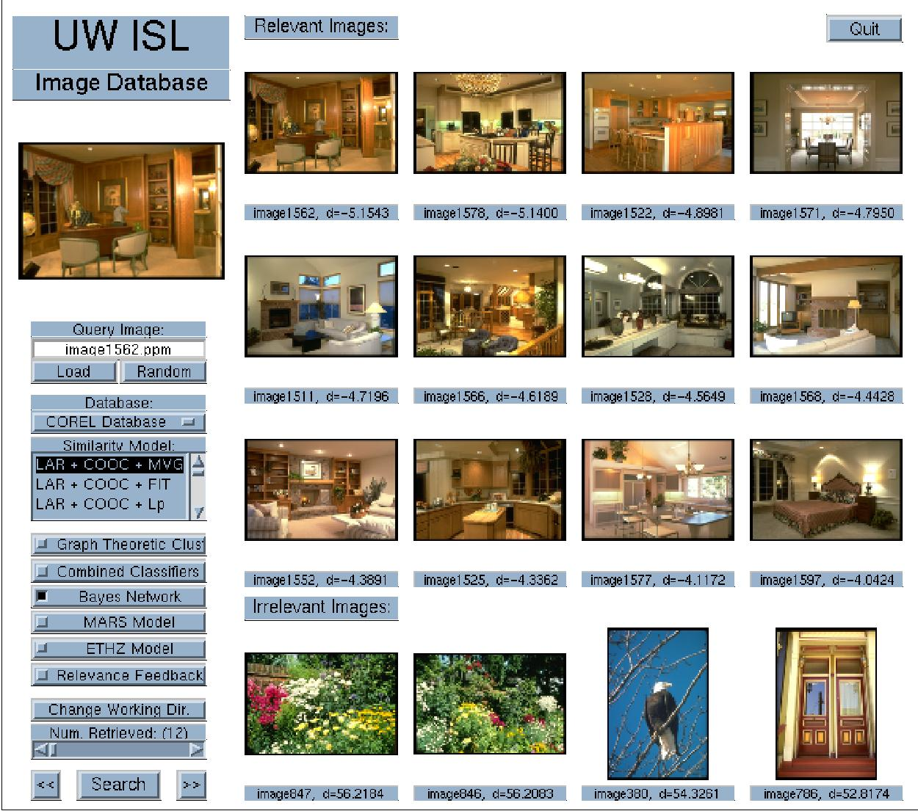
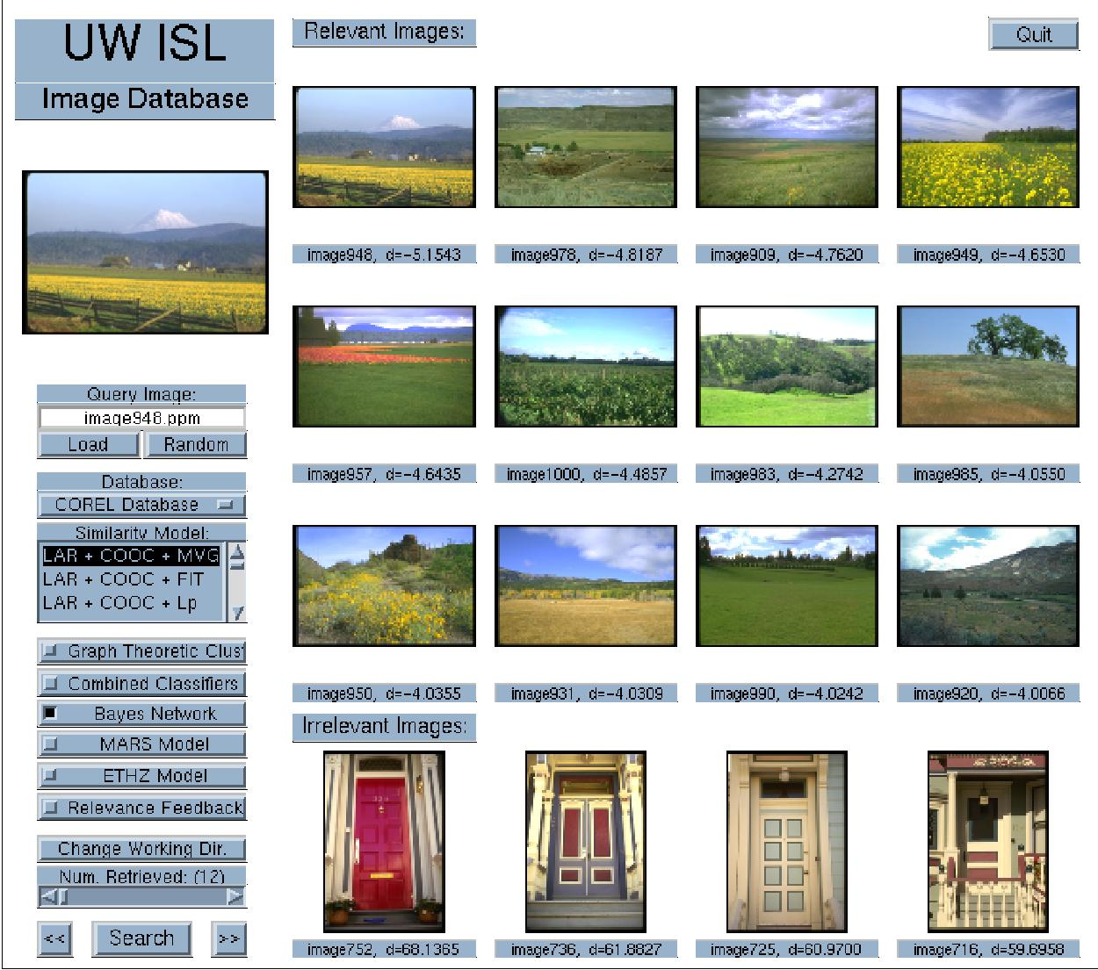
Probabilistic similarity measures
“Residential interiors” (12/12)
“Fields” (12/12)

Slide 24
Shape-based retrieval

Slide 25
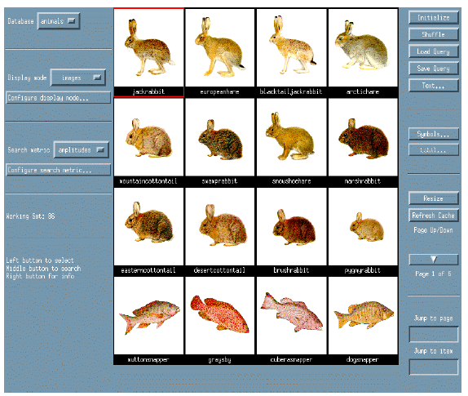
Shape-based retrieval

Slide 26
Elastic shape matching

Slide 27
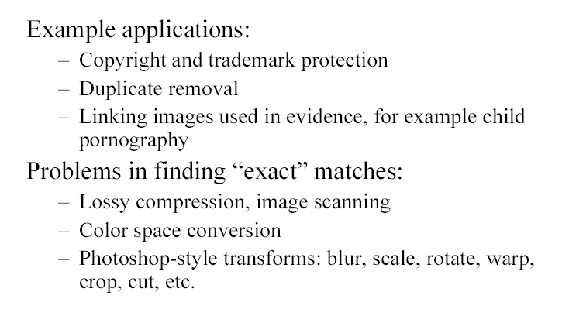
Iconic matching

Slide 28
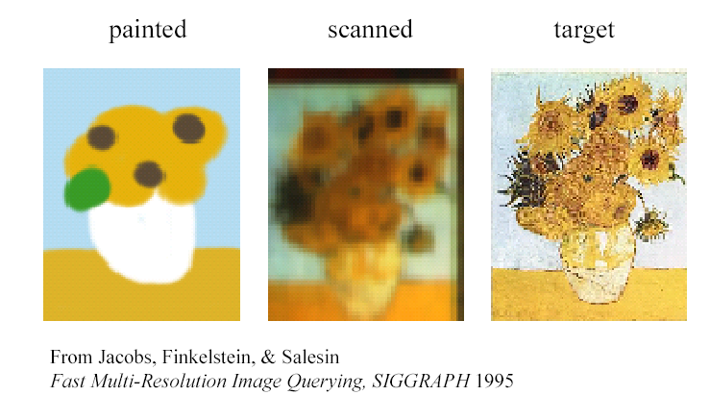
Iconic matching
Wavelet-based image compression
Quantization of coefficients

Slide 29
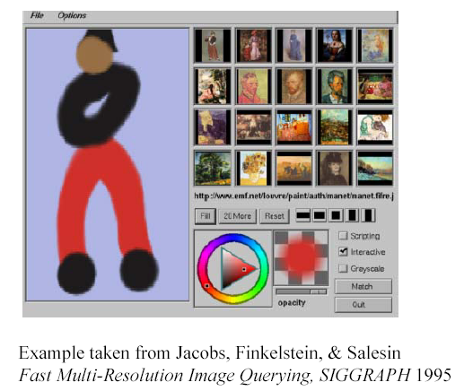
Iconic matching

Slide 30
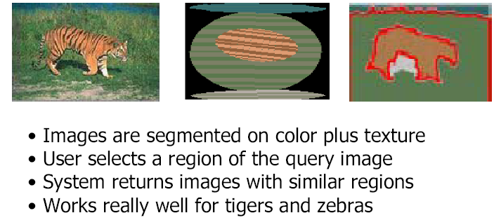
Region-based retrieval: Blobworld

Slide 31
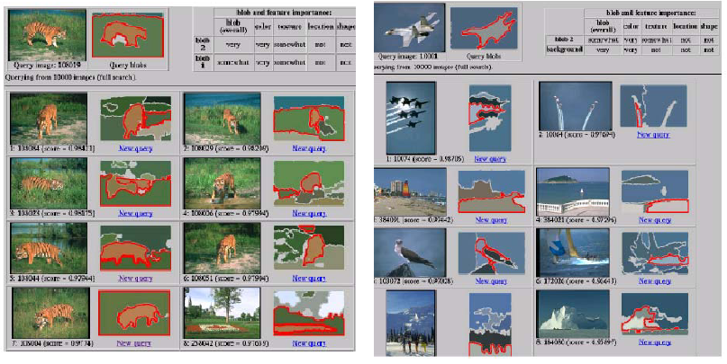
Region-based retrieval: Blobworld

Slide 32
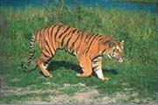
Retrieval using spatial relationships
Build graph using regions and their spatial relationships.
Similarity is computed using graph matching.
image
sky
above
above
adjacent
inside
tiger
grass
above
above
adjacent
abstract regions
sand

Slide 33
Combining multiple features
Text query
on
“rose”

Slide 34
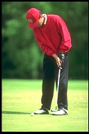
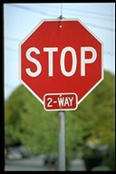
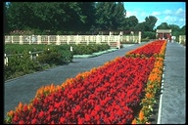
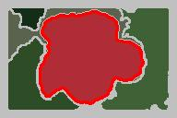
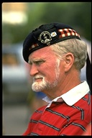
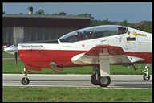
Combining multiple features
Visual query
on

Slide 35
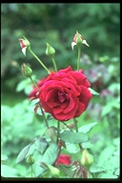
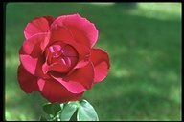
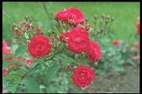
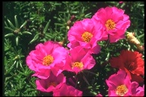
Combining multiple features
Text query on “rose” and visual query on

Slide 36
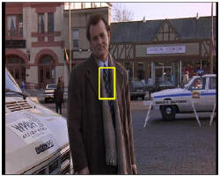
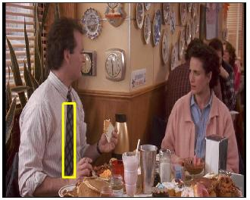
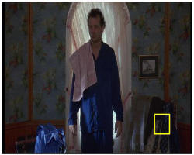
Video Google: object matching

Slide 37
Video Google
Viewpoint invariant descriptors
Visual vocabulary

Slide 38
Video Google
Document 1
Inverted index
Now is the time
for all good men
to come to the aid
of their country.
Word | Document
aid | 1
all | 1
and | 2
can | 2
come | 1, 2
country | 1
for | 1
good | 1
… | …
the | 1, 1, 2
… | …
Document 2
Summer has come
and passed. The innocent
can never last.

Slide 39
Video skimming

Slide 40
Event detection, indexing, retrieval

Slide 41
Informedia Digital Video Library
IDVL interface returned for "El Nino" query along with different multimedia abstractions from certain documents.

Slide 42
Informedia Digital Video Library
IDVL interface returned for “bin ladin" query.
The results can be tuned using many classifiers.

Slide 43
Relevance feedback
In real interactive CBIR systems, the user should be allowed to interact with the system to “refine” the results of a query until he/she is satisfied.

Slide 44
Relevance feedback
Example methods:
Query point movement
Query point is moved toward positive examples and moved away from negative examples.
Weighting features
The CBIR system should automatically adjust the weight that were given by the user for the relevance of previously retrieved documents.
Weighting similarity measures
Feature density estimation
Probabilistic relevance feedback

Slide 45
Relevance feedback
Positive feedback
Negative feedback

Slide 46
Relevance feedback
“Sunsets” using color histograms (1/12)
Using combined features (6/12)
After 1st feedback (12/12)

Slide 47
Relevance feedback
“Auto racing” using color histograms (3/12)
Using combined features (9/12)
After 1st feedback (12/12)

Slide 48
Indexing for fast retrieval
Use of key images and the triangle inequality for efficient retrieval.

Slide 49
Indexing for fast retrieval
Offline
Choose a small set of key images.
Store distances from database images to keys.
Online (given query Q)
Compute the distance from Q to each key.
Obtain lower bounds on distances to database images.
Threshold or return all images in order of lower bounds.

Slide 50
Indexing for fast retrieval
Hierarchical cellular tree

Slide 51
Indexing for fast retrieval

Slide 52
Performance evaluation
Two traditional measures for retrieval performance in the information retrieval literature are precision and recall.
Given a particular number of images retrieved,
precision is defined as the percentage of retrieved images that are actually relevant, and
recall is defined as the percentage of relevant images that are retrieved.

Slide 53
Current research objective
Query Image
Retrieved Images
User
boat
Image Database
…
Animals
Buildings
Office Buildings
Houses
Transportation
Boats
Vehicles
…
Images
Object-oriented Feature Extraction
Categories

Slide 54
Demos
Google Image Search (http://images.google.com/)
Microsoft Image Search (https://www.bing.com/images)
Yahoo Image Search (http://images.search.yahoo.com/)
Vitalas (http://vitalas.ercim.eu/)
FIDS (http://www.cs.washington.edu/research/ imagedatabase/demo/fids/)
Like Visual Shopping (http://www.like.com/)
Now Google shopping (http://www.google.com/shopping)
Google Similar Images
http://googleblog.blogspot.com/2009/10/similar-images-graduates-from-google.html
Google Image Swirl
http://googleresearch.blogspot.com/2009/11/explore-images-with-google-image-swirl.html

